Slide 1
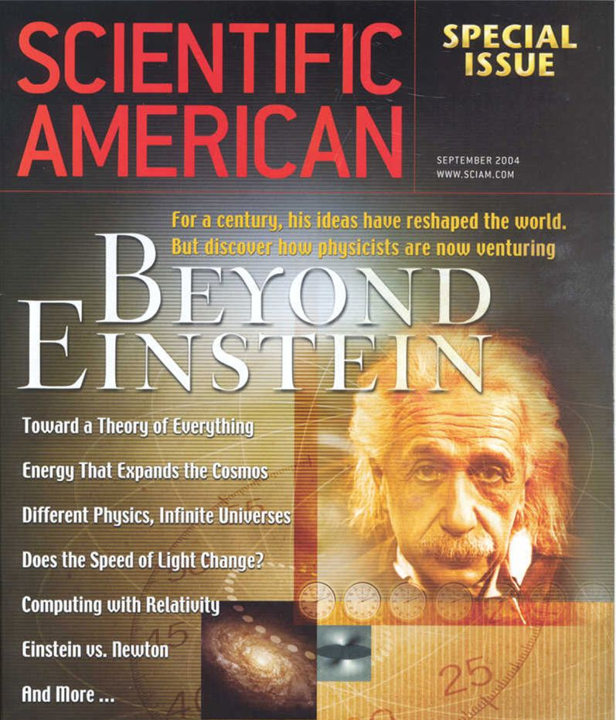
Modern Tests of Spacetime Symmetry
outline
1. Introduction
2. Tests of Lorentz violation
3. Tests Lorentz violation in astrophysics
Teppei Katori @teppeikatori
King’s College London
Neutrino Group seminar, Ruđer Bošković Institute, Zagreb, April 10, 2025

Slide 2
Introduction

Slide 3
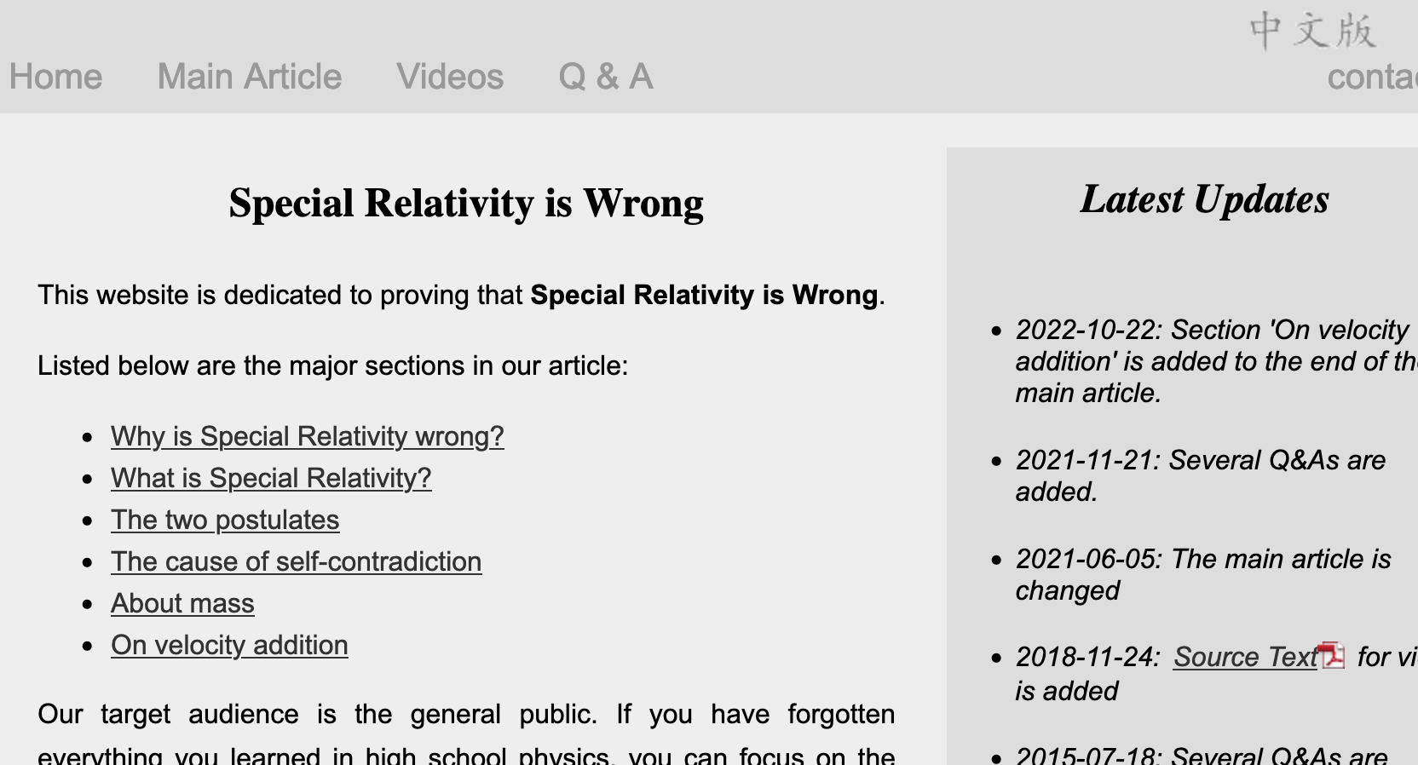
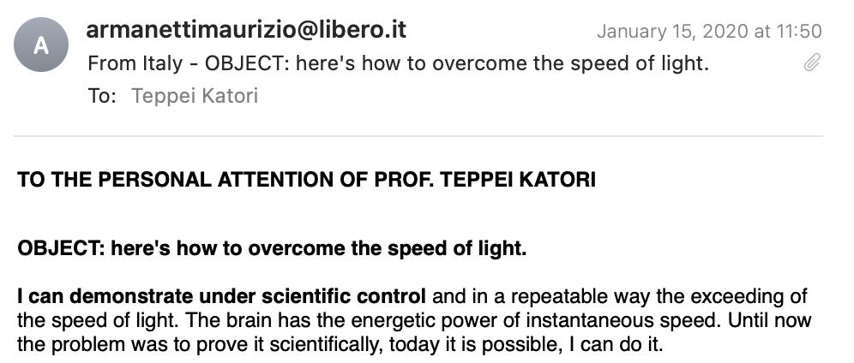
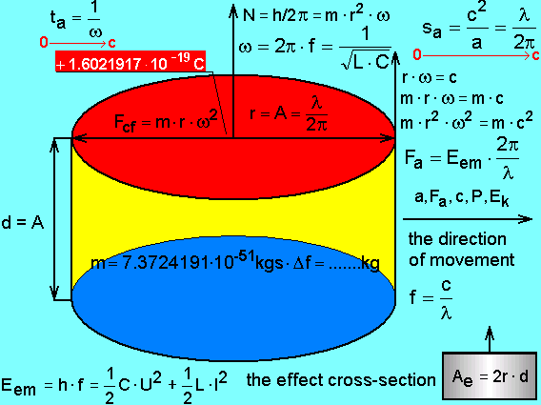
I want to say Einstein is wrong!
How to disprove Einstein’s theory scientifically???

Slide 4
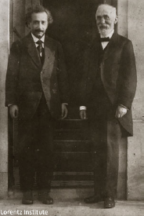
Theory of Special Relativity
Einstein and Lorentz
Special relativity is a basis of both quantum field theory and general relativity
Special relativity is based on Lorentz symmetry
Lorentz symmetry is isotropy of spacetime
If the universe has a special direction, space doesn’t have Lorentz symmetry and Lorentz transformation is violated
→ Lorentz violation
All fundamental physics phenomena must be experimentally tested including Lorentz symmetry

Slide 5
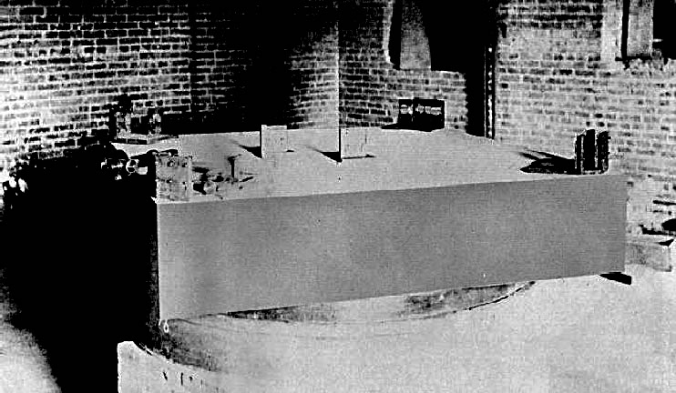
Michelson-Morley experiment
The experiment tried to measure the motion of the Earth relative to æther.
The experiment shows the speed of light is constant regardless the motion of the Earth.
This result suggests the isotropy of spacetime, and Lorentz symmetry.
Lorentz symmetry is valid down to Δc/c~10⁻⁹
mirror 1
beam splitter
lamp
mirror 2
telescope

Slide 6
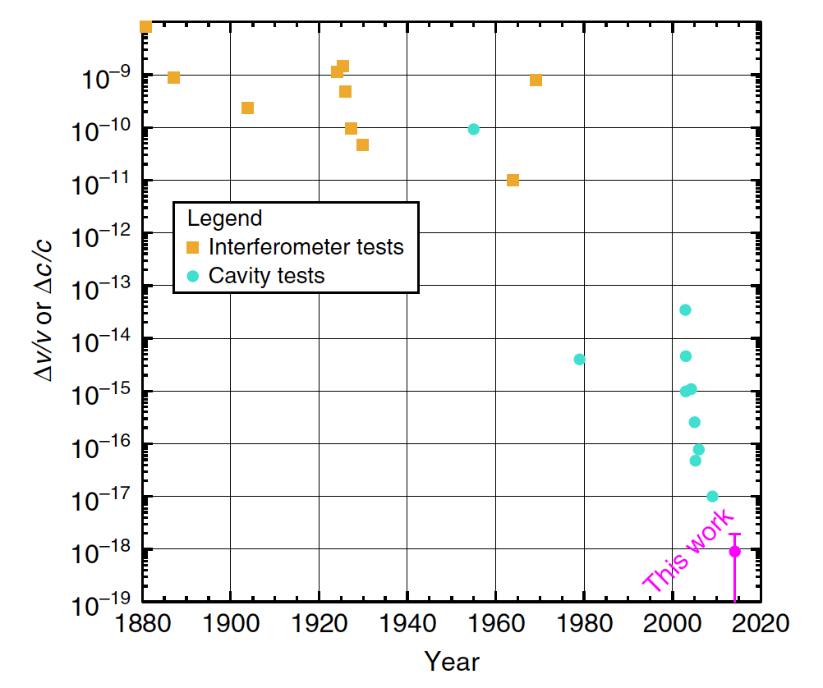
Michelson-Morley experiment
Nagel et al, Nature Comm., 6(2015)8174
The experiment has been improved over 100 years.

Slide 7
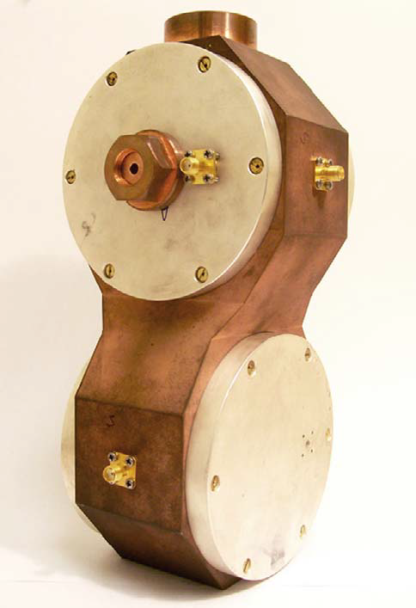
Michelson-Morley experiment
Nagel et al, Nature Comm., 6(2015)8174
The experiment has been improved over 100 years.
Technology shift (interferometer → optical cavity) around 2000s

Slide 8
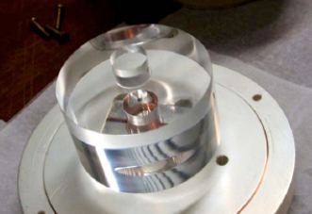
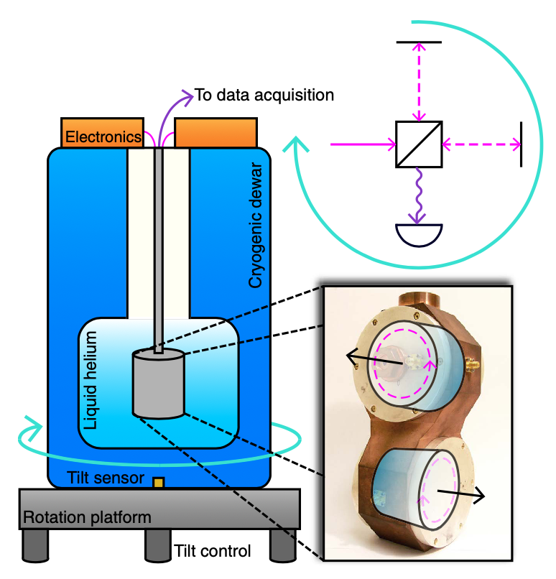
Optical cavity experiment
Nagel et al, Nature Comm., 6(2015)8174
Modern Michelson-Morley experiment
- Saphire crystal resonator
- Whispering gallery mode
- Vacuum insulation, liquid helium cooling to 4K
- Turntable to actively rotate
This experiment is sensitive to the anisotropy of speed of light down to Δc/c~10⁻¹⁸
Why we keep testing this?
Why do we expect Lorentz violation?

Slide 9
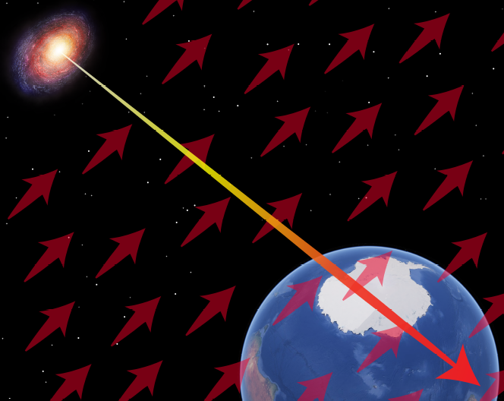
Quantum gravity
Progress in Particle and Nuclear Physics 125 (2022) 103948
Searching Lorentz violation is well motivated
Lorentz violation in Planck scale theories
- string theory
- noncommutative field theory
- quantum loop gravity
etc
Lorentz violation is seen as
- spacetime fluctuation
- background field in vacuum (EFT)
etc
quantum foam
- quantum fluctuation of space-time
Lorentz violating field
- background field of the universe (æther)

Slide 10
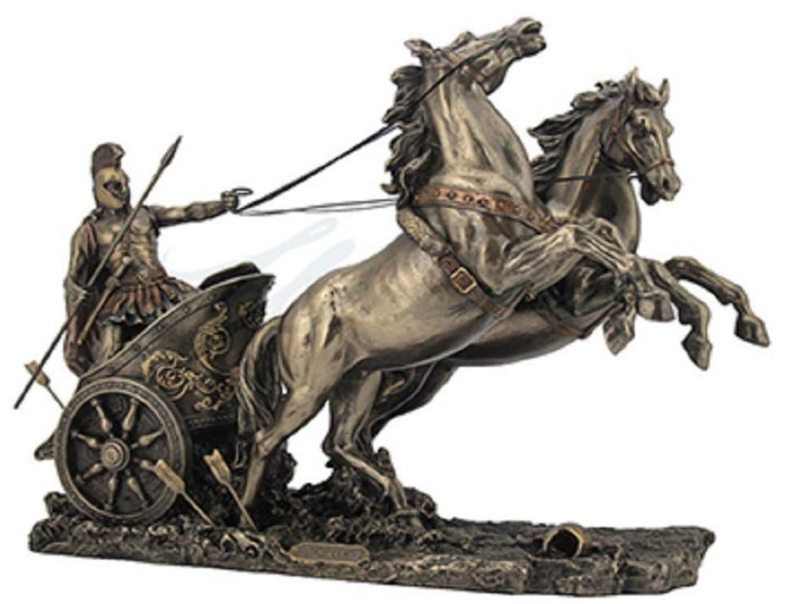
Quantum gravity
Searching Lorentz violation is well motivated
Quantum field theory and general relativity are the foundation of modern physics.
Lorentz symmetry is a basis for both quantum field theory and general relativity
How to formulate Lorentz violation in our theories?
Lorentz symmetry could be spontaneously broken, if so, this doesn’t violate existing framework of modern physics
General Relativity
Quantum Field Theory
Modern Physics
Lorentz symmetry

Slide 11
Spontaneous symmetry breaking
Searching Lorentz violation is well motivated
Nature has many examples of spontaneous symmetry breaking
- Condensed matter (magnetization, crystallization, etc)
- Phase transition in vacuum (Higgs mechanism, spontaneous Lorentz symmetry breaking)
Magnetization
Higgs mechanism
N
N
N
N
N
S
N
S
S
S
S
N
S
N
N
N
S
N
N
S
N
S
S
S
S
S
N
N
N
N
S
N
S
S
S
S

Slide 12
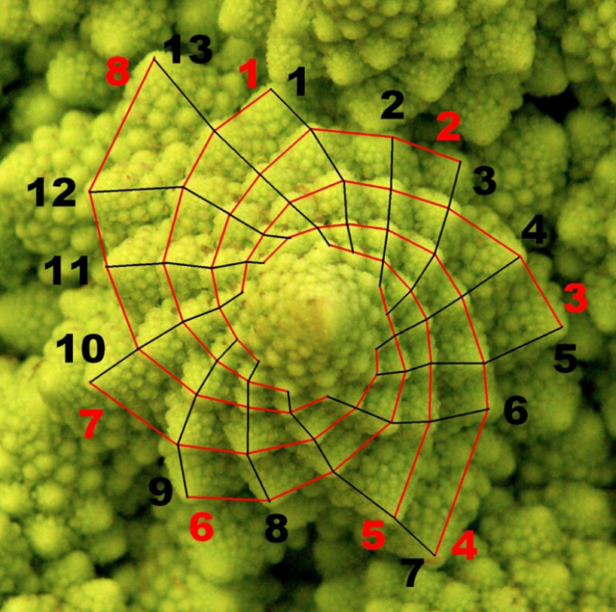
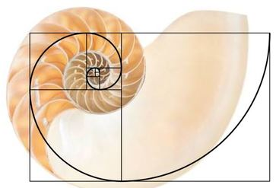
Spontaneous symmetry breaking
Searching Lorentz violation is well motivated
Math is a good approximation of nature
There is no perfect symmetry in nature, all somewhat broken
So why spacetime symmetry is perfect?!
Fibonacci number and broccoli
Golden ratio and seashell

Slide 13
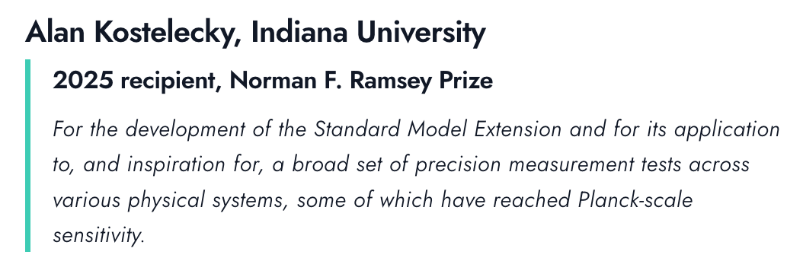
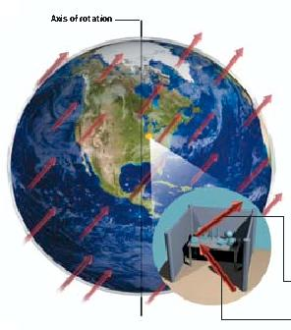
Standard-Model Extension (SME)
Search of Lorentz violation is to find anomalous effects due to the couplings of background fields and ordinary fields (electrons, muons, neutrinos, etc)
Scientific American (Sept. 2004)
SME is an effective field theory framework to look for Lorentz violation
e.g.) vacuum Lagrangian for fermion
$ℒ$ = $i\overline{ψ}γ_{μ}∂^{μ}ψ−m\overline{ψ}ψ+\overline{ψ}γ_{μ}a^{μ}ψ+\overline{ψ}γ_{μ}c^{μν}ψ⋯$
Physics of Lorentz violation
- Spectrum distortion,
- Sidereal time dependence, etc…
Standard Model
couplings with background fields
PM 5:58
AM 6:00
24h 00min 00sec: Solar day
23h 56min 4.1sec: Sidereal day
noon
noon

Slide 14
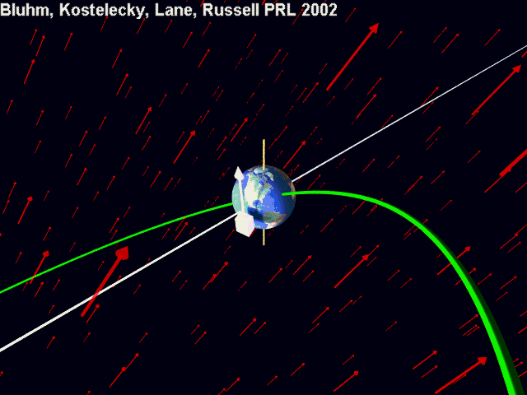

Slide 15
Tests of Lorentz violation

Slide 16
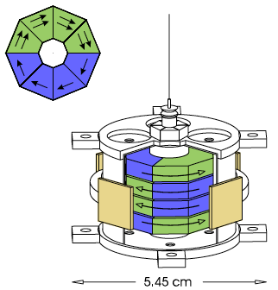
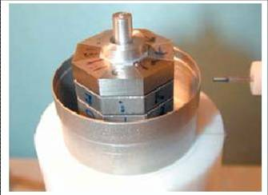
EötWash, PRL97(2006)021603 , PRL122(2019)231301
Torsion pendulum (electron)
Modern torsion balance
- AlNiCo: all magnetic field is from electron spin
- SmCo₅: electron orbital motion creates magnetic field
- Magnetize them to cancel magnetic field, so that the pendulum has net electron spin
- Look for coupling between electron spin and background field

Slide 17
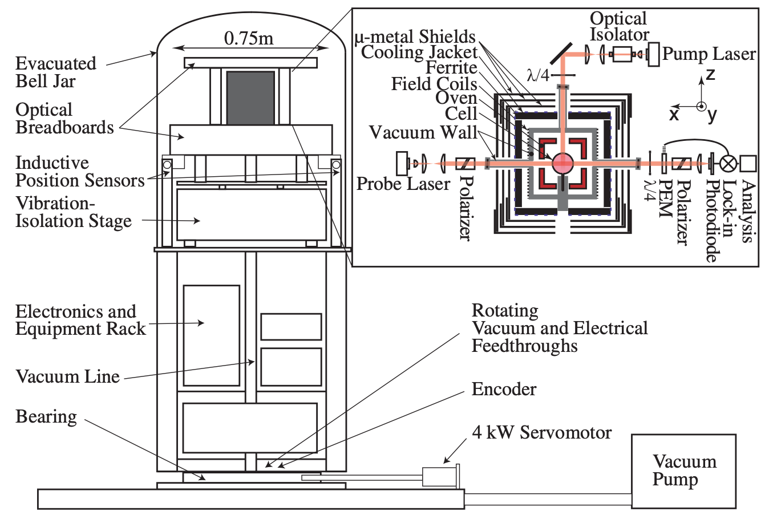
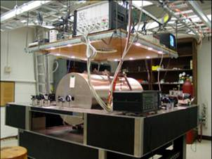
Double gas maser (neutron)
PRL105(2010)151604 and many others
The most sensitive magnetometer
- Optical pump for Rb, K
- Spin transfer to noble gas (Xe, ³He), monitor ³He precession
- Look for coupling between neutron spin and background field

Slide 18
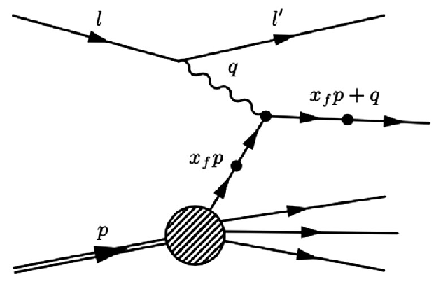
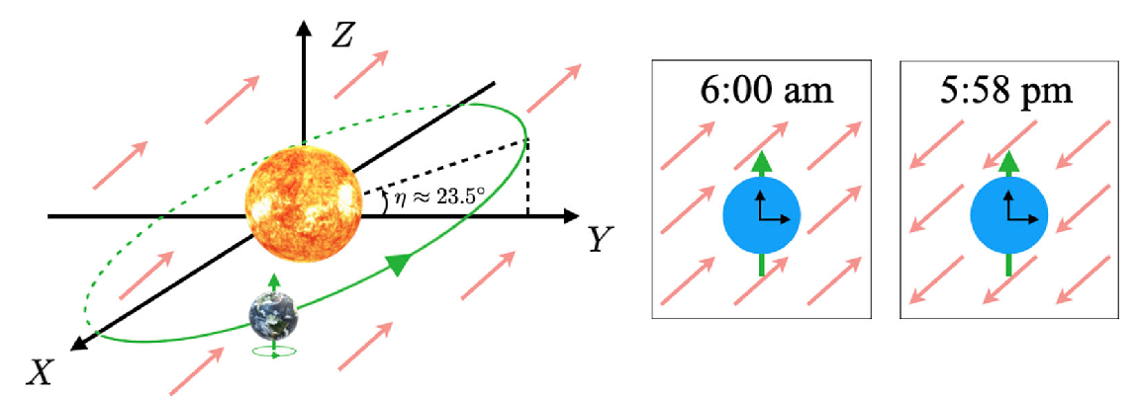
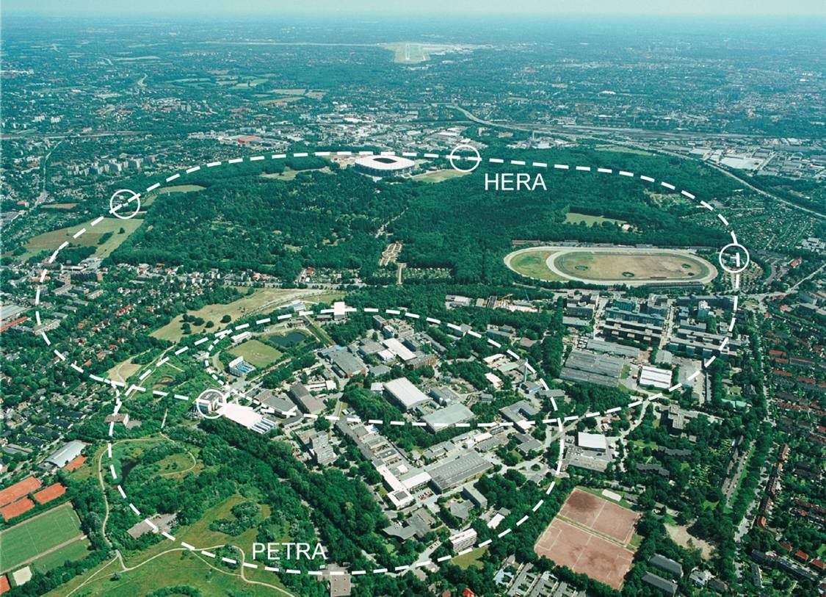
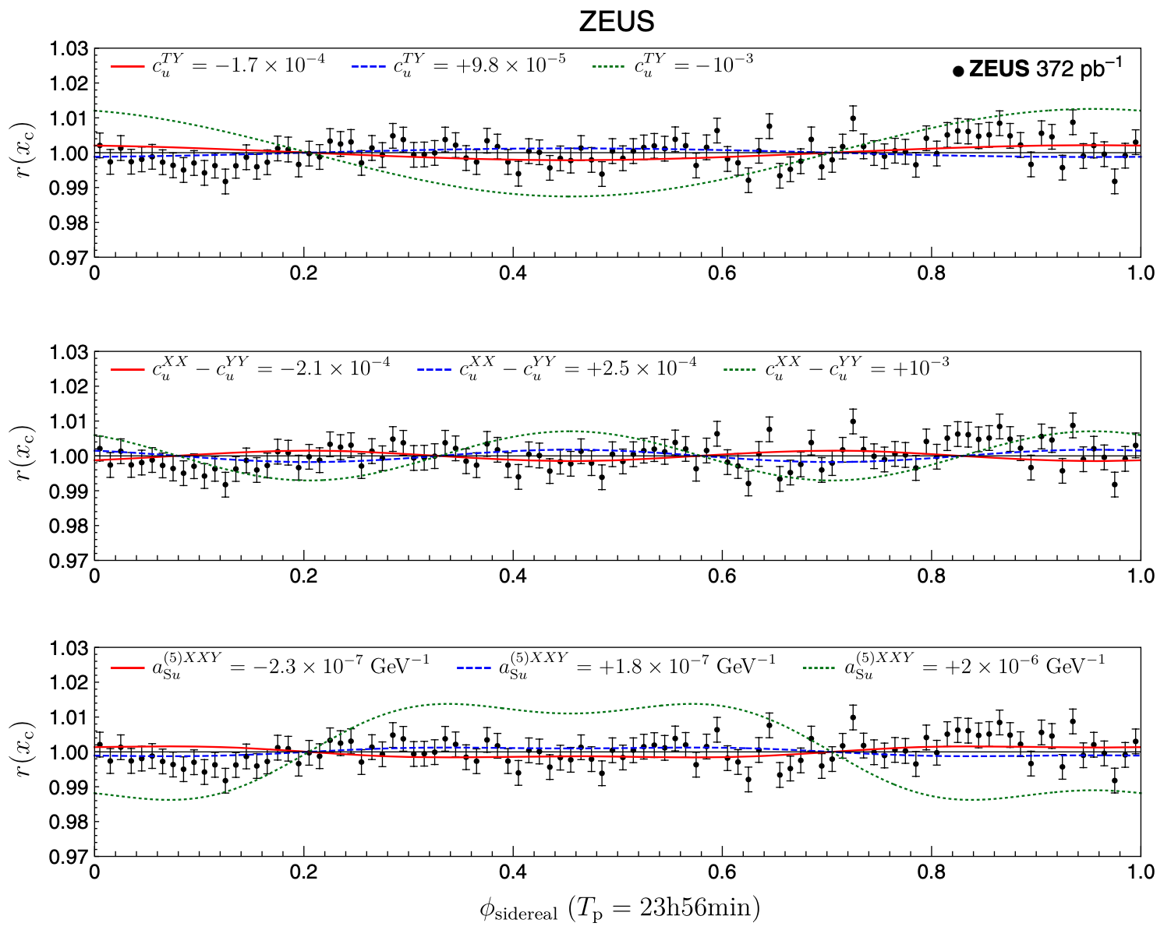
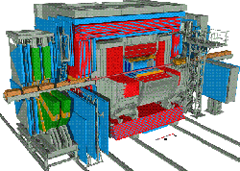
Collider physics (quarks)
ZEUS, PRD107(2023)092008 and many others
HERA p-e⁻ collider
- ZEUS deep-inelastic scattering data
- Monitor sidereal time dependence
- Similar tests are possible for other data

Slide 19
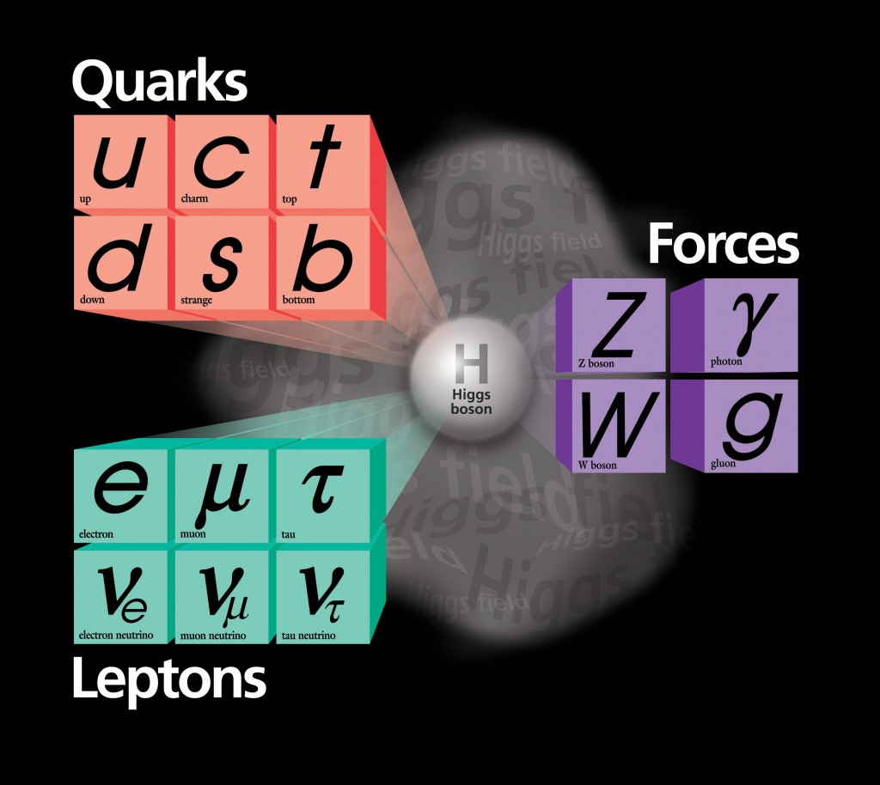
Neutrino physics
Neutrinos in the standard model
The standard model describes 6 quarks and 6 leptons and 3 types of force carriers.
Neutrinos are special because,
1. they only interact with weak nuclear force.
2. interaction eigenstate is not Hamiltonian eigenstate, and propagation of neutrinos changes their species (flavours), called neutrino oscillation.
ν_{μ}
μ
ν_{μ}
ν_{μ}
W
Z
d
u
u
u
Charged Current
(CC) interaction
“W-boson exchange”
Neutral Current
(NC) interaction
“Z-boson exchange”

Slide 20
Neutrino oscillation experiments
Neutrino oscillation is an interference experiment (cf. double slit experiment)
light source
slits
screen
ν₁
ν₂
interference pattern
For double slit experiment, if path ν₁ and path ν₂ have different length, they have different phases and it causes interference.

Slide 21
Neutrino oscillation experiments
Neutrino oscillation is an interference experiment (cf. double slit experiment)
ν_{μ}
ν_{μ}
Neutrino flavour eigenstates are super-position of Hamiltonian eigenstates ν₁ and ν₂

Slide 22
Neutrino oscillation experiments
Neutrino oscillation is an interference experiment (cf. double slit experiment)
ν_{μ}
U_{μ1}
ν₁
U_{e1}∗
ν₂
ν_{μ}
ν₂
ν₁
Neutrino flavour eigenstates are super-position of Hamiltonian eigenstates ν₁ and ν₂
Difference in velocities cause quantum interference

Slide 23
Neutrino oscillation experiments
Neutrino oscillation is an interference experiment (cf. double slit experiment)
ν_{e}
ν_{e}
ν_{e}
ν_{μ}
U_{μ1}
ν₁
U_{e1}∗
ν₂
ν_{μ}
ν_{e}
Neutrino flavour eigenstates are super-position of Hamiltonian eigenstates ν₁ and ν₂
Difference in velocities cause quantum interference
The detection may be different flavour (neutrino oscillations)

Slide 24
Neutrino oscillation experiments
Neutrino oscillation is an interference experiment (cf. double slit experiment)
ν_{e}
ν_{e}
ν_{e}
ν_{μ}
U_{μ1}
ν₁
U_{e1}∗
Background fields of universe
ν₂
ν_{μ}
ν_{e}
Neutrino flavour eigenstates are super-position of Hamiltonian eigenstates ν₁ and ν₂
Difference in velocities cause quantum interference
The detection may be different flavour (neutrino oscillations)
Neutrino propagation may be affected by background fields
→ anomalous neutrino oscillation results

Slide 25
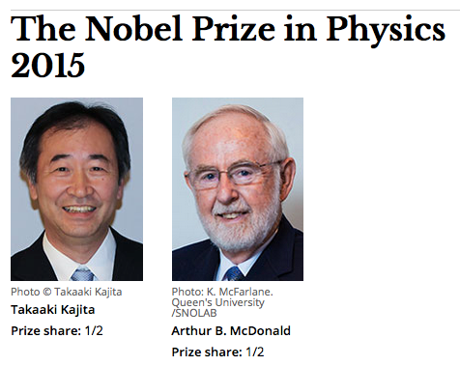
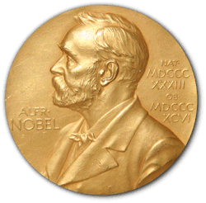
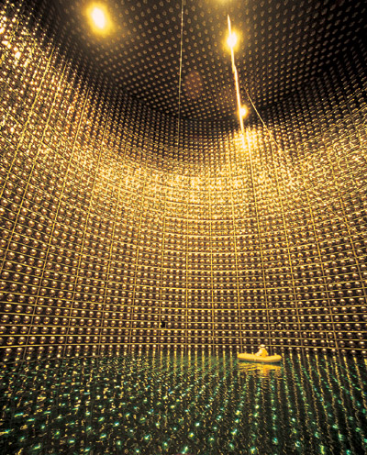
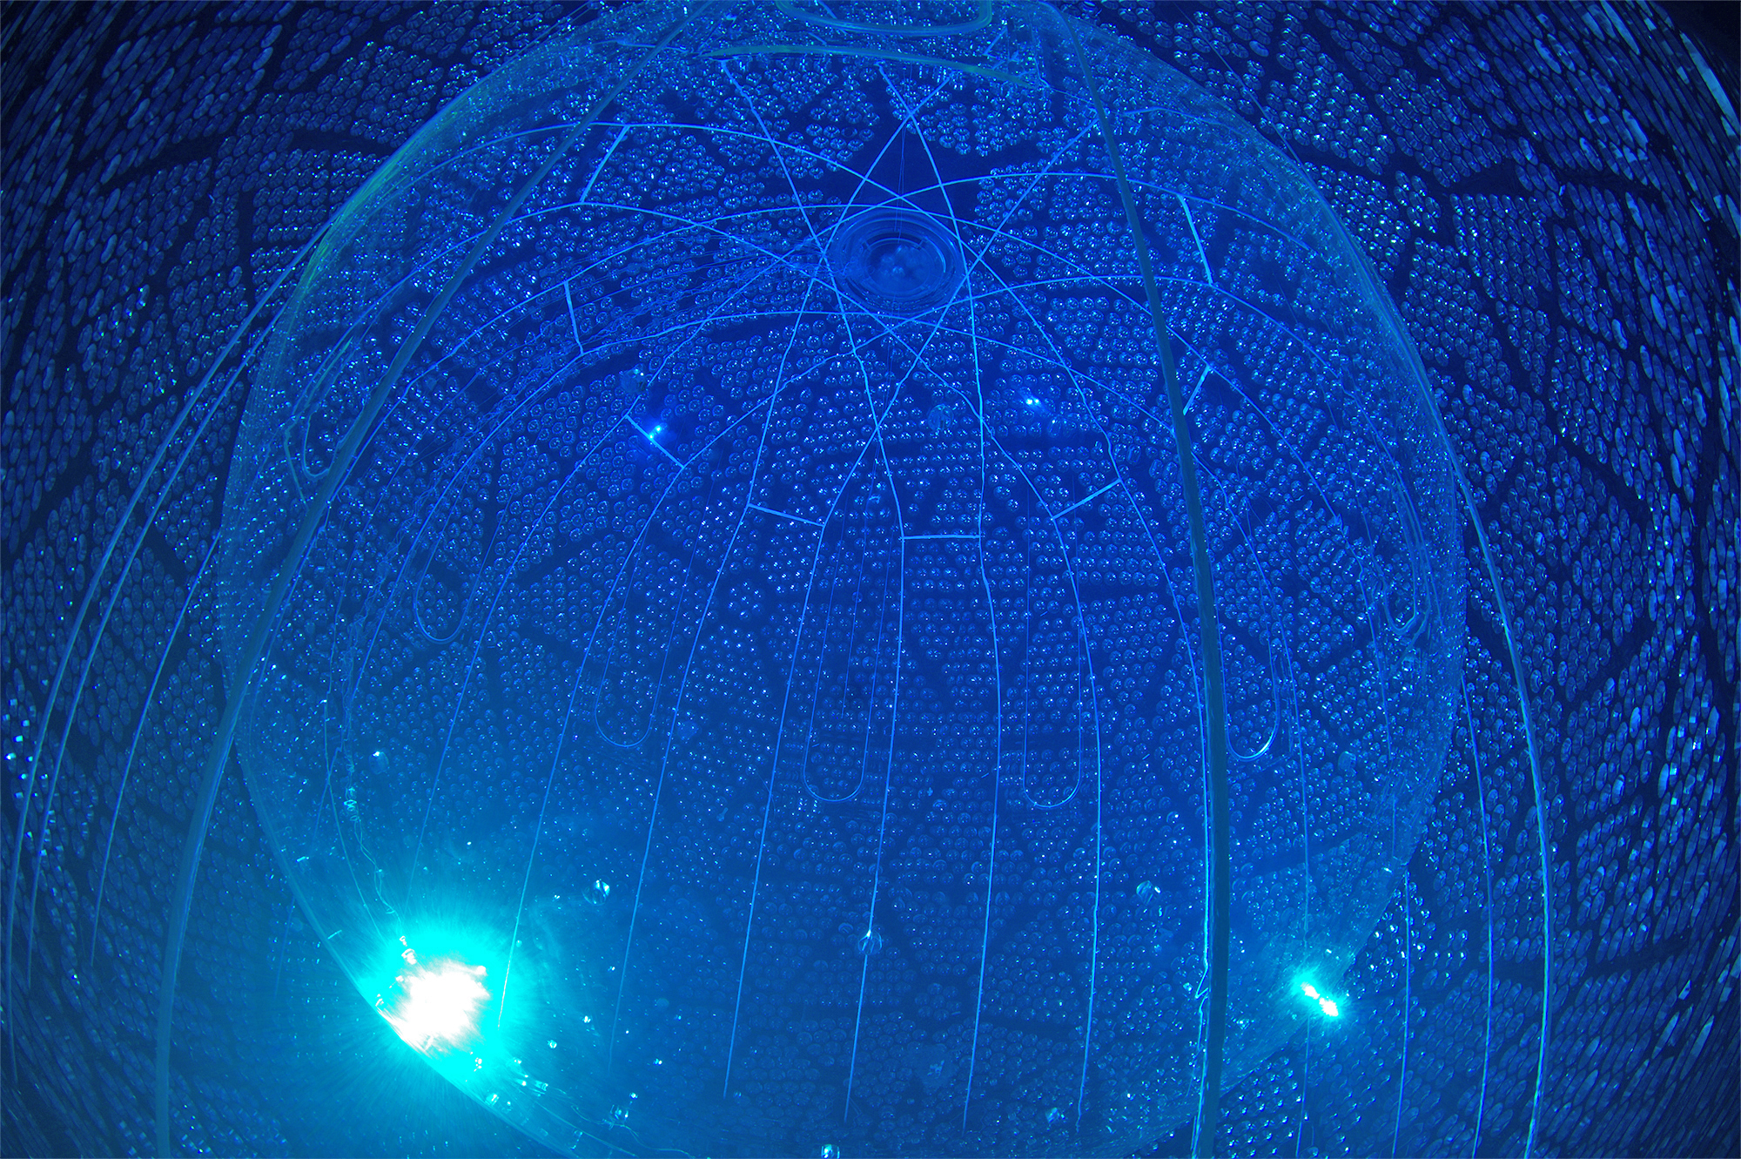
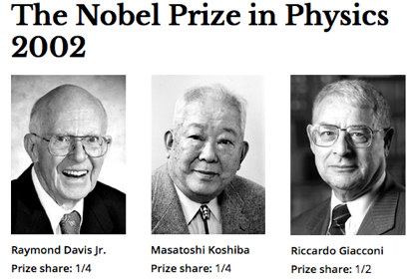
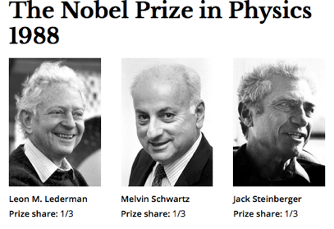
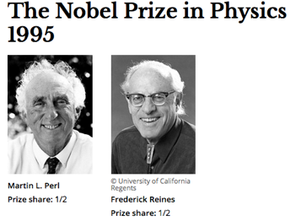
Neutrino oscillation experiments
Neutrino physics → Home of anomalies
- Solar and atmospheric neutrino anomalies (Nobel prizes, 2002, 2015)
Super-Kamiokande detector
SNO detector

Slide 26
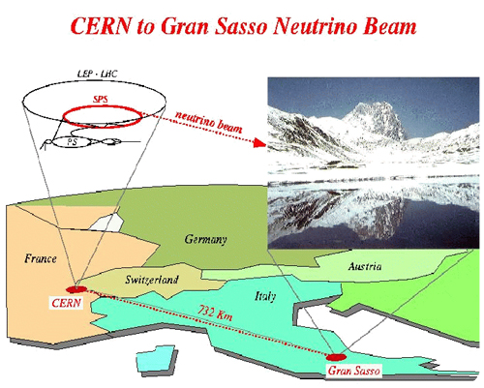
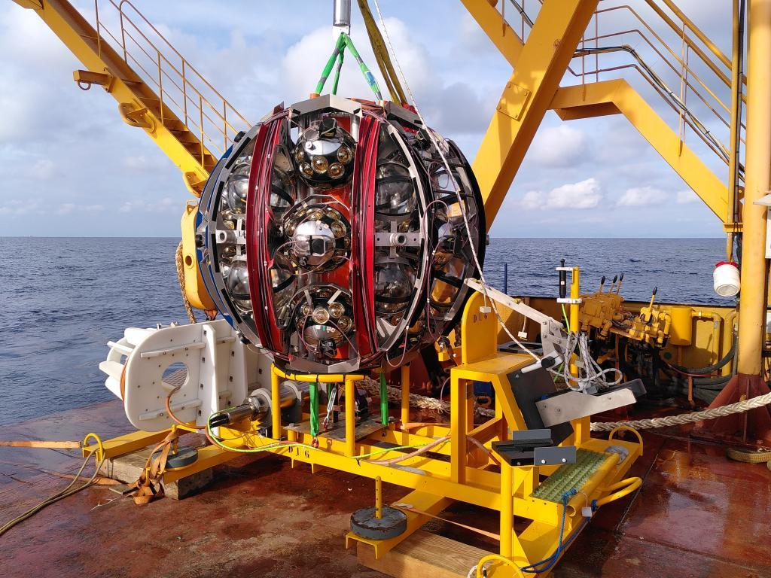
OPERA, ArXiv:1109.4897, KM3NeT, ArXiv:2502.1207
Neutrino oscillation experiments
Neutrino physics → Home of anomalies
- Solar and atmospheric neutrino anomalies (Nobel prizes, 2002, 2015)
- OPERA Neutrino-faster-than-Speed-of-Light
$$δ≡c_{v}^{2}−1 \sim 5×{10}^{−5}$$
KM3NeT 220 PeV neutrino (KM3-230213A)
$$δ≡c_{v}^{2}−1<4×{10}^{−22}$$

Slide 27
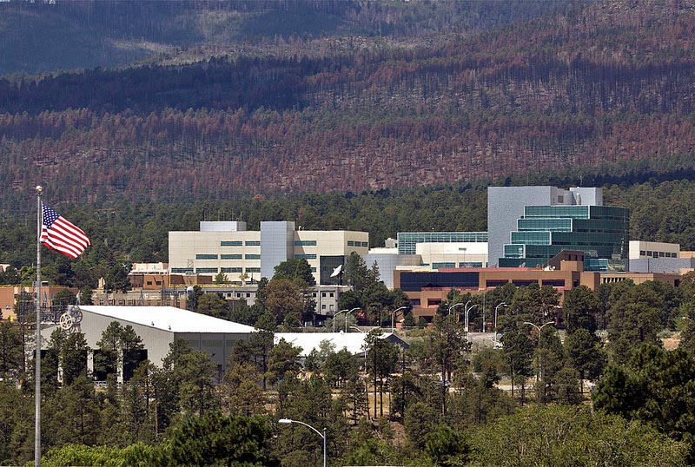
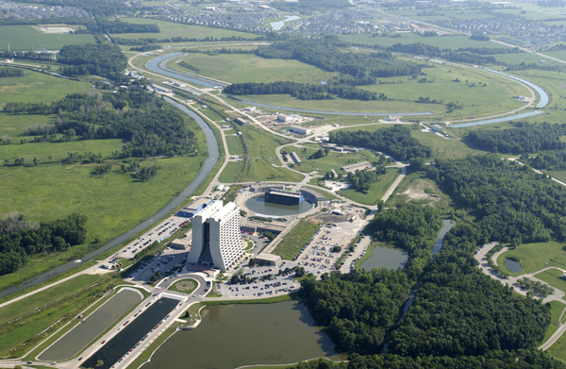
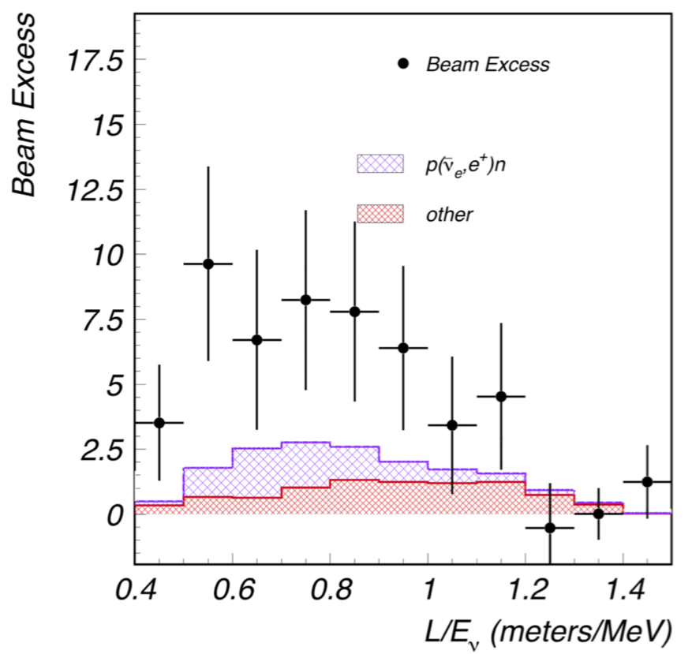
LSND, PRD64(2001)112007, MiniBooNE, PRL121(2018)22180
Neutrino oscillation experiments
Neutrino physics → Home of anomalies
- Solar and atmospheric neutrino anomalies (Nobel prizes, 2002, 2015)
- OPERA Neutrino-faster-than-Speed-of-Light (detector problem)
- LSND excess
- MiniBooNE excess
LSND excess
3.8σ
4.7σ
If these anomalous neutrino oscillation data are due to Lorentz violation, data may show sidereal time dependence
MiniBooNE excess

Slide 28
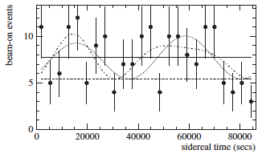
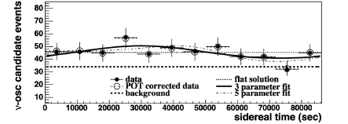
Neutrino oscillation experiments
LSND, PRD72(2005)076004, MiniBooNE, PLB718(2013)1303, TK, MPLA27(2012)1230024
Neutrino physics → Home of anomalies
- Solar and atmospheric neutrino anomalies (Nobel prizes, 2002, 2015)
- OPERA Neutrino-faster-than-Speed-of-Light (detector problem)
- LSND excess (not Lorentz violation)
- MiniBooNE excess (not Lorentz violation)
LSND excess
3.8σ
4.7σ
MiniBooNE excess
Lorentz violation cannot explain these excesses simultaneously

Slide 29
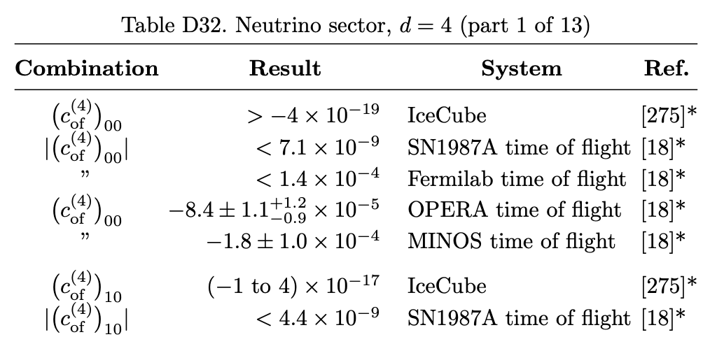
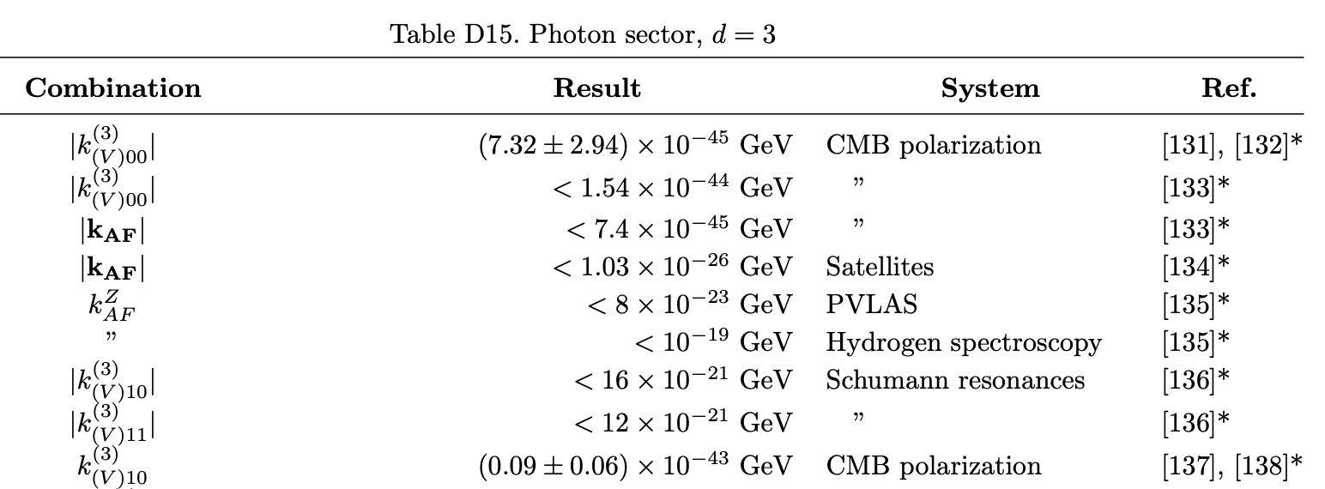
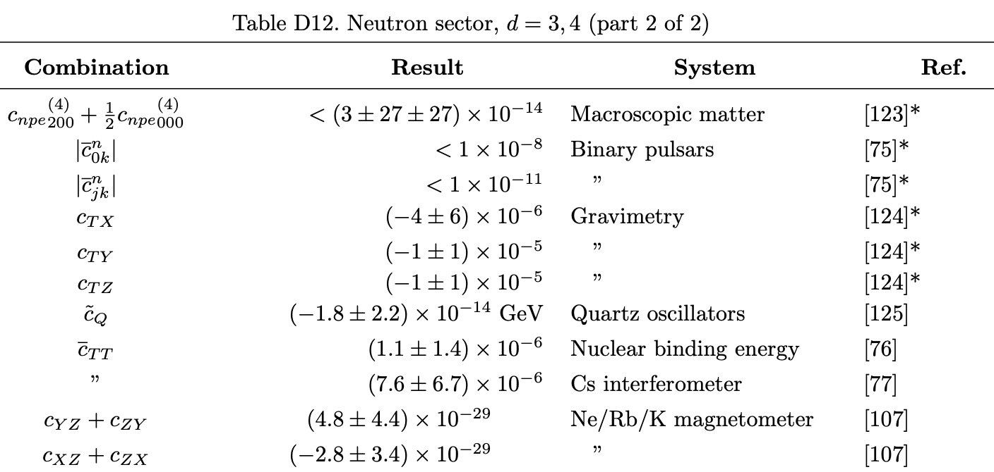
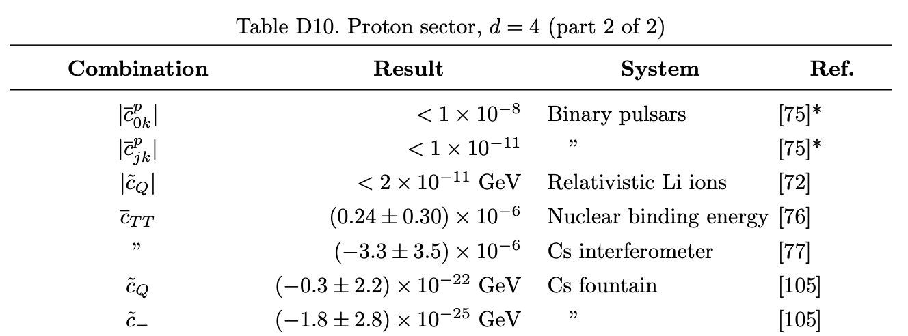
Tests of Lorentz violation – Summary
Limits of SME parameters are summarized in tables
https://arxiv.org/abs/0801.0287v17
So far, there is no compelling evidence of Lorentz violation

Slide 30
When do we find Lorentz violation???
Lorentz violation is motivated by Planck scale theories, so it is suppressed with the power of Planck mass ($\sim {10}^{19} GeV$)
$$\sim \frac{1}{M_{Pl}}, {\left(\frac{1}{M_{Pl}}\right)}^{2}, etc$$
In effective field theory, non-renormalizable operators are the signature of new physics, dimension analysis guides target sensitivity to look for Lorentz violation.
dimension-5 LV operator, $a^{(5)}<{10}^{−19} {GeV}^{−1}$
dimension-6 LV operator, $c^{(6)}<{10}^{−38} {GeV}^{−2}$
etc
These numbers can be used as a
guidance to design new experiments
Steven Weinberg
(CERN Courier Nov. 2017)
“We don’t know anything about non-renormalizable interaction terms, but I’ll swear they are there!’

Slide 31
Tests of Lorentz violation – Astrophysics
Terrestrial experiments
- controlled, high-precision
- various systems (optics, pendulum, gas, particle physics, etc)
So far, no compelling evidence of Lorentz violation
Astrophysical and cosmological experiments
- not controlled, low-precision
- extreme systems (highest energy, longest distance, etc)
- more sensitive to nonrenormalizable operators

Slide 32
Tests of Lorentz violation in Astrophysics

Slide 33
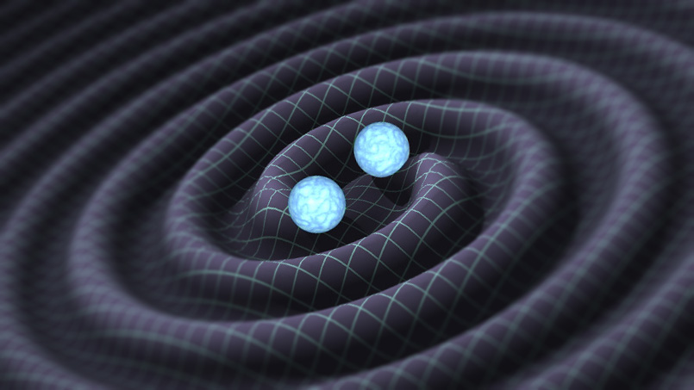
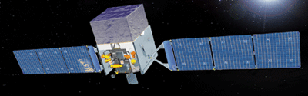
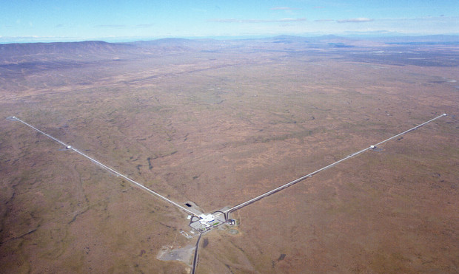
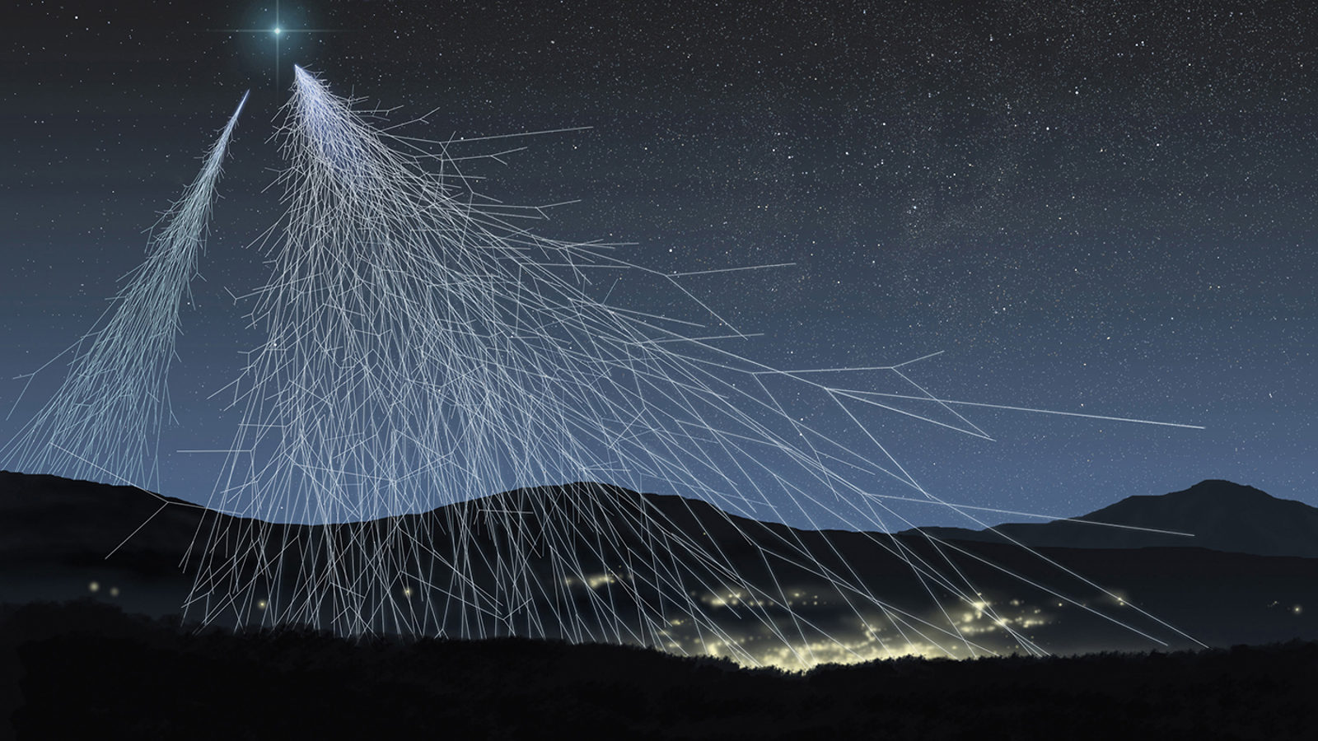
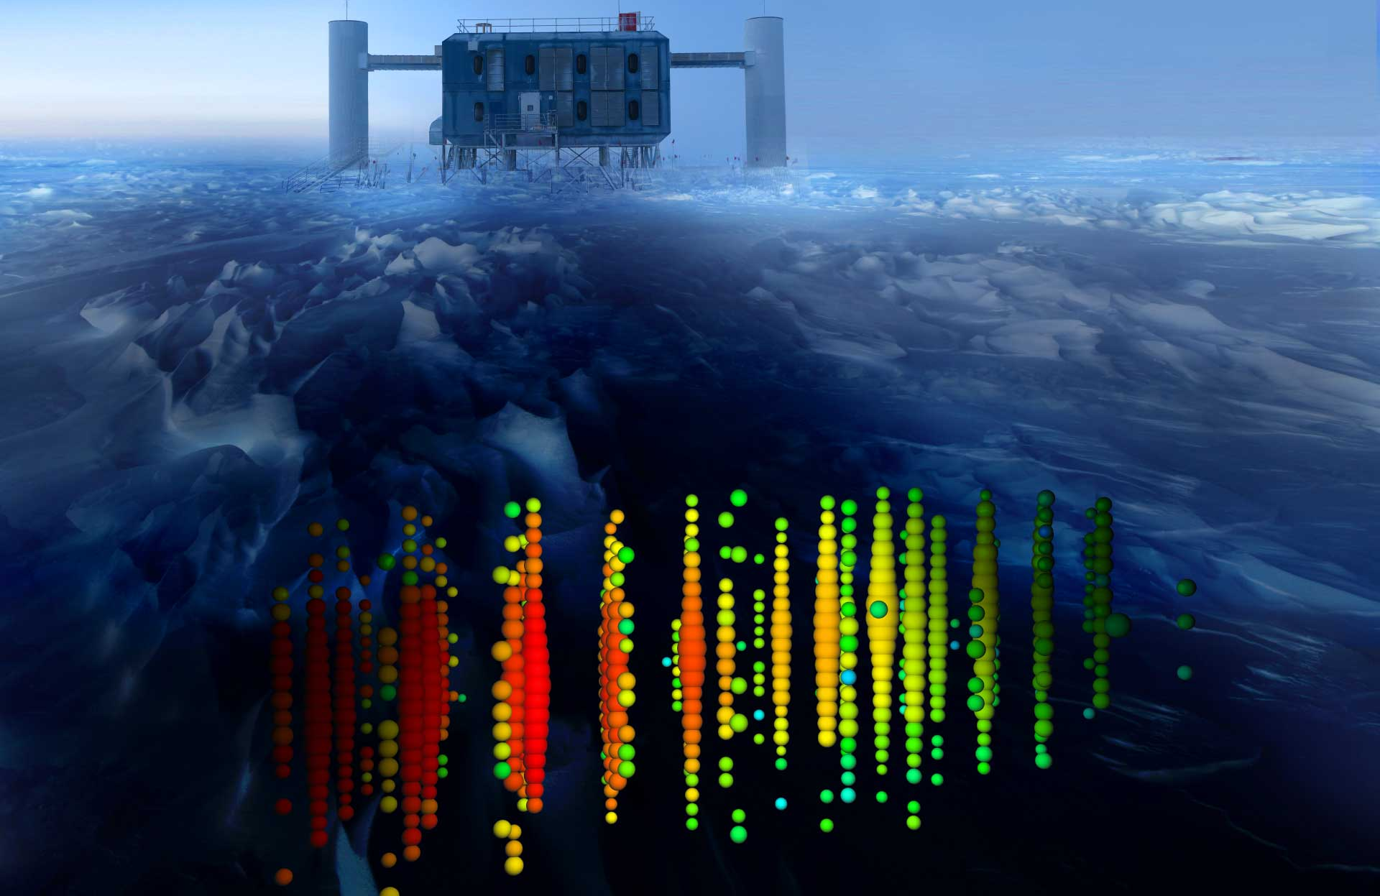
Lorentz violation in Astrophysics
Progress in Particle and Nuclear Physics 125 (2022) 103948
Highest energy particles – ultra-high-energy cosmic rays
Longest propagating waves – gravitational waves, cosmic microwave background
High-energy and long propagation – gamma-ray, high-energy neutrinos

Slide 34
Stecker, et al, PRD91(2015)045009, and many others
Cut-off in high-energy cosmic ray spectrum
Lorentz violation = media in vacuum
- Attenuate high-energy cosmic rays
$$E^{2}=p^{2}+m^{2}+a^{(5)}E^{3}+{c^{\left(6\right)}E}^{4}+⋯$$
$$ν_{e}$$
$$ν_{e},e^{−}$$
$$W^{+}$$
$$Z^{0}$$
$$ν_{e}$$
$$e^{+}$$
$$ν_{i}$$
$${\overline{ν}}_{e},e^{−}$$
$$e^{−}$$
$$ν_{i}$$
Vacuum pair emission
Neutrino splitting
IceCube High-energy neutrino spectrum

Slide 35
Auger, JCAP01(2022)023, and many others
Cut-off in high-energy cosmic ray spectrum
Lorentz violation = media in vacuum
- Attenuate high-energy cosmic rays
$$E^{2}=p^{2}+m^{2}+a^{(5)}E^{3}+{c^{\left(6\right)}E}^{4}+⋯$$
A=1
2≤A≤4
5≤A≤22
23≤A≤38
39≤ A≤ 56
Without LV
With LV
Auger UHECR spectrum

Slide 36
Amelino-Camelia et al, Nature 393(1998)763, LHASSO PRL133(2024)071501), and many others
Time-of-flight of high-energy cosmic rays
Lorentz violation = media in vacuum
- Anomalous time dependent effects
Gamma Ray Bursts
- Energy dependent light curve distortion
$$δv\sim Ek_{00}^{(5)}{+E}^{2}c_{00}^{(6)}+⋯$$
Lorentz violation
low energy photon
high energy photon

Slide 37
Huang and Ma, Communications Physics1(2018)62, Amelino-Camelia et al, Nature Astronomy 7(2023)996 and many others
Time-of-flight of high-energy cosmic rays
Lorentz violation = media in vacuum
- Anomalous time dependent effects
Gamma Ray Bursts
- Energy dependent light curve distortion
- Neutrino time-of-flight ($a^{(5)}$=CPT odd)
$$δv\sim Ea^{(5)}{+E}^{2}c^{(6)}+⋯$$
Lorentz violation
neutrino
photon
IceCube-GRB coincidence candidates with Lorentz violation

Slide 38
Gravity sector
Lorentz Violation ~ quantum gravity phenomenology
- New focus (EFT is difficult for gravity)
LIGO-VIRGO
- Gravitational waves LIGO, Virgo, Fermi, INTEGRAL, 2017 ApJL 848 L13
- Michelson-Morley interferometer PLB761(2016)1
Cosmic rays
- Gravitational Cherenkov radiation PLB 749 (2015) 551
Terrestrial experiments
- Matter wave interferometer PRL100(2008)031101 and many others

Slide 39
Vacuum birefringence
Lorentz violation = media in vacuum
→ Additional source of polarization
GRB polarization PRL110, 201601 (2013) and others
- Strong sensitivity on higher dimension operators
CMB polarization PRL125 (2020) 22, 221301
- The longest distance
- Strongest sensitivity to dimension-3 operator
- Mild tension? (2.4σ)

Slide 40
Anomalous neutrino flavour
IceCube, Nature Physics 18(2022)1287
Lorentz violation = media in vacuum
- MSW-like effect in vacuum
Sensitive to the target signal region of Lorentz violation ($<{10}^{−38} {GeV}^{−2}$ for dimension-6 operators)
No Lorentz violation discovered
Sensitivity is neutrino production model dependent

Slide 41
High-energy, long propagating neutrinos
IceCube, Nature Physics 18(2022)1287
Lower dimension operators → searches by tabletop experiments
Higher dimension operators → searches by astrophysical observations
$$H\sim \frac{m^{2}}{2E}+a^{(3)}−E∙c^{\left(4\right)}+E^{2}∙a^{\left(5\right)}−E^{3}∙c^{(6)}⋯$$
Physics MMA
torsion
pendulum
Astrophysical neutrino flavour mixing
optical
resonator
comagnetomator
Weak interaction
+ Small mass
+ Quantum mixing
= macroscopic quantum system you cannot disturb
vacuum
birefringence
UHECRs
[1] IceCube, Nature Phys. 18, 1287 (2022) [2] WMAP, AstrophysJ.180, 330 (2009) [3] Allmendinger et al., PRL112, 110801 (2014) [4] Heckel et al., PRL97, 021603(2006) [5] Muon g-2, PRL100, 091602 (2008) [6] Kostelecký, Mewes,PRL110, 201601 (2013) [7] Kostelecký, Melissinos, Mewes, PLB 761, 1 (2016) [8] Nagel et al.,Nature Comm. 6, 8174(2015) [9] Smiciklas et al., PRL107, 171604 (2011) [10] Pruttivarasin et al., Nature 517, 592 [11] Maccione et al., JCAP 0904, 022 [12] Kostelecký, Tasson, PLB 749, 551

Slide 42
Tests of Lorentz Violation in Astrophysics – Summary
Astrophysics has a high potential to look for Lorentz violation. But there are many unknowns;
- Energy spectrum
- Production time
- Source information
- Foreground
etc
So far, astrophysical neutrino data are low statistics and further data are needed to search Lorentz violation...

Slide 43
Hyper-Kamiokande, ArXiv:1805.04163
Hyper-Kamiokande
New international neutrino astronomy projects around the world
Hyper-K construction is ongoing
71 m
Super-Kamiokande
68 m
40m

Slide 44
IceCube-Gen2, J.Phys.G48(2021)060501
IceCube-Gen2
New international neutrino astronomy projects around the world
Summer 2024-2045 IceCube team
IceCube (~1Gton)
Gen2-Optical (~8 Gton)
DeepCore (>7 GeV)
IceCube-Upgrade (>3GeV)
IceCube
DeepCore
The first stage of Gen2 (IceCube upgrade) is ongoing

Slide 45
Conclusion
Lorentz violation is motivated from Planck-scale theories
There is a worldwide effort to look for Lorentz violation, using various state-of-the-art techniques, but so far no compelling evidence of Lorentz violation
Astrophysical observations are powerful tools to look for Lorentz violation
Thank you for your attention!

Slide 46
Backup

Slide 47
Models of Lorentz violation
String theory, Kostelecký and Samuel, PRD39 (1989) 683
Ultra-light dark matter, Graham and Rajendran, PRD88 (2013) 035023
Quintessence, Ando, Kamionkowski, and Mocioiu, PRD80 (2009) 123522
Loop quantum gravity, Gambini and Pullin, PRD59 (1999) 124021
Non-commutative field theory, Carroll, Harvey, Kostelecký, Lane, Okamoto, PRL87 (2001) 141601
Hořava-Lifshitz gravity, Pospelov and Shang, PRD85 (2012) 105001
Lee-Wick theory, Myers and Pospelov, PRL90 (2003) 211601
and many more!
Effective Lorentz violation (spontaneous Lorentz symmetry breaking) is compatible with Riemann geometry, however, Intrinsic Lorentz Violation is not
Finsler geometry Kostelecký and Li, PRD104 (2021) 044054 got lots of attention recently, to go beyond Riemann geometry

Slide 48
Lorentz violation tests with neutrinos
Spectral distortion
Sidereal variation
Daya Bay
LSND
Super-Kamiokande
PRD98(2018)092013
PRD72(2005)076004
MINOS FD
MiniBooNE
PRD91(2015)052003
PLB718(2013)1303
MINOS ND
T2K ND
PRL101(2008)151601
PRL105(2010)151601
AMANDA
IceCube
PRD79(2009)102005
IceCube
Double Chooz
PRD95(2017)111101
Nature Physics 14(2018)961
PRD86(2013)112009
PRD82(2010)112003
IceCube
SNO
Flavor ratio
Seasonal variation
Nature Physics, 18(2022)1287
PRD98(2018)112013
Notes:
By the way now we have twice more data for antineutrino so I am thinking update of this analysis.

Slide 49
High-energy, long propagating neutrinos
Snowmass21, EPJC83(2023)15, Snowmass, JHEA36(2022)55, COST Action CA18108 PPNP125(2022)103948
High-energy astrophysical neutrinos
- Long baseline accumulates new physics effect
- High energy enhances new physics effect
$$H\sim \frac{m^{2}}{2E}+V\left(new physics\right), P\sim V\left(new physics\right)∙L$$
- Energy spectrum, arrival time, flavor are affected
by production, propagation, detection of neutrinos
Neutrino – dark energy interaction
Neutrino – dark matter interaction
Long range force
Quantum decoherence
Lorentz violation
etc
High-energy Astrophysical objects
Neutrino detector
???
New physics
IceCube, Nature Physics(2022), (2024), Klop,Ando, PRD97(2018)063006,Argüelles,Kheirandish,Vincent, PRL119(2017)201801, Bustamante,Agarwalla, PRL122(2019)061103, Amelino-Camelia, ,Di Luca, Gubitosi, Rosati, D’Amico, Nature Astronomy (2023)

Slide 50
High-energy astrophysical neutrinos
Kowalski, TeVPA 2017
Above ~100 TeV, neutrinos are only particles pointing to their high-energy sources

Slide 51
High-energy astrophysical neutrinos
IceCube, PRD104(2021)022002
60TeV- 2PeV astrophysical neutrinos are observed by IceCube Neutrino Observatory
high-energy starting event (HESE) sample
Northern Sky (up-going)
2. High-energy astrophysical neutrinos
Southern Sky (down-going)
“Bert”
1.1 PeV
“Big Bird”
2.0 PeV
“Ernie”
1.0 PeV

Slide 52
IceCube event morphology
IceCube-Gen2, J.Phys.G48(2021)060501
Track
ν_{μ}CC
$$ν_{μ}+N→μ+X$$
Cascade
ν_{e}CC, ν_{τ}CC, NC
$$ν_{e}+N→e+X$$
$$ν_{τ}+N→τ+X$$
$$ν_{x}+N→ν_{x}+X$$
Double cascade
ν_{τ}CC (L~50m•E/PeV)
$$ν_{τ}+N→τ+X$$
$τ→X′$

Slide 53
Spontaneous symmetry breaking (SSB)
Kostelecký and Samuel,PRD39(1989)683
vacuum Lagrangian for fermion
$$L=i\overline{ψ}γ_{μ}∂^{μ}ψ$$
SSB
In the Standard Model, a phase transition of a scalar field gives nonzero field value in vacuum
φ
$$L=\frac{1}{2}{\left(∂_{μ}φ\right)}^{2}−\frac{1}{2}μ^{2}φ^{2}−\frac{1}{4}λφ^{4}$$

Slide 54
Spontaneous symmetry breaking (SSB)
Kostelecký and Samuel,PRD39(1989)683
vacuum Lagrangian for fermion
$$L=i\overline{ψ}γ_{μ}∂^{μ}ψ$$
$$−m\overline{ψ}ψ$$
φ
SSB
In the Standard Model, a phase transition of a scalar field gives nonzero field value in vacuum
φ
Particle acquires mass term!
$$L=\frac{1}{2}{\left(∂_{μ}φ\right)}^{2}−\frac{1}{2}μ^{2}φ^{2}−\frac{1}{4}λφ^{4}$$

Slide 55
Spontaneous Lorentz symmetry breaking (SLSB)
Kostelecký and Samuel,PRD39(1989)683
vacuum Lagrangian for fermion
$$L=i\overline{ψ}γ_{μ}∂^{μ}ψ$$
$$−m\overline{ψ}ψ$$
φ
SSB
In the Standard Model, a phase transition of a scalar field gives nonzero field value in vacuum
In String Theory, a vector field can be frozen in vacuum by spontaneous symmetry broken
φ
φ
SLSB
a^{μ}
$$L=\frac{1}{2}{\left(∂_{μ}φ\right)}^{2}−\frac{1}{2}μ^{2}φ^{2}−\frac{1}{4}λφ^{4}$$

Slide 56
Spontaneous Lorentz symmetry breaking (SLSB)
Kostelecký and Samuel,PRD39(1989)683
vacuum Lagrangian for fermion
$$L=i\overline{ψ}γ_{μ}∂^{μ}ψ$$
$$−m\overline{ψ}ψ$$
$$+\overline{ψ}γ_{μ}a^{μ}ψ$$
φ
SSB
In the Standard Model, a phase transition of a scalar field gives nonzero field value in vacuum
In String Theory, a vector field can be frozen in vacuum by spontaneous symmetry broken
φ
φ
a^{μ}
SLSB
Lorentz symmetry is spontaneously broken!
a^{μ}
$$L=\frac{1}{2}{\left(∂_{μ}φ\right)}^{2}−\frac{1}{2}μ^{2}φ^{2}−\frac{1}{4}λφ^{4}$$

Slide 57
Particle and Observer Lorentz transformation
y
x

Slide 58
Particle and Observer Lorentz transformation
hypothetical background vector field
moving particle
Einstein
(observer)
y
x

Slide 59
Particle and Observer Lorentz transformation
Under the particle Lorentz transformation:
y
x

Slide 60
Particle and Observer Lorentz transformation
Under the particle Lorentz transformation:
Lorentz violation is observable when a particle is moving in the fixed coordinate space
y
Lorentz violation!
x
Notes:
particle motion depends on direction

Slide 61
Particle and Observer Lorentz transformation
Under the particle Lorentz transformation:
Under the observer Lorentz transformation:
Lorentz violation is observable when a particle is moving in the fixed coordinate space
y
y
x
x

Slide 62
Particle and Observer Lorentz transformation
Under the particle Lorentz transformation:
Under the observer Lorentz transformation:
Lorentz violation is observable when a particle is moving in the fixed coordinate space
y
y
x
x

Slide 63
Particle and Observer Lorentz transformation
Under the particle Lorentz transformation:
Under the observer Lorentz transformation:
Lorentz violation cannot be generated by observers motion (coordinate transformation is unbroken)
all observers agree for all observations
Lorentz violation is observable when a particle is moving in the fixed coordinate space
y
y
x
x
Notes:
Lorentz violating effect in one frame is conserved in other frame

Slide 64
High-energy, long propagating neutrinos
IceCube, Nature Phys. 18, 1287 (2022)
muon neutrino
Astrophysical neutrino flavor physics
- Flavor triangle
- Spectrum integrated flavor ratio $\left(ν_{e}:ν_{μ}:ν_{τ}\right)$
- Standard production models include $ν_{e}$ and $ν_{μ}$
=(0:1:0)
=(1:2:0)
=(1:0:0)
=(x:1-x:0)
tau neutrino
electron neutrino
High-energy Astrophysical objects
Neutrino detector
???
Flavor mixing

Slide 65
High-energy, long propagating neutrinos
IceCube, Nature Phys. 18, 1287 (2022)
muon neutrino
Astrophysical neutrino flavor physics
- Flavor triangle
- Spectrum integrated flavor ratio $\left(ν_{e}:ν_{μ}:ν_{τ}\right)$
- Standard production models include $ν_{e}$ and $ν_{μ}$
- Flavor ratio observables on Earth is different
- Deviation from this “island” is new physics signal
=(0:1:0)
=(1:2:0)
=(1:0:0)
=(x:1-x:0)
All possible flavor ratios at Earth
tau neutrino
electron neutrino
High-energy Astrophysical objects
Neutrino detector
???
Flavor mixing

Slide 66
High-energy, long propagating neutrinos
IceCube, Nature Phys. 18, 1287 (2022), IceCube, PRD104,(2021)022002, EPJC82(2022)1031
muon neutrino
Astrophysical neutrino flavor physics
- Flavor triangle
- Spectrum integrated flavor ratio $\left(ν_{e}:ν_{μ}:ν_{τ}\right)$
- Standard production models include $ν_{e}$ and $ν_{μ}$
- Flavor ratio observables on Earth is different
- Deviation from this “island” is new physics signal
Data contour covers most of flavor triangle
- New physics cannot be discovered from current data
- Limits are set on vacuum operators
IceCube data contours
All possible flavor ratios at Earth
tau neutrino
electron neutrino
High-energy Astrophysical objects
Neutrino detector
???
Flavor mixing

Slide 67
IceCube, Nature Physics18(2023)1287
HESE 7.5-yr flavor Lorentz violation search
dim-6 new physics operator limit
60 HESE events in 60 TeV – 2 PeV
IceCube data start to explore quantum gravity-motivated signal region for some parameters
$$c^{\left(6\right)}≤\frac{1}{M_{Planck}^{2}}\sim {10}^{−38}{GeV}^{−2}$$

Slide 68
Flavor new physics search with effective operators
Mewes and Kostelecký, PRD85(2012)096005
Standard Model Extension (SME) is an effective field theory to look for Lorentz violation
$$L=i\overline{ψ}γ^{μ}∂_{μ}ψ−m\overline{ψ}ψ+\overline{ψ}γ^{μ}a_{μ}^{}ψ+\overline{ψ}γ^{μ}c_{μν}^{}∂^{ν}ψ⋯$$
Effective Hamiltonian can be written from here
$$h_{eff}\sim \frac{1}{2E}U^{†}M^{2}U+a_{αβ}^{(3)}−{Ec}_{αβ}^{\left(4\right)}+E^{2}a_{αβ}^{\left(5\right)}−{E^{3}c}_{αβ}^{\left(6\right)}⋯$$
IceCube is sensitive to higher dimension operators
dimension-6 operator natural scale: $c^{\left(6\right)}\sim \frac{1}{M_{Planck}^{2}}\sim {10}^{−38}{GeV}^{−2}$
Standard Model
New physics
New physics
(renormalizable)
higher dimension operator
(non-renormalizable)
Standard Model
$${E^{3}c}_{αβ}^{(6)}=E^{3}\left(\begin{matrix}c_{ee}^{(6)} & c_{eμ}^{(6)} & c_{τe}^{(6)} \\ c_{eμ}^{\left(6\right)∗} & c_{μμ}^{(6)} & c_{μτ}^{(6)} \\ c_{τe}^{\left(6\right)∗} & c_{μτ}^{\left(6\right)∗} & c_{ττ}^{(6)}\end{matrix}\right)$$

Slide 69
IceCube, PRL114(2015)171102, Astro.J.809:98(2015), PRD99(2019)032004, EPJC82(2022) 1031
IceCube flavor ratio measurements
IceCube
1st flavour ratio result
(0.0:0.2:0.8)
IceCube
2nd flavour ratio result
(0.5:0.5:0.0)
IceCube
3rd flavour ratio result
(0.0:0.2:0.8)
2018 flavour ratio measurement
- Likelihood is very shallow and fit often confuses between ν_{e} and ν_{τ}
- Flavour ratio result has some power to distinguish ν_{e} and ν_{τ}

Slide 70
IceCube-Gen2, J.Phys.G48(2021)060501
Energy dependence of flavor ratio
Muon neutrino increases at higher energy
Future higher-statistics flavor measurement

Slide 71
Rasmussen, Lechner, Ackermann, Kowalski, Winter, PRD96(2017)083018
New physics flavor ratio predictions
New physics models have different flavor ratios
Effective operator
- It includes Lorentz violation
- Assuming all possible standard production models, (ν_{e}:ν_{μ}:ν_{τ}) = (x:1-x:0), it covers 2/3 of the phase space.

