Slide 1
Software Architecture & Design
6CCS3SAD / 7CCSMDAS
Dr Kevin Lano

Slide 2
Session 9: Model-Driven Engineering I
March 11th, 2019

Slide 3
Learning Outcomes
At the end of this session you should be able to:
Explain the benefits of automation in software development;
Explain the MOF meta-modelling architecture

Slide 4
So far
Architecture models constructed manually
Abstract Architectures
Concrete Architectures for .NET
Architectural Styles
Architectures are then passed on to developers for manual design and implementation

Slide 5
Problems
Enforcing architectures and constraints?
Errors introduced through manual implementation
Reuse?

Slide 6
Today
Model-Driven Engineering (MDE) can help address these problems
→ Automatically transform models all the way to code
Enforce architectural constraints
Avoid implementation errors
Simplify reuse and increase consistency

Slide 7
Model-Driven Engineering (MDE)
Overview
Models as central artefacts of software development
Architecture, design, ...
Model transformations to encode and automate processing of models
Model-to-model (M2M): Transform models into other models
Model-to-text (M2T): Transform models to source code or other text

Slide 8
Model-Driven Engineering (MDE)
Overview
Models as central artefacts of software development
Architecture, design, ...
Model transformations to encode and automate processing of models
Model-to-model: Transform models into other models
Model-to-text: Transform models to source code/text

Slide 9
Model-to-Text Transformations
Programs that
Take a model (or models) as input
For example, an architecture diagram
Requires formalised (i.e., computer processible) representation of the model
Produce a text file (or files) as output
Often, but not always, source code

Slide 10
Model-to-Text Transformations
Programs that
Take a model (or models) as input
For example, an architecture diagram
Requires formalised (i.e., computer processible) representation of the model
Produce a text file (or files) as output
Often, but not always, source code

Slide 11
Models
Models are abstractions of a system
Different from the system – details are left out
Can be used as an example to produce a system
Models are descriptions of a system written in a well-defined modelling language
Modelling languages we have used:
To design class hierarchy of a system using language of UML class diagrams
To design system architecture using UML2 component-diagram language
To design a COM+ specific system architecture using COM+ specialization of UML2 component diagrams

Slide 12
Metamodels
A metamodel is a description of a modelling language
A model of models
Defines all concepts that can be used within a language
A model is constructed using the syntax defined by a metamodel
You know a range of metamodels:
UML class diagrams
UML2 component diagrams
.NET/COM+ specialization
Relational data model diagrams
XMLSchema for XML documents …

Slide 13
Models, languages and metalanguages
Meta-
Language
is written in
Metamodel
is written in
Model

Slide 14
The Meta-Object Facility (MOF)
Is an OMG standard for defining modelling languages
OMG = Object Management Group
A model of meta-models (a meta-metamodel)
UML, the OCL, relational database models, specializations of UML can all be represented in the MOF
An object-oriented approach to defining modelling languages
Modelling concepts defined as “meta-classes”
Meta-classes themselves are instances of MOF classes
4 layered architecture to define the modelling / meta-modelling process
Layers M0 to M3

Slide 15
Layers M0 and M1
We already know these
Layer M0 is the actual running system
E.g., component instances
E.g., customer objects, representing actual customers accessing an ecommerce system
Layer M1 is a system model
Defines the types of entities and relationships that make up a system
E.g., component specifications
E.g., a UML class model, defining a Customer class that specifies that customer objects are system entities
Every element of M0 is an instance of an element from M1

Slide 16
Layers M0 and M1
M0: System (at runtime)
:Customer
title = “Dr”
name = “Jekyll”
:Customer
title = “Mr”
name = “Hyde”
Notes:
M0 are system instances – specific objects, eg., at runtime

Slide 17
Layers M0 and M1
Customer
title : String
name : String
M1: Model of a System
M0: System
:Customer
title = “Dr”
name = “Jekyll”
:Customer
title = “Mr”
name = “Hyde”

Slide 18
Layers M0 and M1
Customer
title : String
name : String
<<instance-of>>
<<instance-of>>
M1: Model of a System
M0: System
:Customer
title = “Dr”
name = “Jekyll”
:Customer
title = “Mr”
name = “Hyde”

Slide 19
Layers M0 and M1
Customer
title : String
name : String
<<instance-of>>
<<instance-of>>
M1: Model of a System
M0: System
:Customer
title = “Dr”
name = “Jekyll”
:Customer
title = “Mr”
name = “Hyde”
Notation:
‘:’ and underscore to indicate objects
→ This is an object diagram

Slide 20
Layers M0 and M1
Notation:
No ‘:’ nor underscore to indicate class
→ This is a class diagram
Customer
title : String
name : String
<<instance-of>>
<<instance-of>>
M1: Model of a System
M0: System
:Customer
title = “Dr”
name = “Jekyll”
:Customer
title = “Mr”
name = “Hyde”

Slide 21
Layer M2
For a modelling tool, all elements of a model are objects
They are on ‘M0’
Their classes are things like ‘Class’, ‘Attribute’, or ‘Association’
A meta-model (M2 model) reflects this:
Meta-classes on M2 are instantiated by model elements on M1

Slide 22
M0 as instance of M1
Customer
title : String
name : String
<<instance-of>>
<<instance-of>>
M1: Model of a System
M0: System
:Customer
title = “Dr”
name = “Jekyll”
:Customer
title = “Mr”
name = “Hyde”

Slide 23
Layer M2
M1: Model of a System
Customer
title : String
name : String

Slide 24
Layer M2
M1: Model of a System
:UML Attribute
name = “title”
type = “String”
:UML Class
name = “Customer”
:UML Attribute
name = “name”
type = “String”
Notes:
M1 model is viewed as an instance of an M2 model.

Slide 25
Layer M2
M2: Meta-model of UML
M1: Model of a System
:UML Attribute
name = “title”
type = “String”
:UML Class
name = “Customer”
:UML Attribute
name = “name”
type = “String”

Slide 26
M1 as instance of M2
Instantiation of associations by links.
This happens between M1 and M0, too.
1
UML Attribute
name : String
type : String
UML Class
name : String
*
<<instance-of>>
<<instance-of>>
M2: Meta-model of UML
M1: Model of a System
:UML Attribute
name = “title”
type = “String”
:UML Class
name = “Customer”
:UML Attribute
name = “name”
type = “String”
Notation:
‘:’ and underscore to indicate objects
→ This is an object diagram
Side note: The actual UML meta-model is more complex
and uses different names for the meta-classes.

Slide 27
Layer M3
We use the same trick again
We get a language for defining meta-models
A meta-meta-language
Defines key concepts of meta-models
Meta-classes and associations of M2 are instances of meta-meta-classes of M3
The MOF is really the language for M3 models

Slide 28
Layer M3
1
UML Attribute
name : String
type : String
UML Class
name : String
*
<<instance-of>>
<<instance-of>>
M2: Meta-model of UML
M1: Model of a System
:UML Attribute
name = “title”
type = “String”
:UML Class
name = “Customer”
:UML Attribute
name = “name”
type = “String”

Slide 29
Layer M3
M2: Meta-model of UML
1
UML Attribute
name : String
type : String
UML Class
name : String
*

Slide 30
Layer M3
M2: Meta-model of UML
:MOF Class
name = “UML Class”
src
:MOF Association
:MOF Class
name = “UML Attribute”
tgt

Slide 31
Layer M3
src
1
MOF Class
name : String
1
MOF Association
tgt
M3: MOF Meta-meta-model
M2: Meta-model of UML
:MOF Class
name = “UML Class”
src
:MOF Association
:MOF Class
name = “UML Attribute”
tgt

Slide 32
M2 as instance of M3
src
1
MOF Class
name : String
1
MOF Association
tgt
<<instance-of>>
<<instance-of>>
M3: MOF Meta-meta-model
M2: Meta-model of UML
:MOF Class
name = “UML Class”
src
:MOF Association
:MOF Class
name = “UML Attribute”
tgt
Notes:
M2 model viewed as an instance of an M3 model

Slide 33
Putting It All Together
src
1
MOF Class
name : String
1
MOF Association
tgt
M3: MOF Meta-meta-model

Slide 34
Putting It All Together
src
1
MOF Class
name : String
1
MOF Association
tgt
M3: MOF Meta-meta-model
M2: Meta-model of UML
:MOF Class
name = “UML Class”
src
:MOF Association
:MOF Class
name = “UML Attribute”
tgt

Slide 35
Putting It All Together
src
1
MOF Class
name : String
1
MOF Association
tgt
M3: MOF Meta-meta-model
M2: Meta-model of UML
:MOF Class
name = “UML Class”
src
:MOF Association
:MOF Class
name = “UML Attribute”
M2: Meta-model of UML
tgt
M1: Model of a System
:UML Class
name = “Customer”
:UML Attribute
name = “title”
type = “String”
:UML Attribute
name = “name”
type = “String”
M1: Model of a System
M0: System
:Customer
title = “Dr”
name = “Jekyll”
:Customer
title = “Mr”
name = “Hyde”

Slide 36
Putting It All Together (2)
M3: MOF Meta-meta-model
M2: Meta-model of UML
M1: Model of a System
M0: System

Slide 37
Why so many layers?
M0 and M1 are clearly useful
Programs and models of programs. Writing good models is essential to sound software development
M2
Important for defining modelling languages, eg., UML
Different modelling languages for different contexts
E.g., a modelling language for COM+ architectures
M3
Important to relate languages and build language tools
E.g., code generators from UML to Java

Slide 38
Part of UML class diagram metamodel
*
*

Slide 39
Part of the UML2 Components Metamodel
Specialisation of UML Class language
Component metaclass specialises UML Class with provided and required interface attributes
This is how languages are defined:
First provide metaclass diagrams
Then document metaclass semantics in English and OCL
Class
Interface
provided
*
Component
*
required

Slide 40
Reminder: What we wanted to do
Automate implementations of architecture
By generating source code from architecture models
Using model-to-text transformations
Requires formal representation of models
Requires language for expressing transformations
Requires engine for executing transformations

Slide 41
Meta Modelling tools
Eclipse : ECORE meta-modelling framework (MOF based)
MetaCase Tool

Slide 42
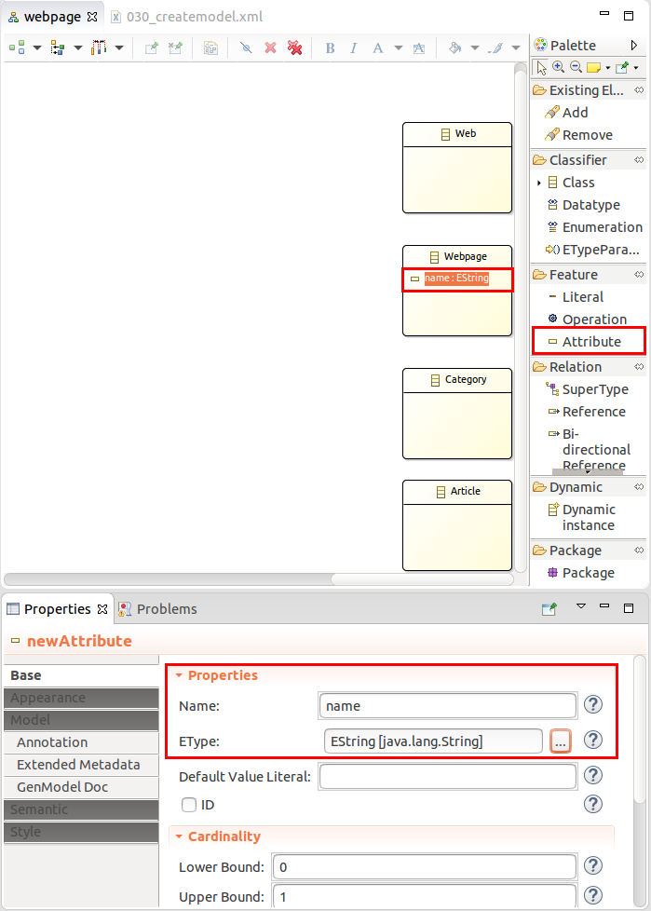
Eclipse ECORE

Slide 43
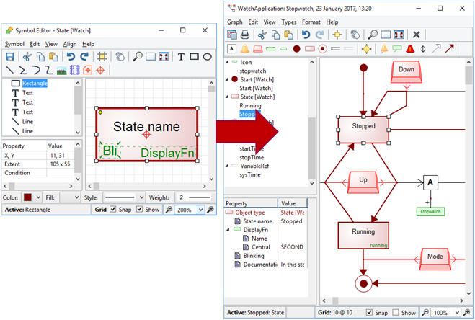
MetaCase

Slide 44
Coming up
Code Generation with EGL (Epsilon Generation Language)

