Slide 1
Investment Choice in Collective Funds
John Armstrong
Cristin Buescu King’s College London

Slide 2
The potential benefits of choice
Can we combine the benefits of collective and individual funds? Can we quantify the benefits?

Slide 3
Survivor fund structure
Maintain separate accounts for each investor at all times
Distribute funds of deceased in proportion to their contribution
Contribution := Wealth at end of period × Probability of dying over period
Intuitively fair
The more you are likely to leave behind, the more you receive
The better investment decisions you make, the more you receive
In the infinite fund limit it is equivalent to the optimal situation of investors pooling only with others just like them.

Slide 4
Example
 | Investor 1 (Age 80) | Investor 2 (Age 70) | Investor 3 (Age 80)
Fund in 2023 | £200,000 | £300,000 | £250,000
Probability of dying | 0.2 | 0.1 | 0.2
Pension for 2023 | £20,000 | £15,000 | £20,000
Investment strategy | High risk | Low risk | High risk
Return for 2023 | 8% | 2% | 8%
Survival | Survived | Survived | Died
Funds before redistribution | £194,400 | £290,700 | £248,400
Contribution | 0.2 × £194,400 = £38,880 | 0.1 × £290,700= £29,070
Amount received | £142,131 | £106,269
Fund in 2024 | £336,531 | £396,969

Slide 5
Mathematical model
To estimate the benefits we assumed a rational optimal investor.
Stochastic risk factors
Individual mortality (matched to CMI data)
Equity returns
Deterministic risk factors
Everything else: CPI, gilt returns, triple lock etc. chosen to match OBR figures in 2019
Three parameter risk preference model
Satiation parameter (matched to elasticity of intertemporal substitution evidence)
Adequacy level (matched to DWP data)
Risk parameter
Individual finances
Median earner at retirement
Pension exactly sufficient to give an adequate pension

Slide 6
Collective fund outcome

Slide 7
Comparison with individual fund

Slide 8
Quantifying the benefit of choice
Our representative investor is 20% better off in a collective fund with choice than either
A collective fund targeting constant income (or equivalently an annuity)
An individual fund without longevity pooling
This takes into account risk and is scaled in cash terms
An annuity that provides the same risk-adjusted welfare as a collective fund would cost 20% more than you need to invest in the fund.

Slide 9
A wealthy, highly risk-averse investor

Slide 10
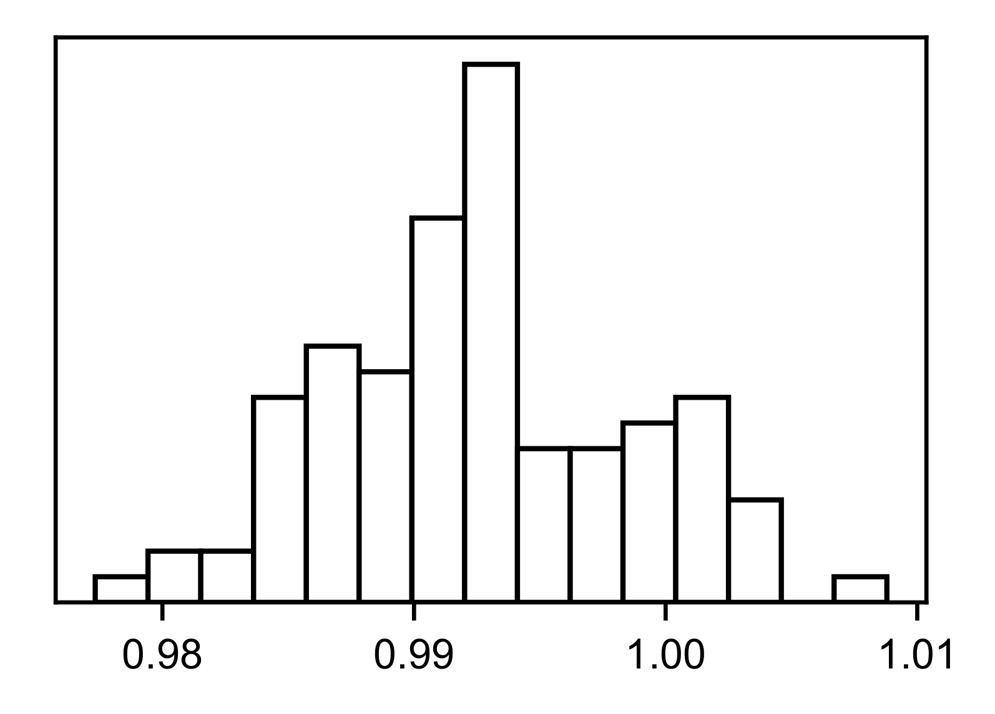
How large a fund is required?
Simulated a fund of 100 investors – varying wealth, preferences, mortality
Each investor made decisions as they would if all investors were identical to them
We plotted a histogram of the proportion of the maximum welfare benefit that they actually received.

Slide 11
Further risk sharing?
Risk sharing by a central planner leads to perceived unfairness
Investors might choose to exchange mutually beneficial insurance contracts
These contracts could be priced by requiring the market clears

Slide 12
Conclusions
Investor choice can be implemented in collective funds
Investors don’t have to follow any particular strategy
We estimate a 20% benefit for a representative individual who invests optimally
The funds do not need large numbers of members to achieve the potential benefit
Further benefits may be possible by creating an internal insurance market

