Slide 1
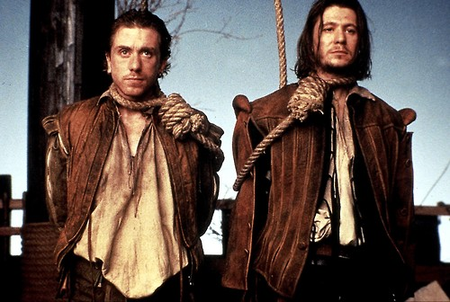
Rosencrantz and Guildenstern are Dead

Slide 2
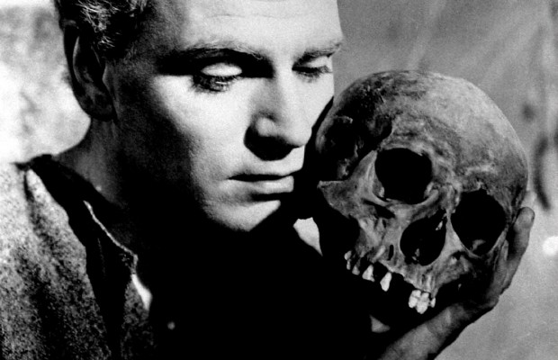

Slide 4
7400000000
338

Slide 5
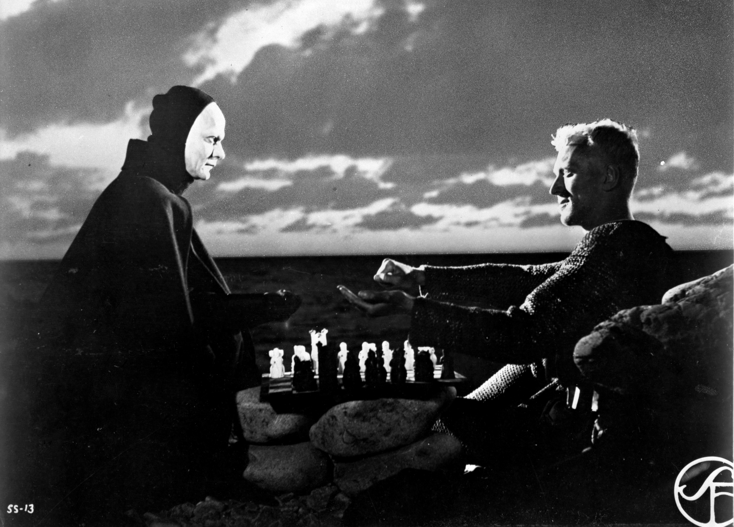
Destiny?
Chance?
Free Will?

Slide 6
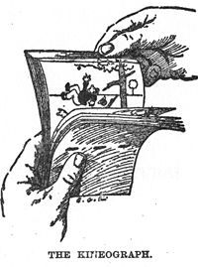
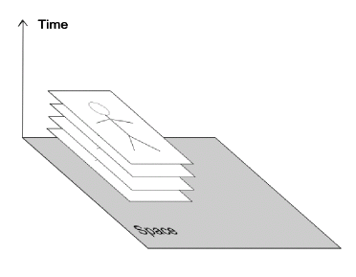

Slide 7
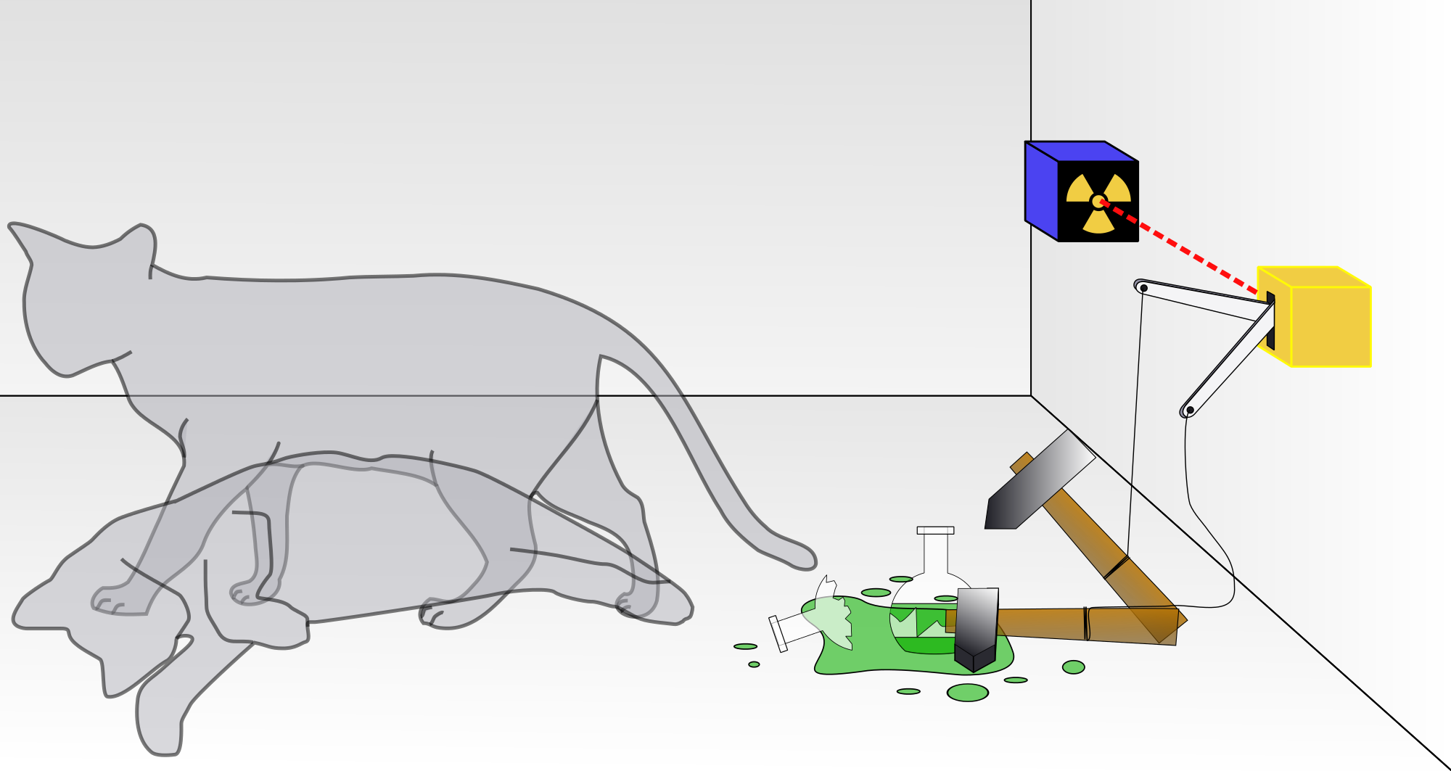

Slide 8
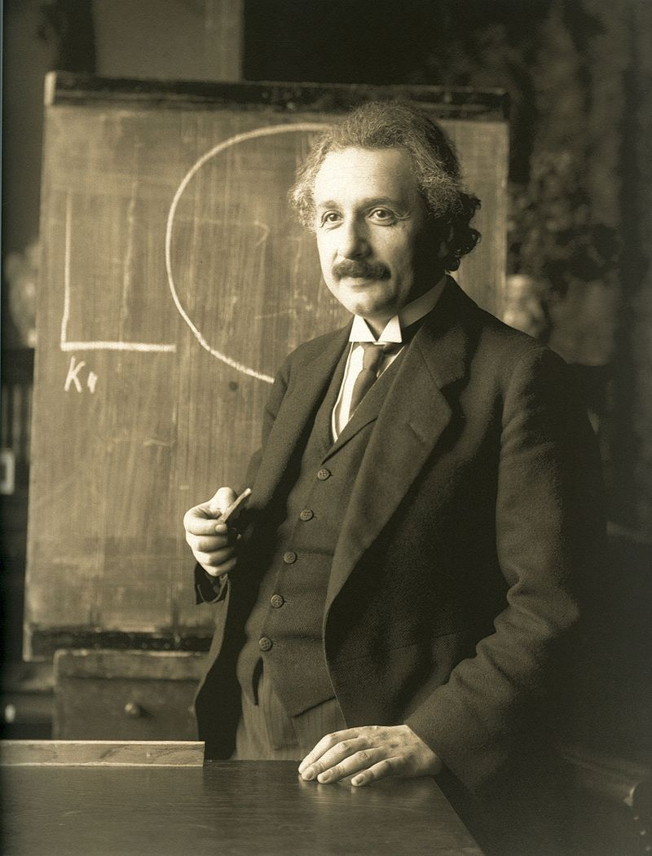

Slide 9
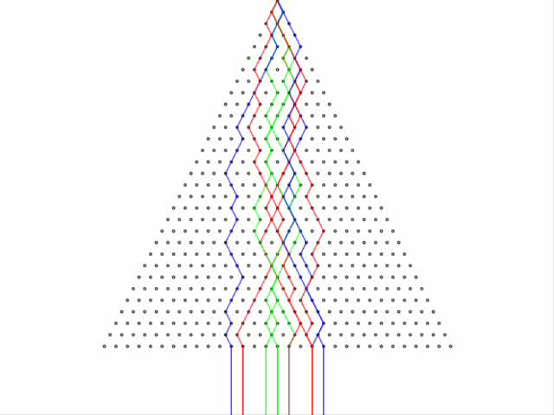

Slide 11
Two Facts
A. Any closed physical system will eventually get back to a state close to where it started.
B. The disorder of a system always increases

Slide 12


Slide 13
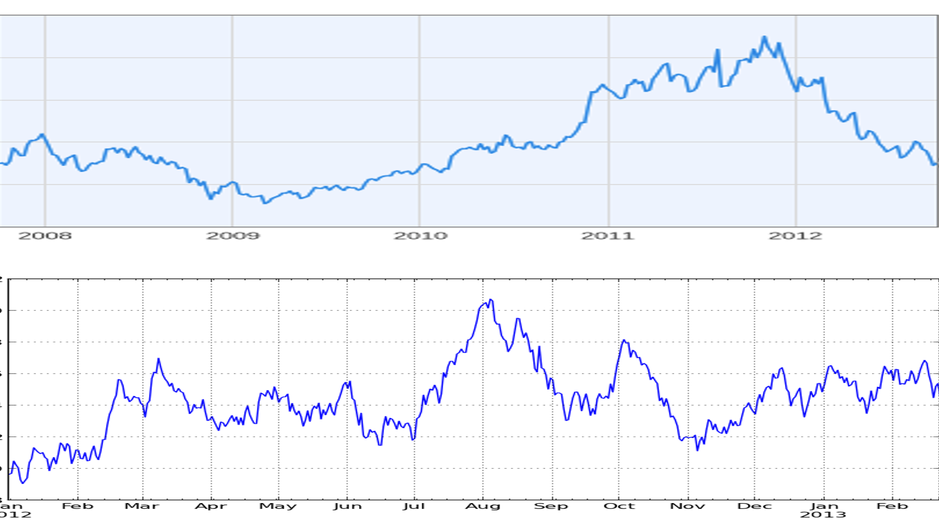

Slide 14
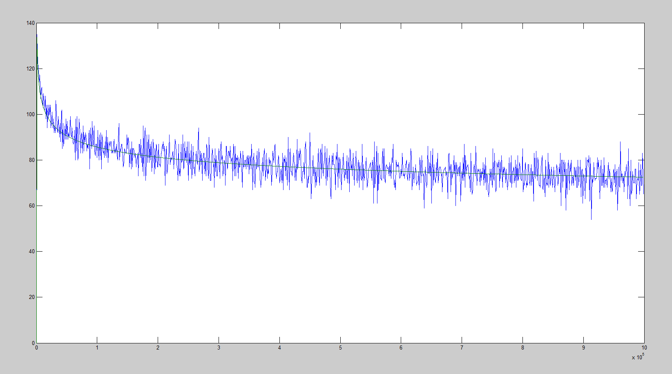

Slide 15
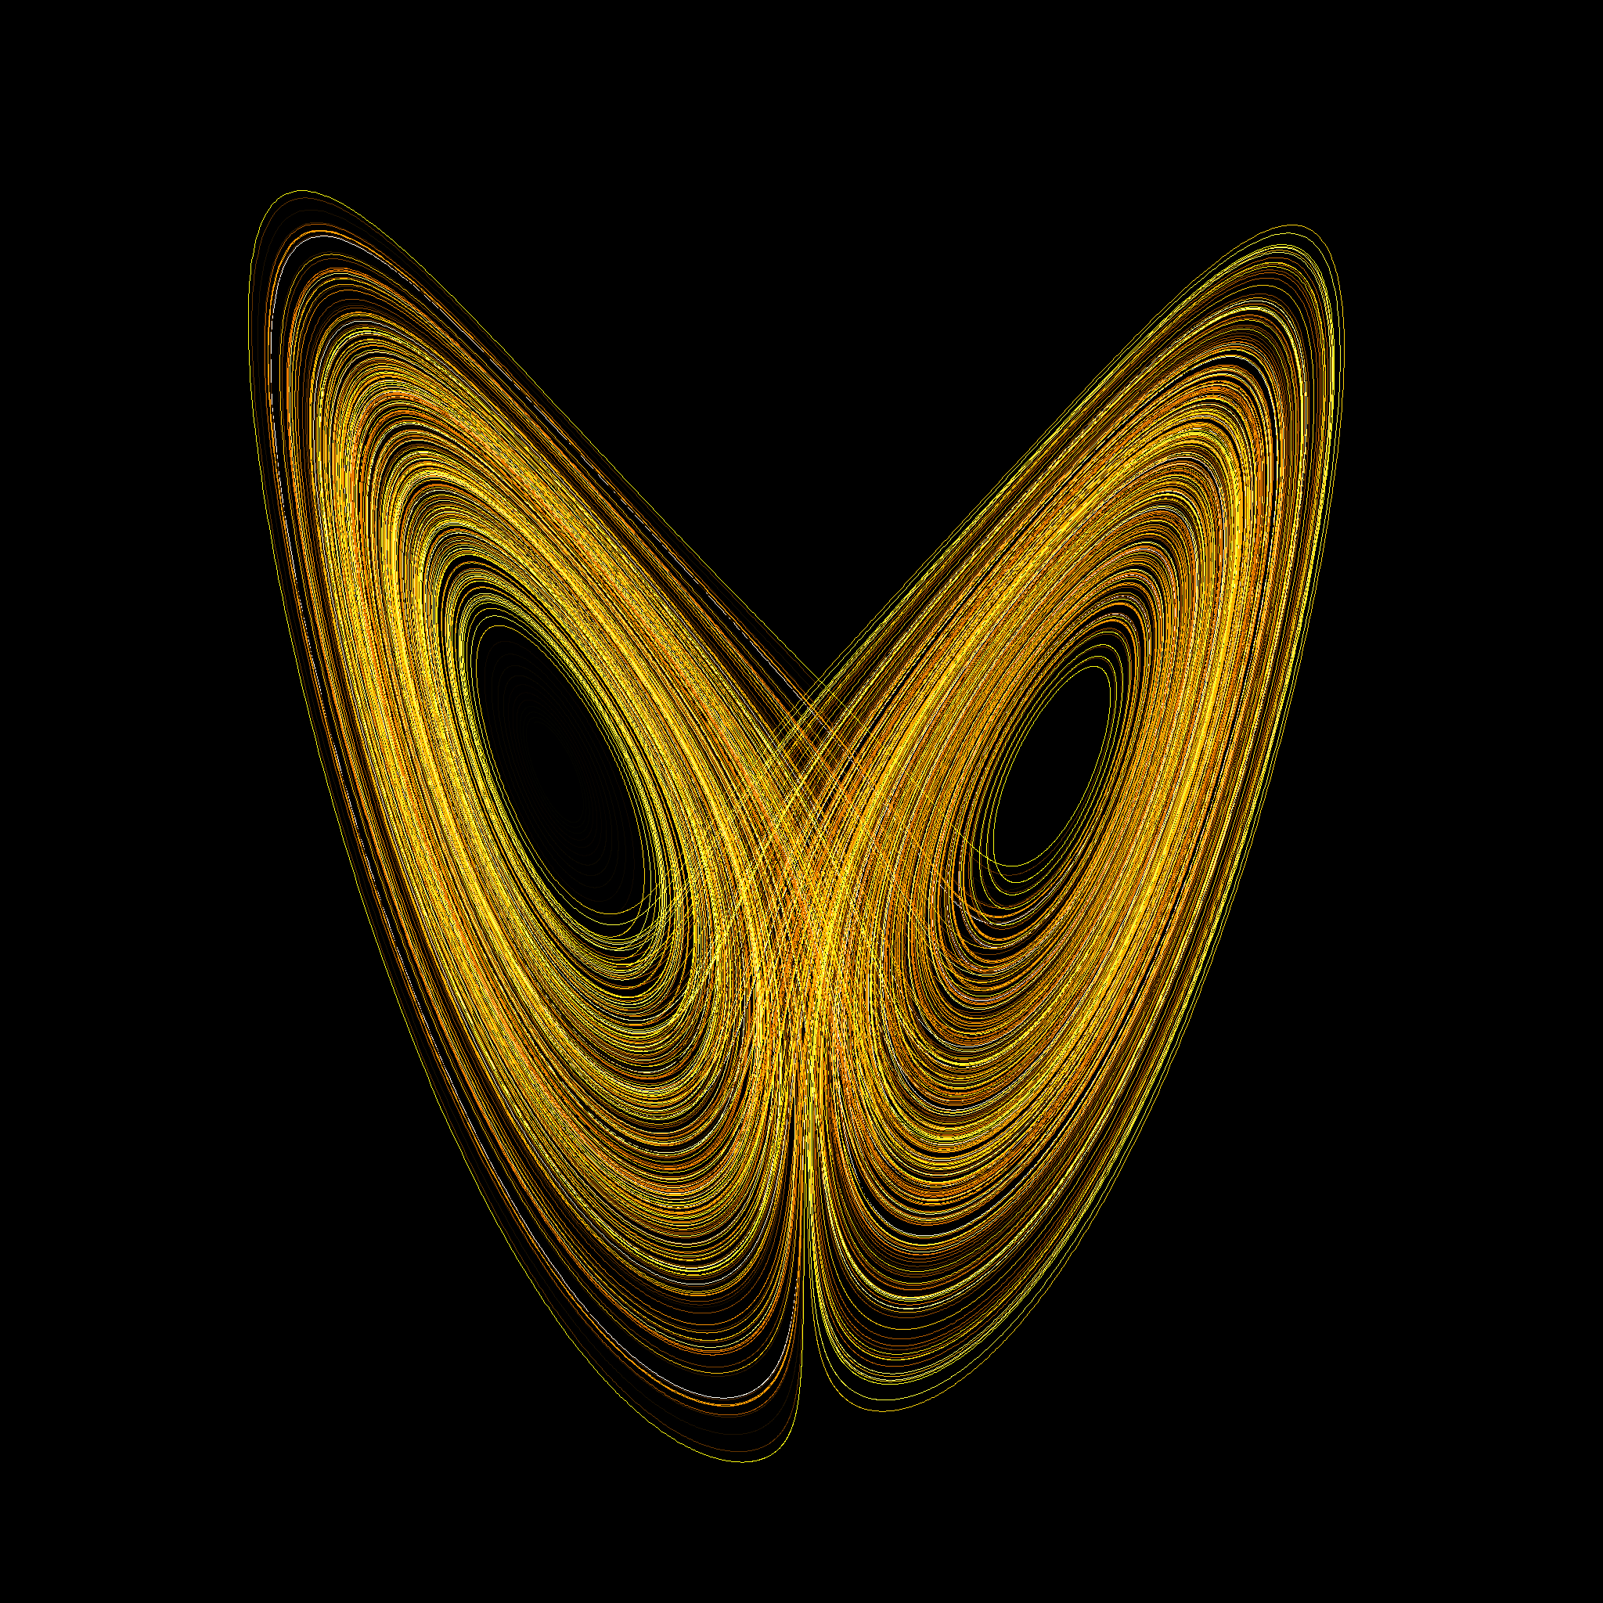

Slide 16
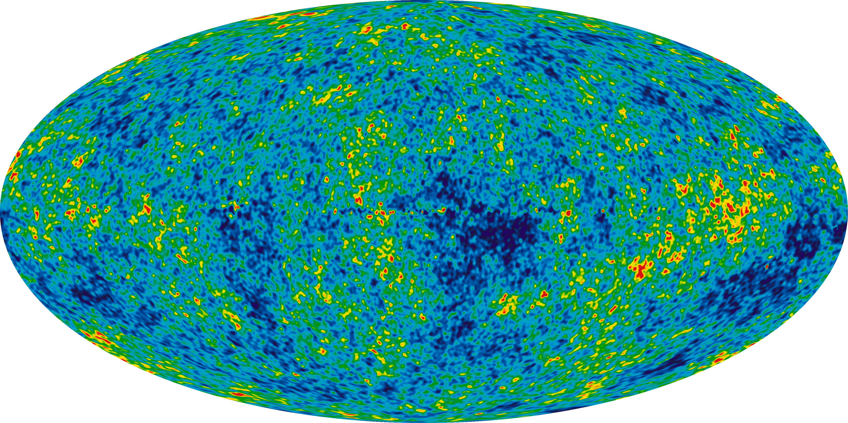

Slide 17
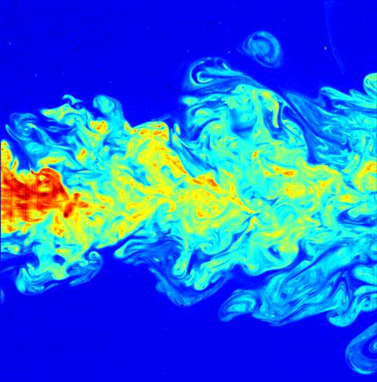

Slide 18
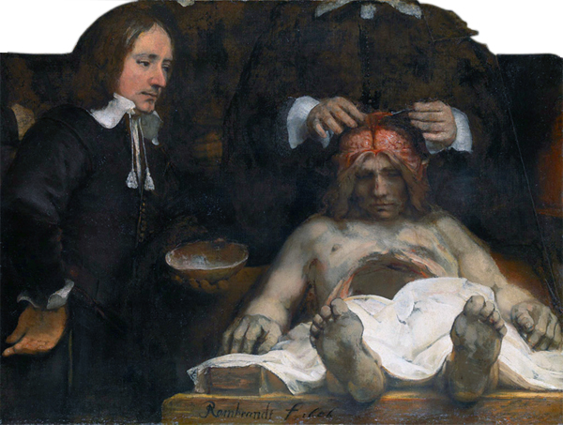

Slide 19
Factors affecting social destination
Parent’s social class
Parent’s qualifications
Cognitive test results age 5
Cognitive test results age 10
School type
Exam performance 16
Exam performance 18
Highest qualification
83% of variance unexplained

Slide 20
Destiny
Chance
Free Will

Slide 22
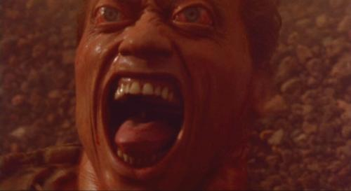

Slide 23


Slide 24
Destiny
Chance
Free Will

Slide 25


Slide 26
Destiny
Chance
Free Will

Slide 27
Stills from:
Rosencrantz and Guildenstern are Dead (Tom Stoppard, 1990)
Hamlet (Laurence Olivier, 1948)
The Seventh Seal (Ingmar Bergman, 1957)
Total Recall (Paul Verhoeven, 1990)
Wall Street (Oliver Stone, 1987)
Other images Wikimedia and John Armstrong

