Slide 1
Bioinformatics Goes Translational: Infrastructural Challenges and Opportunities in Big Data and Precision Medicine
Rolf Apweiler
Director, EMBL-EBI
www.ebi.ac.uk

Slide 2
Tremendous success of life sciences
Biology the leading science discipline
Hypothesis driven research
Data driven research
  Especially generation of sequencing data and other Omics data with the human genome project as the big bang event

Slide 3
EMBL-EBI data growth

Slide 4

Biology data very complex and varying
Molecular biology was always at the forefront of open data/open access/data sharing/data reuse/data integration
Databases were and are central for the development of modern biology

Slide 5
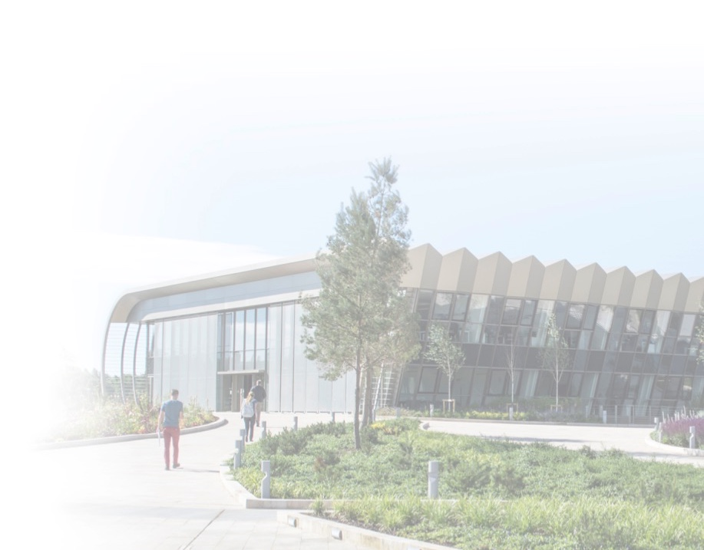
What is EMBL-EBI?
Europe’s home for biological data services, research and training
A trusted data provider for the life sciences
Part of the European Molecular Biology Laboratory, an intergovernmental research organisation
International: >600 members of staff from >60 nations
Home of the ELIXIR Technical hub

Slide 6

Our funders
EMBL-EBI is primarily funded by EMBL member states.
Other major funders:
  European Commission
  Research Councils UK
  National Institutes of Health
  Wellcome Trust
  Industry

Slide 7

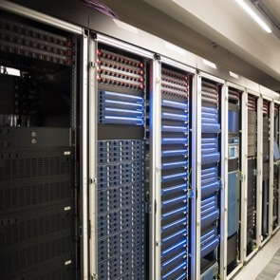
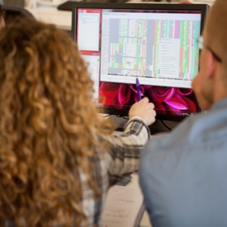
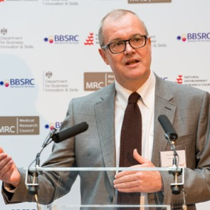

Our mission
Deliver excellent research
Deliver scientific
services
Train the next generation of scientists
Engage with European industry
Coordinate bioinformatics in Europe

Slide 8
EMBL-EBI Service Mission
To enable life science research and its translation to medicine, agriculture, the bioindustries and society by providing biological data, information and knowledge

Slide 9
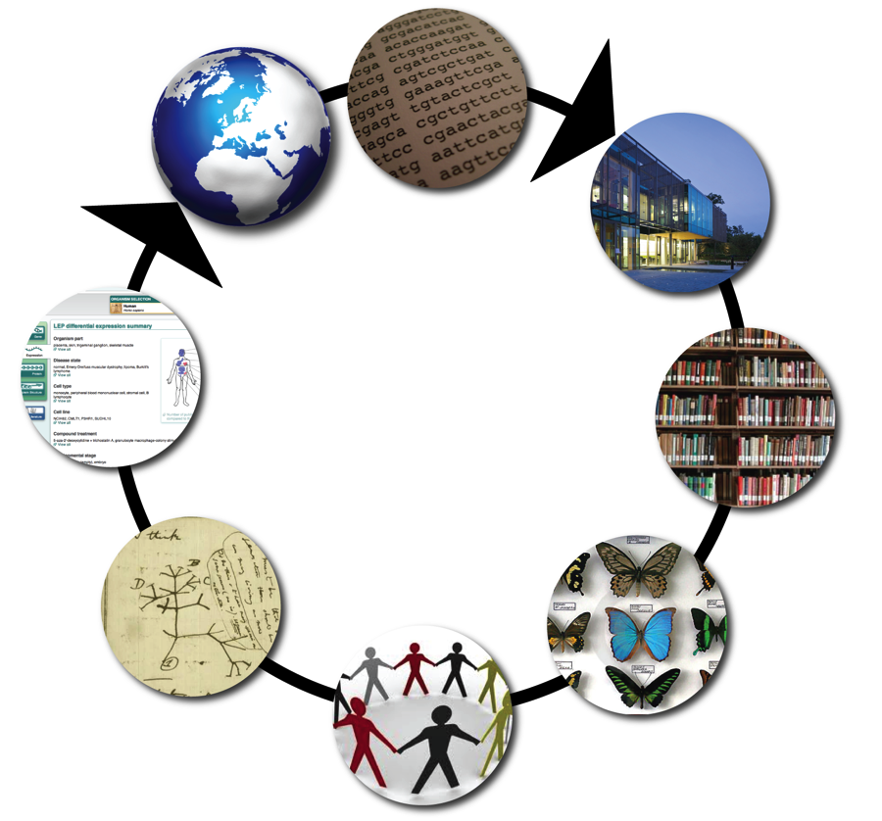
What services do we provide?
Labs around the world send us their data and we…
…provide tools to help researchers use it
Analyse, add value and integrate it
A collaborative
enterprise
Archive it
Classify it
Share it with other data providers

Slide 10
Data resources at EMBL-EBI
Genes, genomes & variation
Ensembl
Ensembl Genomes
GWAS Catalog
Metagenomics portal
Gene, protein & metabolite expression
Expression Atlas
Metabolights
PRIDE
RNA Central
Protein sequences,
families & motifs
InterPro
Pfam
UniProt
Molecular structures
Protein Data Bank in Europe
Electron Microscopy Data Bank
Literature & ontologies
Experimental Factor Ontology
Gene Ontology
BioStudies
Europe PMC
Chemical biology
ChEBI
ChEMBL
SureChEMBL
Systems
BioModels
BioSamples
Enzyme Portal
IntAct
Reactome
Molecular Archives
European Nucleotide Archive
European Variation Archive
European Genome-phenome Archive
ArrayExpress
Notes:
The slide shows the core resources at the EBI to show the range of data you can access through the EBI.

Slide 11
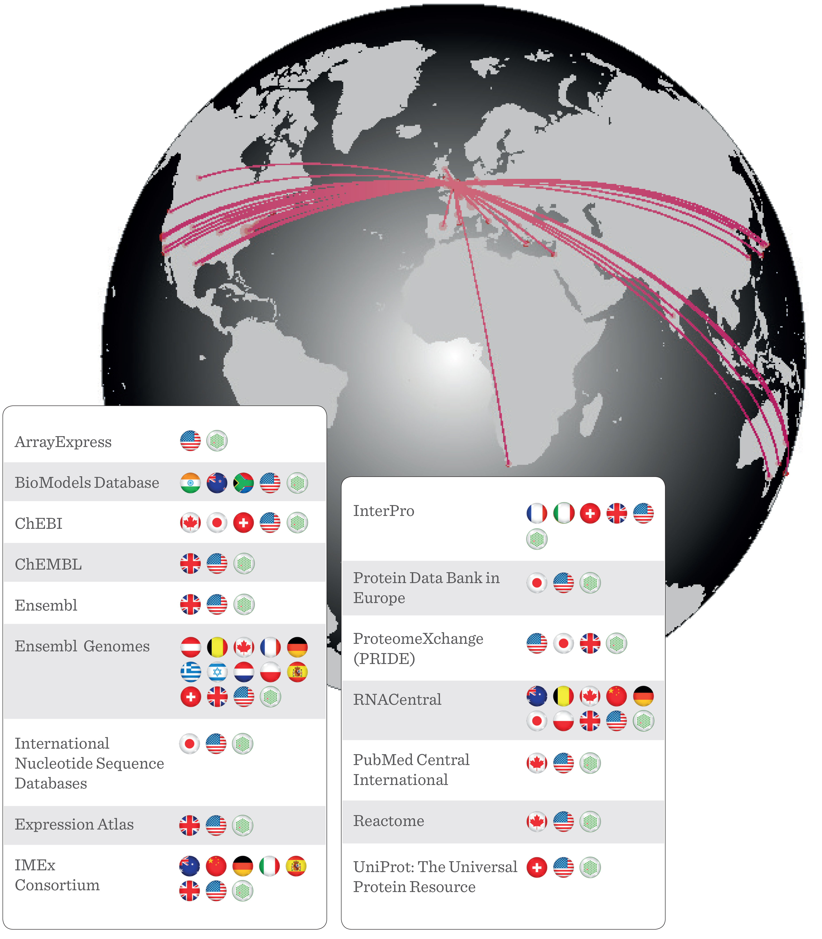
Major Database Collaborations
Our data resource teams collaborate with organisations throughout the world
Internal collaboration essential
Integration of public molecular data for the global scientific community
Network makes open data possible and sustainable.

Slide 12
Big data, big demand
>37 million
requests to EMBL-EBI websites every day
Scientists at over
5 million
unique sites use
EMBL-EBI websites
EMBL-EBI handles
> 14 million
jobs on average per month
> 200 petabytes
of EMBL-EBI storage capacity
Notes:
Compressed nucleotide sequence data: 2.58 petabytes stored
Genomes, all species and strains: 20 343
Gene expression assays: 1.62 million
Protein sequences: 89.1 million
Macromolecular structures: 105 444
Protein families, motifs and domains 27 002 entries
Top 1%: ‘Ranking web of Reseach Centres’ for ‘the processes of generation and scholarly communication of

Slide 13
Looking ahead

Slide 14
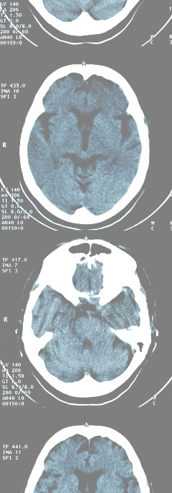
Opportunities: New data
Next-generation sequencing data
  Human variation
  Single cell analysis
Images
  High resolution light microscopy
  3D cellular imaging techniques, e.g. 3D scanning-electron microscopy (3D-SEM), soft X-ray tomography (SXT), correlative light and electron microscopy (CLEM)
  Tomography
  Cellular and organismal atlases
  Complexes
Medical data
Unstructured data
  e.g. supplemental data from articles

Slide 15
Opportunities: New knowledge
Connecting to medicine and agriculture, biodiversity and environmental science
Exploring genetic variation data & phenotypic correlates
Towards understanding human biology

Slide 16
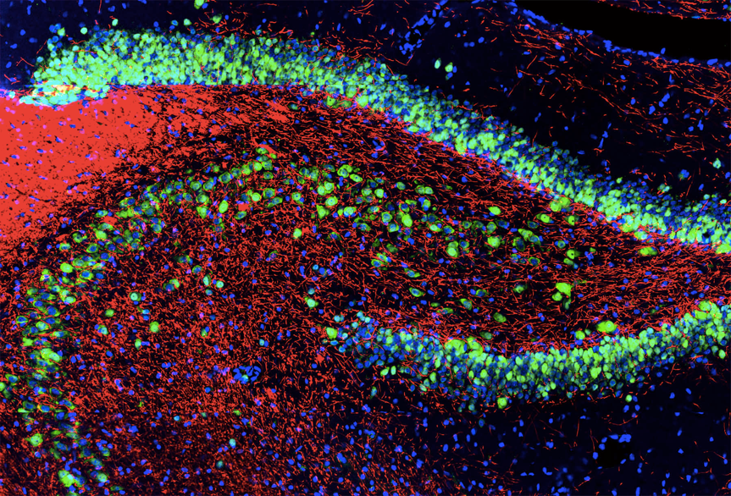
A comprehensive atlas of all human cells
Redefining human anatomy
Better comprehension of human biology
Enabling improved understanding, diagnosis and monitoring of disease
Image Credit: EnCor Biotechnology Inc and Gerry Shaw
Notes:
The initial atlas is targeting openly consented samples from as many different issues as possible to build this reference atlas providing the community with a comprehensive description of all human cells improving our ability to understand, diagnose and monitor disease.

Slide 17
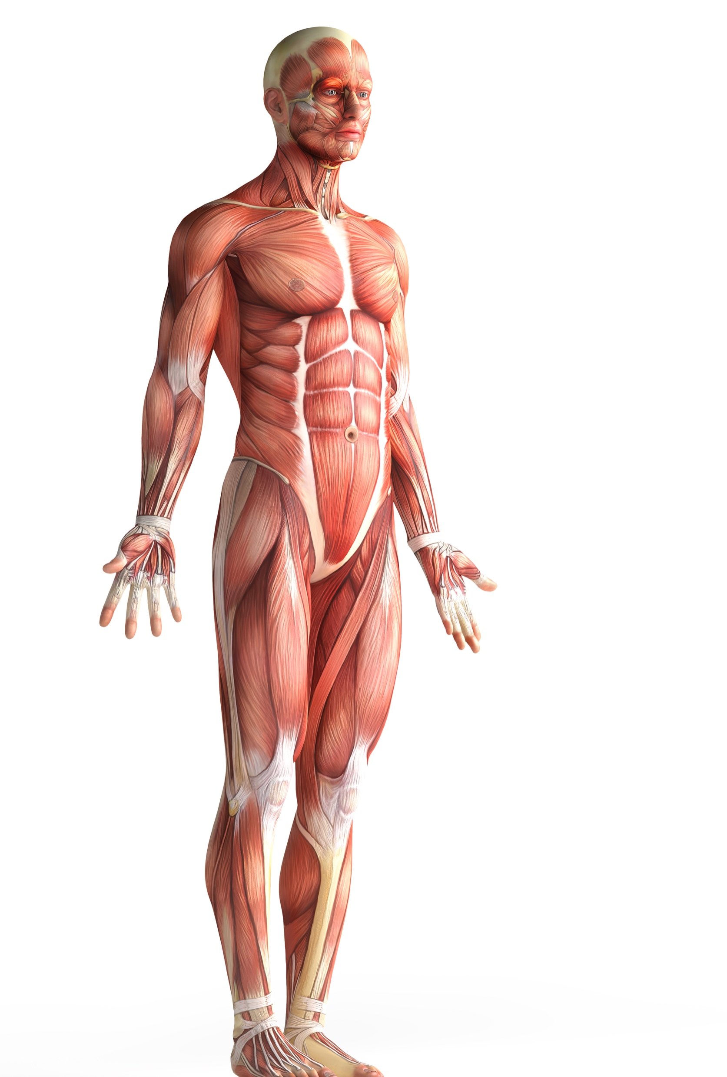
A comprehensive atlas of all human cells
37 trillion cells in the human body
Textbooks/Wikipedia
  200-300 cell types
  https://en.wikipedia.org/wiki/List_of_distinct_cell_
  types_in_the_adult_human_body
Science
  Approx. 100 subtypes of retinal neurons
  Dozens of immune cell types
Notes:
There are 37 trillion cells in the human body but text books suggest there are only between 200 and 300 cell types, recent experiments suggest this is a gross underestimate.

Slide 18






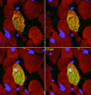

A comprehensive atlas of all human cells
Type
Location
State
Interactions
Transitions
Lineage
Notes:
The Human Cell Atlas will produce a systematic reference map of all cells in the human body, This atlas will not only cover cell type but other facets of a cell’s behaviour such as state, transitions between cell types, lineage of cell types, interaction between cells and a cells local neighbourhood

Slide 19

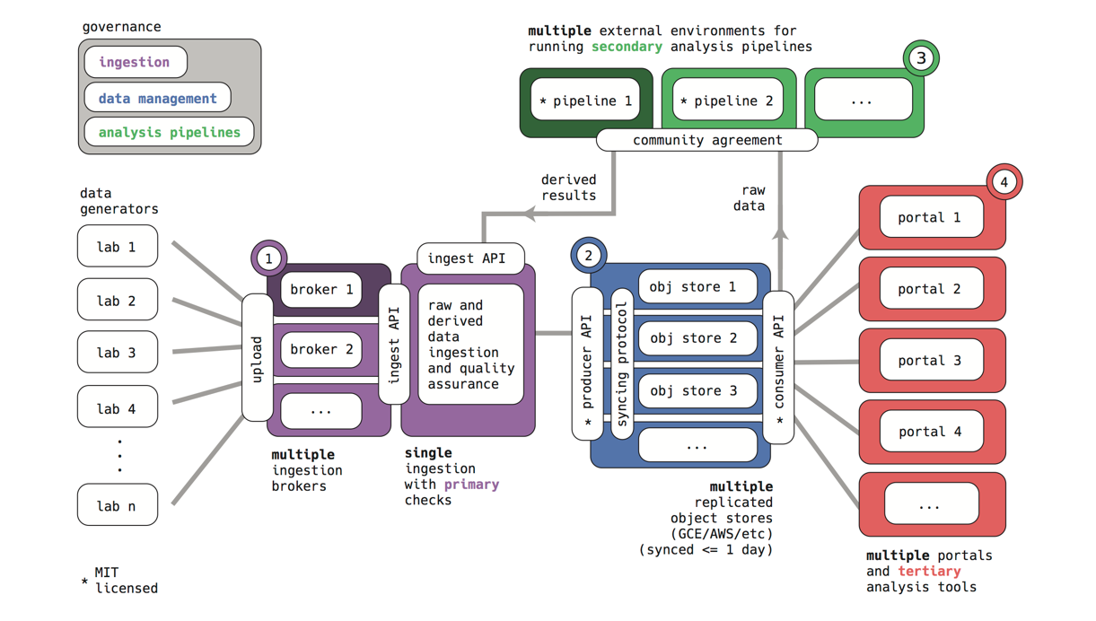



The Human Cell Atlas Data Coordination Platform
Notes:
Of course such an undertaking requires a significant computational infrastructure to ensure the large volume of data is useful and accessible to the whole scientific community. EMBL-EBI is collaborating with the Broad, UC Santa Cruz and the Chan Zuckerberg Initative to build the HCA Data Coordination Platform to ensure the data from this project is collected in and available to the community in a sustainable and scalable manner.

Slide 20
The Human Cell Atlas Data Coordination Platform
Modular
Cloud based
Transparent Development
Open Source code
Open Data
Supports Reproducibility
Notes:
The DCP team are building a modern, cloud-based, modular architecture for organizing and sharing data for the Human Cell Atlas. All software will be developed in the open and made available as open source.

Slide 21
Our role in the HCA Data Coordination Platform
Leading Ingestion Infrastructure
  Submission API
  Validation Service
  Marshall Data and Metadata into HCA Cloud Store
Supporting users providing data
  Accessibility through the Single Cell Expression Atlas
  User interface design
  User support and Training

Slide 22
Bioinformatics goes translational

Slide 23


Genomics: from research to healthcare
Research
English language
Light-weight legal
Similar systems
Open data
Publications
Grant funding
Practicing Medicine
National language
Heavy legal framework
Different systems
Closed data
Not published
Contract funding

Slide 24
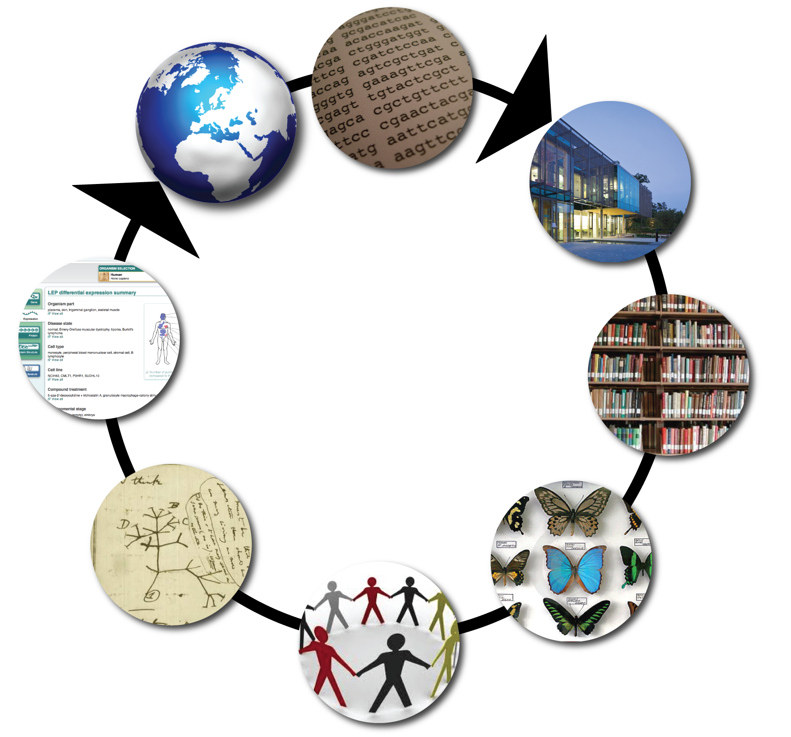
Clinical data?
Nurses in hospitals collect data
Few tools for data analysis since data not available
Rarely stored in a computer-friendly systematic way
Data analysis limited to a few research hospitals
A not-so collaborative
enterprise
Clinicians interpret data & treat patients
Little data sharing

Slide 25


Health Care systems
NHS
Single Payer
“Single” organisation outside of GPs (eg, NICE payment rules)
Commissioning moving to primary health care
Standards by NICE
Gesetzliche und private Krankenversicherungen
Multiple payer
Hospitals and independent GPs and consultants (Facharzt)
Commissioning by insurance companies
Standards by IQWiG

Slide 26
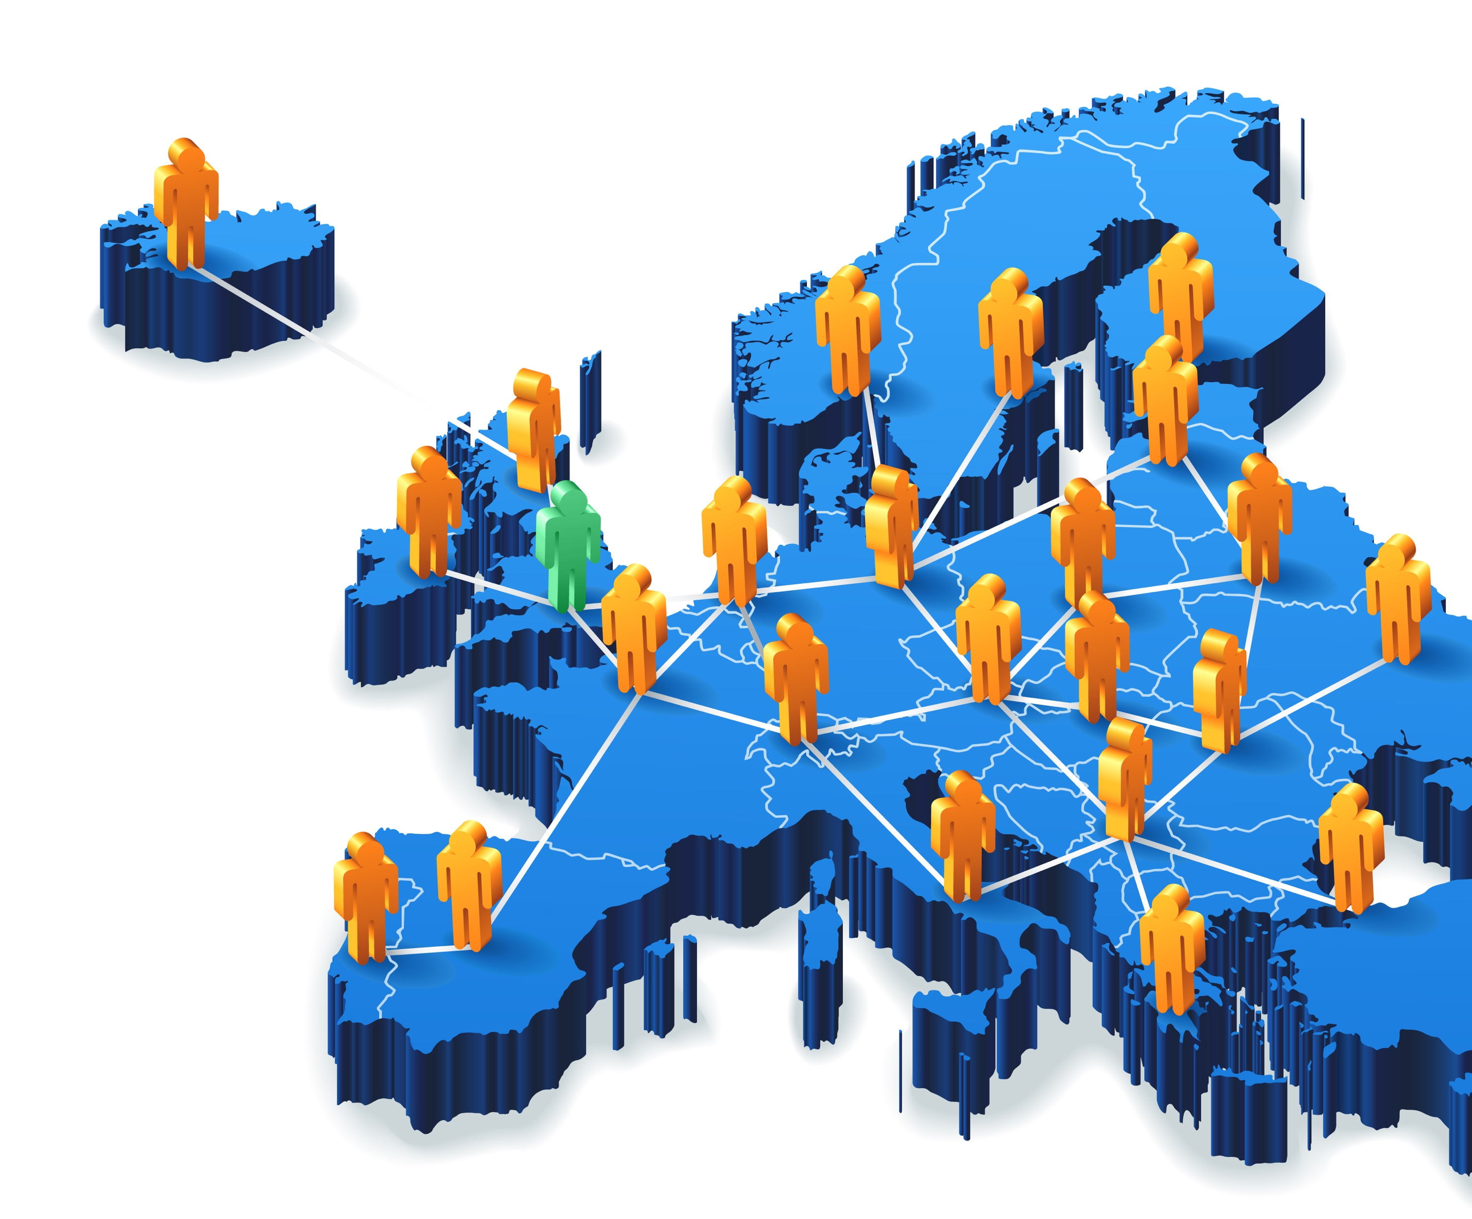
Long term goal for clinical data in Europe
Ideally each European nation state should establish an “Institute for Biomedical informatics” and EMBL-EBI should interact with them
In bigger nations, this is likely to be a network, but with a centre of gravity
EMBL-EBI (and ELIXIR) will handle research style data, sharing it between researchers (including clinical researchers)
These “BMI” institutes will have responsibility for exploiting molecular reference data and ensure “open research” data flows back to enhance the core reference data at EMBL-EBI and is made available to researchers

Slide 27
EMBL-EBI long term goal
Reference Information Inc. Reference Disease
DE
UK
FI
Skill set:
Honest Broker for data sharing
Long-horizon information management
Integration across biological domains
Large scale disk, compute, network
Knowledge extraction/management
Algorithms and Statistics
International and Consortium interactions

Slide 28

Global standards: the GA4GH
GA4GH is the standards-setting
body for genomics in healthcare
    Embraces federated approach
    Setting community standards early
Cloud: Analysis carried out where the data ‘lives’
“You’re already using it!”: SAM/BAM/CRAM/VCF formats
Tools: htsget – the first step away from file-based access
Rare disease diagnoses: Matchmaker Exchange
Federated discovery: GA4GH Beacons

Slide 29


Federation
Open research data
Healthcare data
with research use
analysis
analysis
Aggregate data globally
Download, analyse locally
Analyse data locally (via VMs)
Collate analyses

Slide 30
Controlled Access Data: EGA

Slide 31
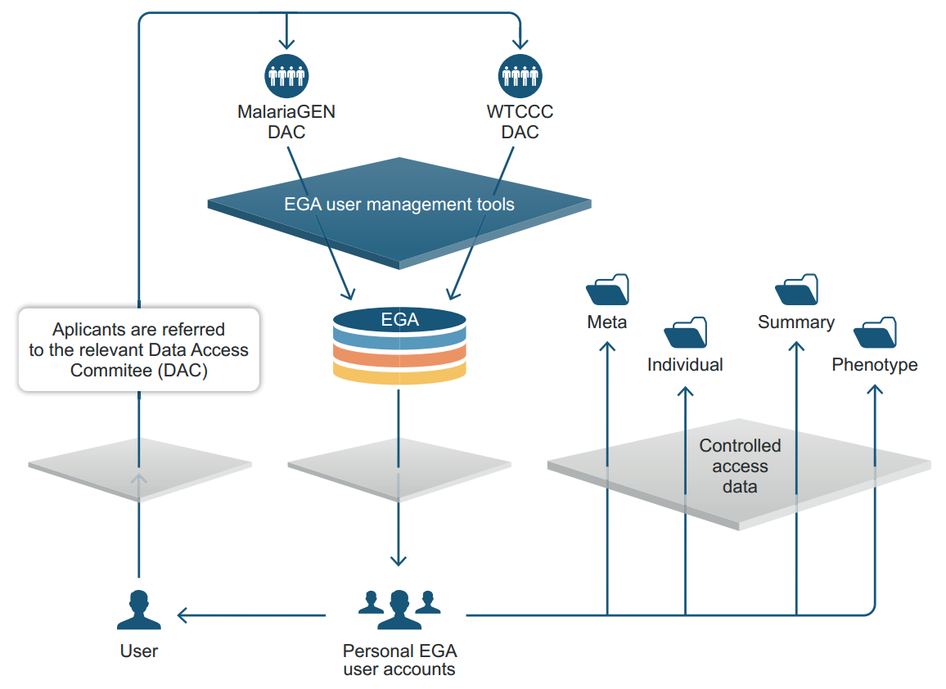
What is the EGA?
The EGA is a resource for permanent secure archiving and sharing of all types of potentially identifiable genetic and phenotypic data resulting from biomedical research projects.
Data is provided by research centers and health care institutions.
Access is controlled by Data Access Committees.
Data requesters are researchers from other research or health care institutions.

Slide 32
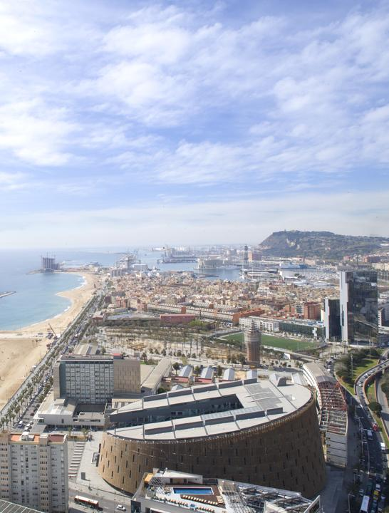
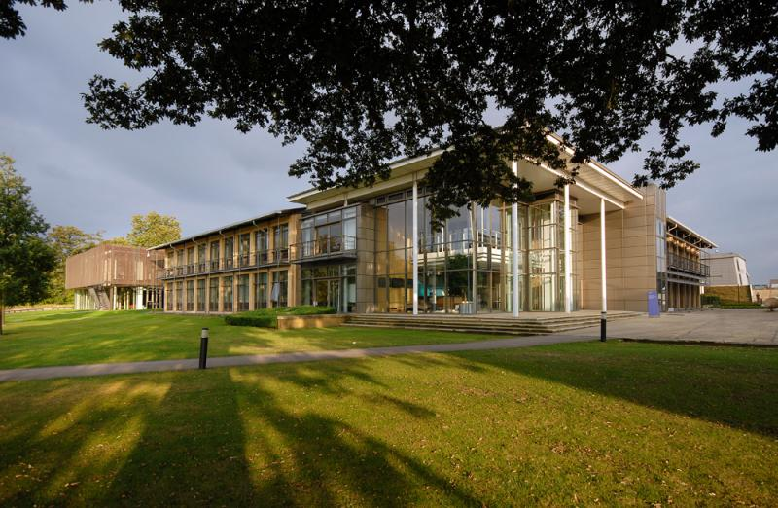
How the EGA is managed
In 2012, EBI and CRG started working together to establish EGA as a joint resource, which has grown in the context of ELIXIR
The EGA was launched in 2008 by the EBI

Slide 33
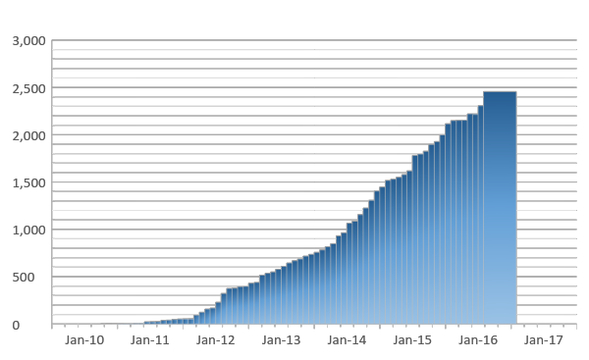




The EGA contains a growing amount of data
~650,000 files*
>2.5 PB*
July-2010
May-2016
* Files encrypted in different formats are counted only once

Slide 34
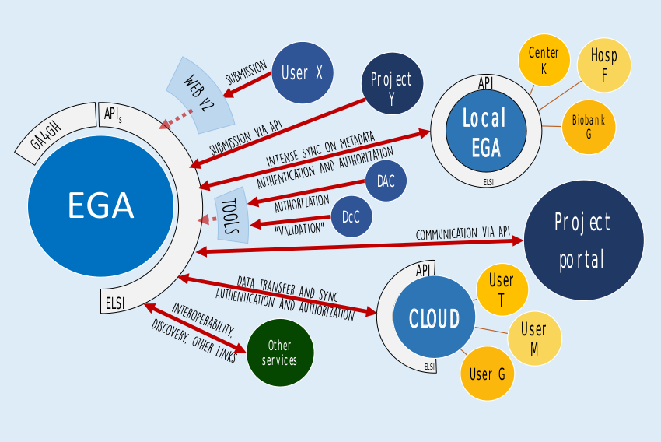
EGA federation (future)

Slide 35

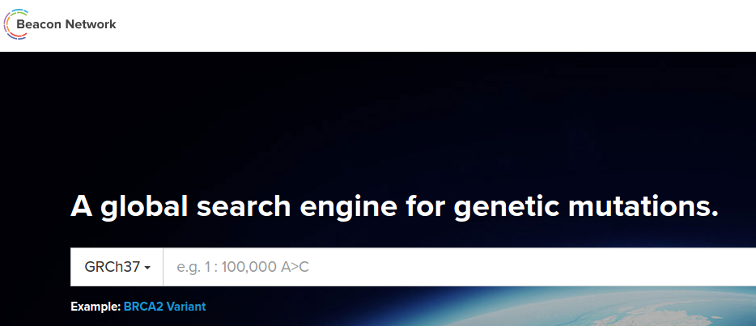
Global Alliance for Genomics and Health (GA4GH)
Beacon
  Developing V0.3 specification (complete)
Regulatory and Ethics
  Consent Codes
Software Security
  Beacon security / AAI
  Re-identification attacks and mitigation
Genomics file formats and streaming/transfer protocols

Slide 36
ELIXIR: The Global European Bioinformatics Research Infrastructure

Slide 37
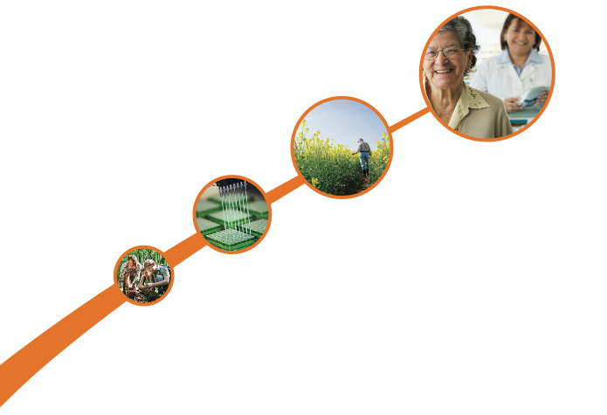
ELIXIR connects national centres and EMBL-EBI to build a sustainable European infrastructure for biological research data.
medicine
agriculture
bioindustries
environment
www.elixir-europe.org
Notes:
ELIXIR is a unique undertaking that consolidates Europe’s core bioinformatics resources, services, and national centres into a single, coherent platform.
ELIXIR support international collaboration, decision making and secures long-term sustainability.
Scientific services are brought together and connected to support scientific communities across the life-sciences - from marine research through plants and agriculture to health research on rare diseases.
Since last update in September
ELIXIR pilot actions: Marine, Data management and secure high volume data transfer building on gridFTP/Globus
Projects are all under way, report back outcomes next meeting
Established Training coordinators group – best practices and sharing of content across nodes
Talk through 3 developments today
Training
Industry advisory committee and long term planning
Planning for the large ELIXIR implementation project next year

Slide 38
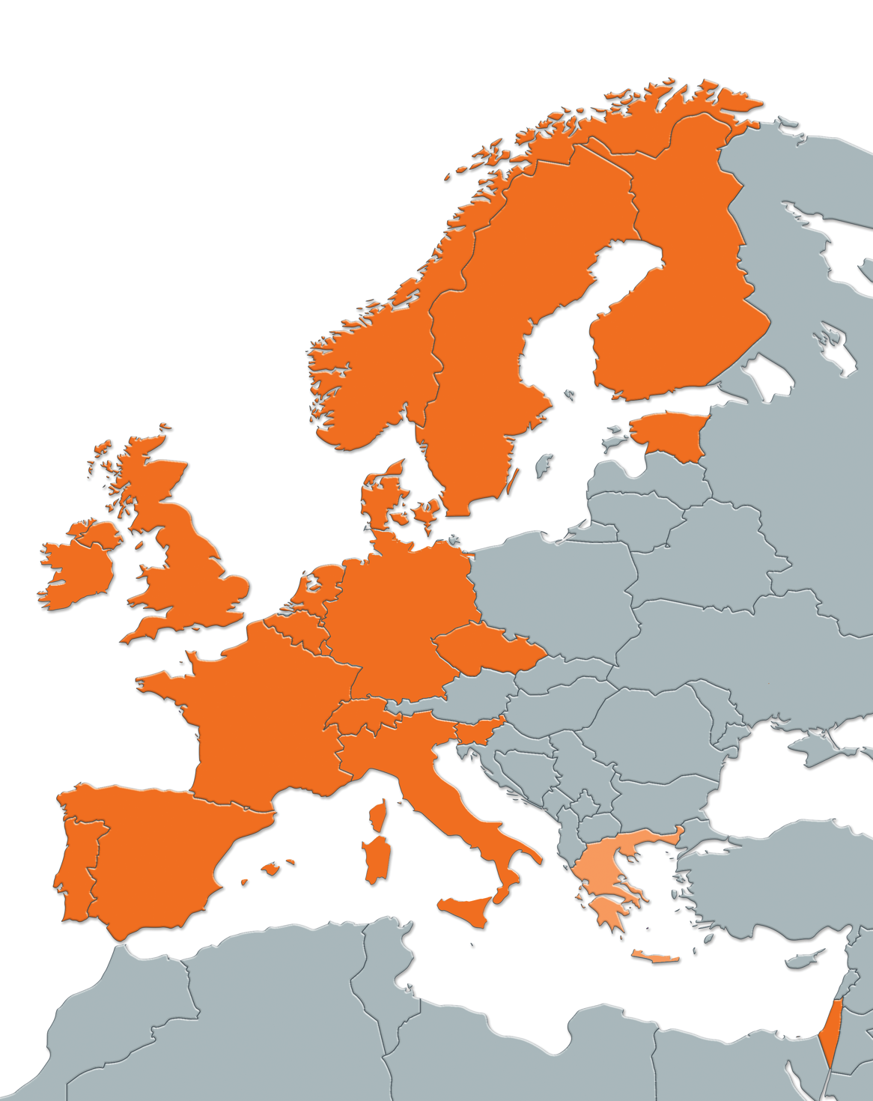
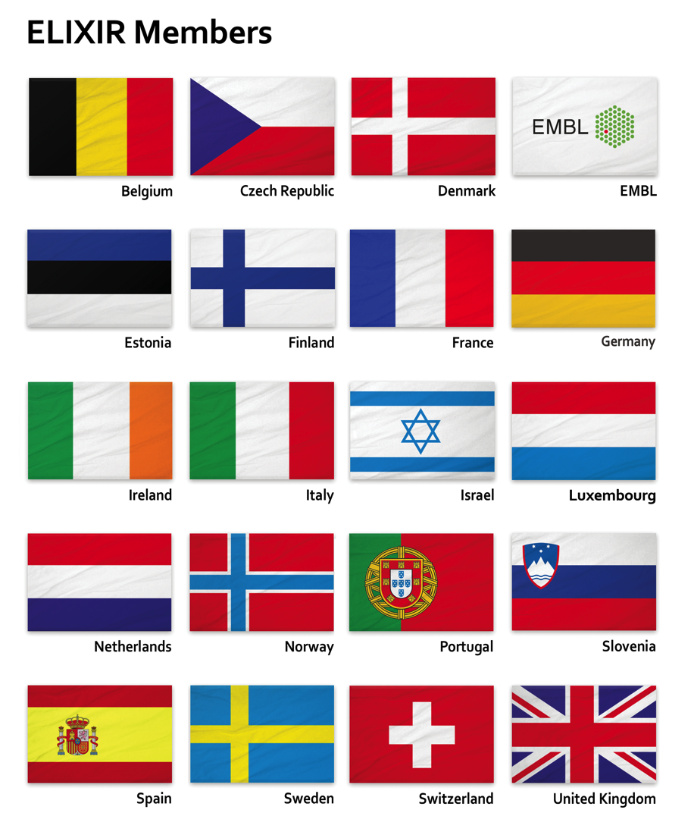
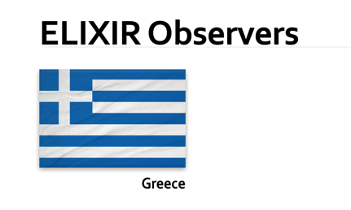
ELIXIR Membership

Slide 39
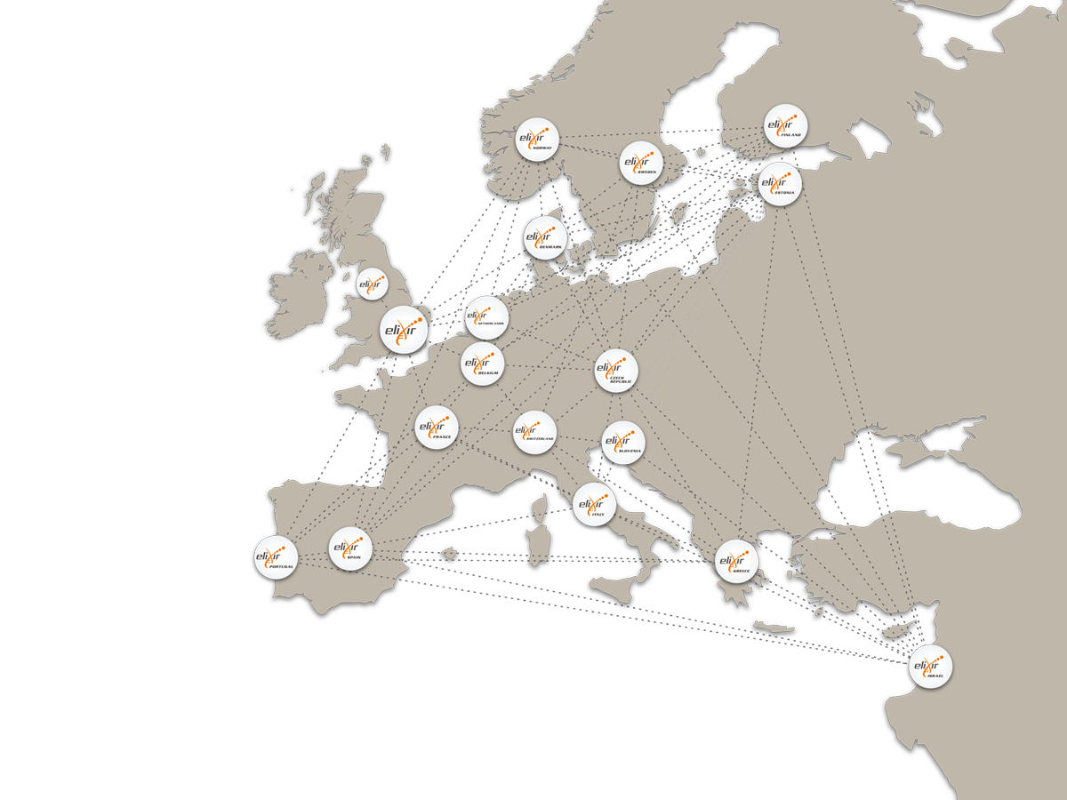
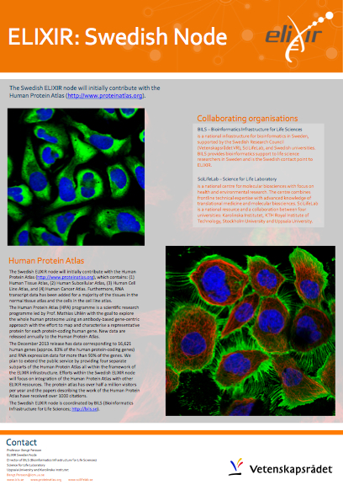
A network of data nodes
ELIXIR Nodes are funded nationally
ELIXIR Nodes support national research with data management
ELIXIR Nodes provides a national and international framework for long-term resource management.
Notes:
Creating a robust infrastructure for biological information is a bigger task than any individual organisation or nation can take on alone
These are issues of such complexity that no single institution or country can tackle alone
ELIXIR Nodes ensures local bioinformatics capacity throughout Europe

Slide 40
Data Roaming…
  Access of large, and growing, reference data sets
  Access human reference and study data
  Standardising, curating and depositing large data-sets

Slide 41
Thank you

