Slide 1
Perpetual maintenance of machines with different attendance frequency needs
Leszek A Gąsieniec, Jie Min (University of Liverpool, UK)
Ralf Klasing (Bordeaux University, France),
Christos Levcopoulos, Andrzej Lingas (Lund University, Sweden),
Tomasz Radzik (King’s College London, UK)

Slide 2
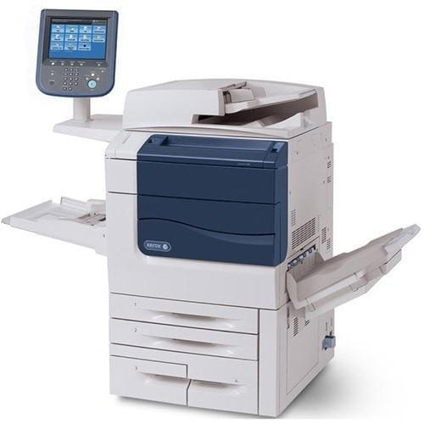
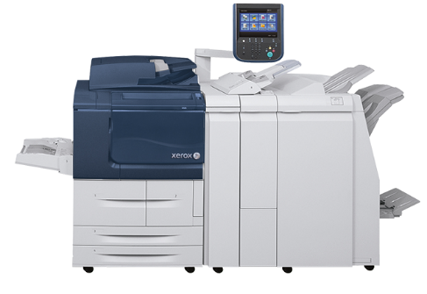
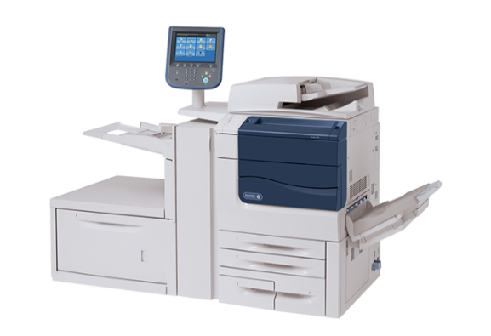
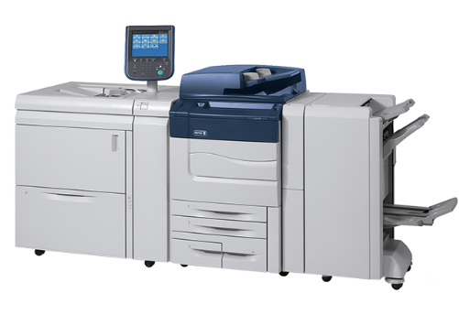
Perpetual maintenance of machines with different attendance frequency needs
Machines m₁, m₂, ..., m_{n} which need to be regularly serviced.
Each machine m_{i} has maintenance indicator x_{i} which is increased daily by h_{i}, where h₁ ≥ ... ≥ h_{n}.
Every day an engineer can service one m_{i}, reducing its indicator x_{i} to 0.
Perpetual Maintenance of Machines (PMM): design of a perpetual schedule with the goal of keeping maintenance indicators as low as possible (minimize max).
A schedule is an infinite sequence with each element in {1,2,…,n}: (2,3,2,4,3,2,1,4,…)

Slide 3
Generalized Maintenance Scheduling Problem
n machines m₁, m₂, ..., m_{n}.
In each time slot, at most M ≥ 1 machines can be scheduled for maintenance.
The cost of operating machine m_{i} in a current time slot is equal to c_{i}(d), where d is the number of time slots since the last maintenance of m_{i} and c_{i}(.) is a growing function.
Find an optimal schedule (an infinite sequence (S₁, S₂, … ), S_{t} subset of {1,2, … , n}, |S_{t}|≤ M) which minimizes the long-run average operating cost per time slot.
Applications:
Broadcast disks - a broadcast system with clients waiting for different files; files have varied popularity, modelled by given probabilities of wishing to access particular files; “operating costs” ≈ expected waiting time; minimize the (long-run) expected waiting time.
Multi-item replenishment – items are consumed with different rates
PMM: the “operating cost” for machine m_{i} is c_{i}(d) = dh_{i} but we want to minimize the maximum operating cost over all machines over all time slots.

Slide 4
PMM – minimize the maximum height
Initial state
Greedy approach
Growth rates $h_{i}$
Round 0
Round 1
Round 2
Round 3
x₁
x₂
x₃
x₄
x₅
x₆

Slide 5
PMM: minimize the maximum height
Let T be our target: we don’t want any (maintenance) indicator to grow above T
Find an (infinite) sequence with elements in {1,2, … , n} such that each 1 ≤ i ≤ n occurs infinitely many times and any two consecutive occurrences of i are at most T/h_{i} positions apart:
………………………i……………………i…………………………i………….
≤ T/h_{i} ≤ T/h_{i} ≤ T/h_{i}

Slide 6
Important lower (reference) bound H
Max height cannot be kept below $H={ h}_{1}+h_{2}+…+h_{n},$ which is equal to the total growth in one round
H
0
x₁
x₂
x₃
x₄
x₅
x₆
H – trivial optimal solution for the fractional relaxation of the problem.

Slide 7
Pinwheel Problem
f_{i} - frequency of item i (integer)
d_{i} = 1/f_{i} - density of item i
Schedule each item i so that any two consecutive occurrences are at most f_{i} positions apart
f
d
special instance of PMM,
target T = 1
2
1/2
Application:
Processing data from satellites,
each satellite has its own
requirement how frequently it should
transmit.
4
1/4
7
1/7
≤2
≤7
……………..
≤4

Slide 8
Pinwheel Problem
f_{i} - frequency of item i (integer)
d_{i} = 1/f_{i} - density of item i
Schedule each item i so that any two consecutive occurrences are at most f_{i} positions apart
f
d
Density of the instance
D = 1/2+1/4+1/7 = 25/28
2
1/2
4
1/4
Basic facts:
D>1, not schedulable
D≤1/2, easy to schedule
D<3/4, may be hard to schedule, but always possible
D>5/6, not always possible, e.g., d=2,3, large int. N
D=1, easy to schedule if all f_{i} are powers of 2
7
1/7
≤2
≤7
≤4

Slide 9
Periodic (Fair) Scheduling Problem
n tasks m₁, m₂, ..., m_{n}
Each task m_{i} has a rational weight (frequency requirement) e_{i}/p_{i}
Find a periodic-fair schedule which allocates a resource to a task m_{i} for exactly e_{i} slots in each interval [kp_{i}, (k+1) p_{i})
Example:
frequencies 1/2, 1/3, 1/6
periodic-fair schedule: (2, 3, 2, 3, 2, 6, 2, 3, 2, 3, 2, 6, ......)
pinwheel schedule not possible
Periodic-fair schedules exists for all instances with density ≤ 1 and can be found by simple greedy algorithms.
Deciding whether a given instance with density ≤ 1 admit a pin-wheel schedule is NP-hard.
no 3

Slide 10
Continuous PMM problem
It takes time $t_{ij}>0$ to move from machine m_{i} to machine m_{j}.
The machines are serviced instantaneously, only the travel time is counted.
Objective as before: find a perpetual schedule which minimizes the highest (maintenance) indicator.
We assume symmetric traveling time and the triangle inequality.
Note: Discrete PMM is a special case of Continuous PMM, when $t_{ij}=1$ for all i,j

Slide 11
The main results: approximation algorithms
Algorithms | Approximation ratio
Discrete PMM
Reduce-Max (Greedy approach) | $$O(\log_{2}{n})$$
Reduce-Fastest | $$4$$
Reduce-to-Pinwheel | $\left(1+δ\right)$ for any $δ>0$
Continuous PMM
Algorithm 1 | $$O(\frac{h_{1}}{h_{n}})$$
Algorithm 2 | $$O(\log_{2}{\frac{h_{1}}{h_{n}}})$$
Algorithm 3 | $$O(\log_{2}{n})$$

Slide 12
Discrete PMM
“Online”: memoryless, flexible (fault-tolerant, self-stabilizing), harder to analyse
Reduce-Max (Greedy 1)
Reduce-Fastest (Greedy 2)
4H
Max height
$$≤4H$$
2H
Approximation ratio μ defined as $\frac{MaxHeight}{OPT}$ ≤ $\frac{MaxHeight}{H}$
Currently μ $=O(\log_{2}{n})$ for Reduce-Max and μ $=O(1)$ for Reduce-Fastest

Slide 13
Discrete PMM
Comment:
By adopting δ=1 one can allow all frequencies f to be powers of 2:
μ=2 approx. is always feasible
Reduce to a feasible Pinwheel instance (density ≤ 1)
H’= μ∙H=
$\left(1+δ\right)$H
H/h_{i} ≤f_{i} ≤ H($1+δ)$/h_{i}
d_{i} = 1/f_{i}
2
1/2
H
4
1/4
7
1/7
≤2
≤7
x₁
x₂
x₃
≤4

Slide 14
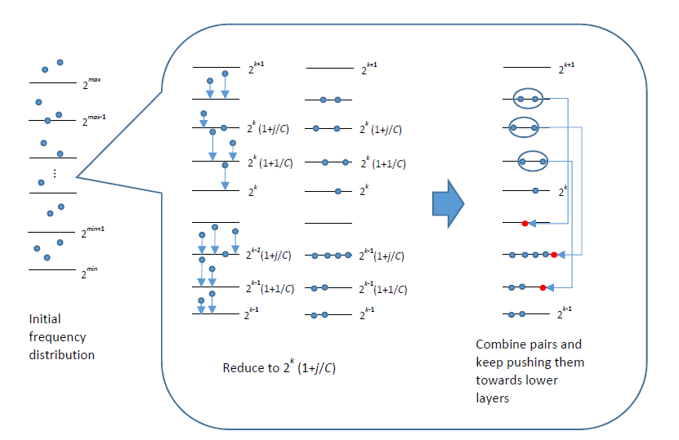
Discrete PMM μ= 1+δ, balanced instances

Slide 15
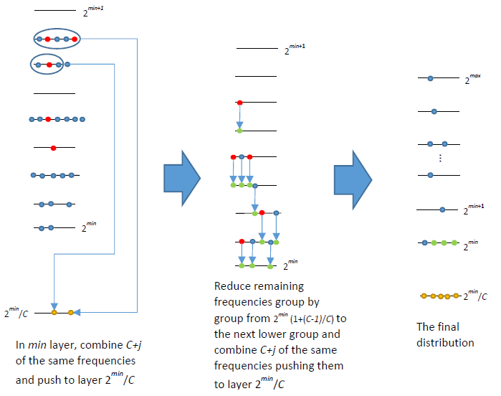
Discrete PMM μ= 1+δ, balanced instances

Slide 16
Discrete PMM (μ= 1+δ, balanced instances)
Important observations (1) and (2)
Any two frequencies $2^{k}\left(1+\frac{j}{C}\right)$ can be combined via their superposition into a shorter frequency $2^{k−1}\left(1+\frac{j}{C}\right).$
One can combine $m_{j}=C+j$ frequencies $2^{k}\left(1+\frac{j}{C}\right)$ into one frequency $2^{k}/C$ which is also a power of 2, as $\frac{2^{k}(1+\frac{j}{C})}{m_{j}}=\frac{2^{k}(C+j)}{m_{j}C}=\frac{2^{k}}{C}, (C is a power of 2$).
The idea of the proof
When the instances in PMM are more balanced one can schedule most of the growth rates as powers of two in the Pinwheel Problem perfectly

Slide 17
Continuous PMM
$$D$$
Differences to discrete PMM:
The set of machines V is represented as points in a space of diameter D.
For any pair of machines $m_{i}$ and $m_{j}$, the engineer needs time $t_{ij}>0$ to travel from $m_{i}$ to $m_{j}$ and the travel distances are symmetric and satisfy the triangle ineq.
When attended the machines are serviced instantly
Two natural lower bounds
$Ω(Dh_{max})$
${Ω(h}_{min}MST(V)$), MST – minimum spanning tree

Slide 18
Continuous PMM
Algorithm 1
Compute a minimum spanning tree MST(T) for V
Repeatedly perform the Euler-tour traversal of edges in T.
Upper bound: $h_{max}(V)MST(V)$
Approximation ratio: $O\left(\frac{h_{max}\left(V\right)}{h_{min}\left(V\right)}\right)$
[based on the lower bound 2]

Slide 19
Continuous PMM
Algorithm 2
Partition machines into sets according to their growth rates.
V1: $h_{min}≤h_{i}<2h_{min}$
V2: $2h_{min}≤h_{i}<4h_{min}$
…
At most $\left\lceil \log_{2}{\frac{h_{max}}{h_{min}}}\right\rceil$ sets
Compute a minimum spanning tree MST(V_{i}) for each V_{i}.

Slide 20
Continuous PMM
Algorithm 2
Partition machines into sets according to their growth rates.
V1: $h_{min}≤h_{i}<2h_{min}$
V2: $2h_{min}≤h_{i}<4h_{min}$
…
At most $\left\lceil \log_{2}{\frac{h_{max}}{h_{min}}}\right\rceil$ sets
Compute a minimum spanning tree MST(V_{i}) for each V_{i}.

Slide 21
Continuous PMM
Algorithm 2
Partition machines into sets according to their growth rates.
V1: $h_{min}≤h_{i}<2h_{min}$
V2: $2h_{min}≤h_{i}<4h_{min}$
…
At most $\left\lceil \log_{2}{\frac{h_{max}}{h_{min}}}\right\rceil$ sets
Compute a minimum spanning tree MST(V_{i}) for each V_{i}.

Slide 22
Continuous PMM
Algorithm 2
Partition machines into sets according to their growth rates.
V1: $h_{min}≤h_{i}<2h_{min}$
V2: $2h_{min}≤h_{i}<4h_{min}$
…
At most $\left\lceil \log_{2}{\frac{h_{max}}{h_{min}}}\right\rceil$ sets
Compute a minimum spanning tree MST(V_{i}) for each V_{i}.

Slide 23
Continuous PMM
Algorithm 2
Partition machines into sets according to their growth rates.
V1: $h_{min}≤h_{i}<2h_{min}$
V2: $2h_{min}≤h_{i}<4h_{min}$
…
At most $\left\lceil \log_{2}{\frac{h_{max}}{h_{min}}}\right\rceil$ sets
Compute a minimum spanning tree MST(V_{i}) for each V_{i}.

Slide 24
Continuous PMM
Algorithm 2
Partition machines into sets according to their growth rates.
V1: $h_{min}≤h_{i}<2h_{min}$
V2: $2h_{min}≤h_{i}<4h_{min}$
…
At most $\left\lceil \log_{2}{\frac{h_{max}}{h_{min}}}\right\rceil$ sets
Compute a minimum spanning tree MST(V_{i}) for each V_{i}.

Slide 25
Continuous PMM
Algorithm 2
Partition machines into sets according to their growth rates.
V1: $h_{min}≤h_{i}<2h_{min}$
V2: $2h_{min}≤h_{i}<4h_{min}$
…
At most $\left\lceil \log_{2}{\frac{h_{max}}{h_{min}}}\right\rceil$ sets
Compute a minimum spanning tree MST(V_{i}) for each V_{i}.

Slide 26
Continuous PMM
Algorithm 2
Partition machines into sets according to their growth rates.
V1: $h_{min}≤h_{i}<2h_{min}$
V2: $2h_{min}≤h_{i}<4h_{min}$
…
At most $\left\lceil \log_{2}{\frac{h_{max}}{h_{min}}}\right\rceil$ sets
Compute a minimum spanning tree MST(V_{i}) for each V_{i}.
Upper bound: $O({\log_{2}{\frac{h_{max}}{h_{min}}}h}_{max}\left(V_{i}\right)max⁡\{D,MST\left(V_{i}\right)\})$
Approximation ratio: $O(\log_{2}{\frac{h_{max}}{h_{min}}})$

Slide 27
Continuous PMM
Algorithm 3
Consider only large enough growth rates
V0: $h_{i}≤n^{−2}$
V1:$n^{−2}<h_{i}≤2n^{−2}$
V2: $2n^{−2}<h_{i}≤4n^{−2}$
…
At most$\left\lceil 2\log_{2}{n}\right\rceil$sets
Machines with smaller growth rates are attended incidentally
V0

Slide 28
Continuous PMM
Algorithm 3
Different partitions.
V0: $h_{i}≤n^{−2}$
V1:$n^{−2}<h_{i}≤2n^{−2}$
V2: $2n^{−2}<h_{i}≤4n^{−2}$
…
At most$\left\lceil 2\log_{2}{n}\right\rceil$sets
Machines with smaller growth rates are considered incidentally
Upper bound: $O({\log_{2}{n}h}_{max}\left(V_{i}\right)max⁡\{D,MST\left(V_{i}\right)\})$
Upper bound of V0: $O\left(\frac{1}{n}D\log_{2}{n}\right)=O\left(h_{max}D\log_{2}{n}\right)$
Approximation ratio: $O(\log_{2}{n})$
V0

Slide 29
The main results: approximation algorithms
Algorithms | Approximation ratio
Discrete PMM
Reduce-Max (Greedy approach) | $$O(\log_{2}{n})$$
Reduce-Fastest | $$4$$
Reduce-to-Pinwheel | $\left(1+δ\right)$ for any $δ>0$
Continuous PMM
Algorithm 1 | $$O(\frac{h_{1}}{h_{n}})$$
Algorithm 2 | $$O(\log_{2}{\frac{h_{1}}{h_{n}}})$$
Algorithm 3 | $$O(\log_{2}{n})$$

Slide 30
Open Problems, Unanswered Questions
Tighter upper bound on Reduce-Max (constant approximation?), Reduce-Fastest, and other online methods
Better, i.e., o(log n) approximation in the continuous case
What is the notion of greedy algorithm in the continuous case?
Multiple engineers, not properly studied yet
Monitoring of sets instead of single machines
Dynamic case, when demands of machines change over time
Relationship to other perpetual scheduling problems

