Slide 1
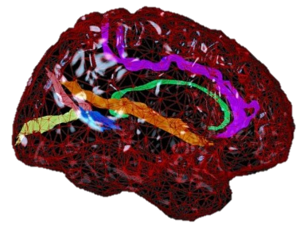
A symbolic dynamics approach to Epileptic Chronnectomics:
Employing strings to predict seizure onset
Presenter:
Dr. Nantia D. Iakovidou
Research Associate in Bioinformatics
Institute of Psychiatry, Psychology & Neuroscience
King’s College London

Slide 2
Preview
Motivation
EEG Recordings and Graphs
Epileptic Data
Symbolization Scheme
Implementation
Experiments and Results
Conclusions
Future Plans
Notes:
This is a general preview of my presentation.
First of all I will talk about the motivation of our research.
Why do we study epilepsy data and especially EEG epilepsy datasets.
I will explain in general what is an EEG, why do we use it what its advantages are.
Next I will give some general description of the data that we used in this particular study.
I will present our symbolization scheme and the methodology that we applied to the datasets.

Slide 3
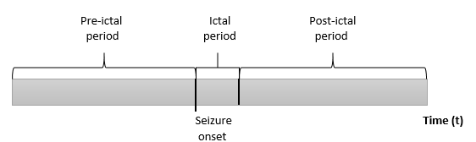
Epilepsy
Epilepsy is a brain disorder in which a person has episodes of abnormal brain activity (seizures) that cause changes in attention or behavior repeatedly over time.
Target: prediction of epileptic seizures across time.
Notes:
It is a prevalent neurological disorder that influences (an important percentage of) people of all ages worldwide.
Epilepsy is characterized by sudden and unpredictable seizures that can cause other health problems as well.
It is highly essential to study epileptic data in order to help patients avoid potentially endangering situations.
Seizure prediction is a notoriously difficult task and has not been achieved so far.
We want to focus on the behavior of the data before the seizure onset.
Predict the occurrence of an epileptic episode.

Slide 4
Electroencephalogram (EEG)
Measures and records the electrical activity of
the brain, using sensors (electrodes).
Advantages against other methods.
Presents high research and clinical interest.
Valuable sources of information for epilepsy
research and diagnosis.
Carry a large amount of rich information for detecting ongoing seizures.
Recorded continuously and over long periods of time.
Notes:
An EEG measures and records the electrical activity of the brain using special sensors (electrodes) which are placed at specific areas along the scalp.
Epilepsy-related EEG data are also recorded continuously and over long periods of time, even if the event of interest lasts only for very short periods.
Important to develop innovative methodologies in order to discover new knowledge in that kind of data.
Main advantages of EEGs against other methods include: the low cost, the tolerance to movement.
(In other methods just blinking an eye may add noise to the signals.)

Slide 5
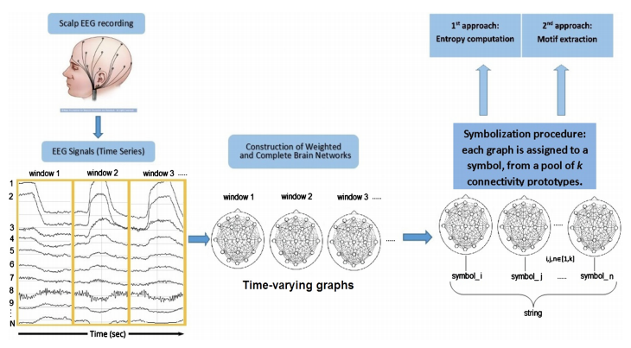
General Scheme
Notes:
Neurology Ward of the Cyprus Institute of Neurology and Genetics
The data were collected and converted into graphs in that Institute.
Time series of symbols.

Slide 6
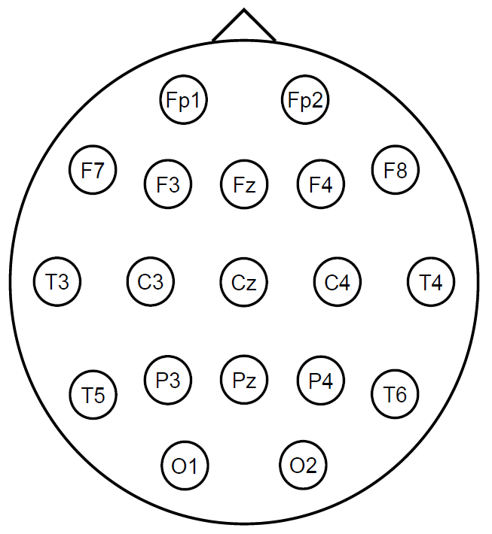
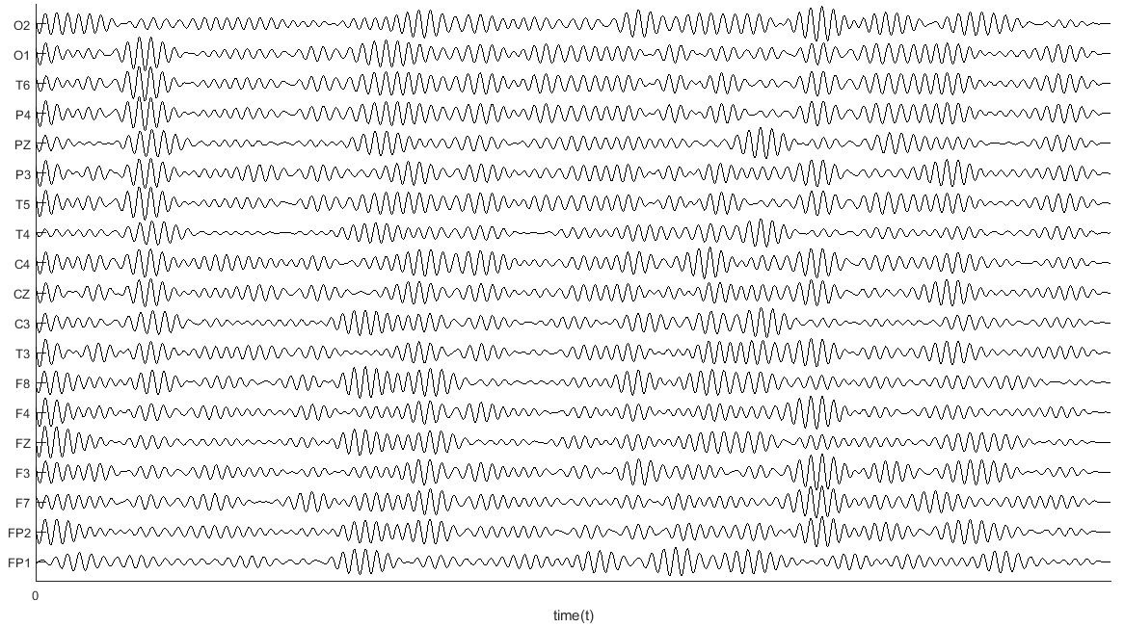
Spatiotemporal data
M. Christodoulakis, et al.,
“On the effect of volume conduction on graph theoretic measures of brain networks in epilepsy”, Modern EEG Assessment Techniques,
pp. 103-130, Part of the Neuromethods book series, vol. 91, 2015.
Notes:
Odd numbers are assigned to the electrodes of the left hemisphere and even numbers to the right hemisphere.
In order to convert the signals into graphs, we
Perform pairwise correlations between all pairs of time series using several connectivity measures.
In our case we used the normalized cross correlation measure.
What we take is a fully-connected and weighted graph.
Higher weight value corresponds to higher reliability of connection.

Slide 7
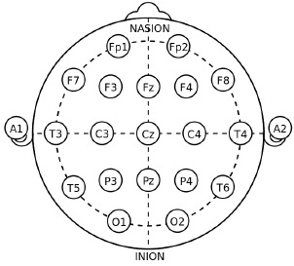
Epileptic EEG recording
21 electrodes were placed according to
the 10-20 international system.
2 electrodes were used to record
the electrooculogram (EOG) signals.
Sampling rate of 200Hz and converted
to the bipolar montage.
Bipolar montage: Pairs of neighboring
electrodes are subtracted from one
another. Usually, the pairs are taken in
straight lines from the front to the back
of the head.
Notes:
EOG: is a technique for measuring the (corneo-retinal) standing potential that exists between the front and the back of the human eye.
The time series that correspond to neighboring electrodes …….

Slide 8
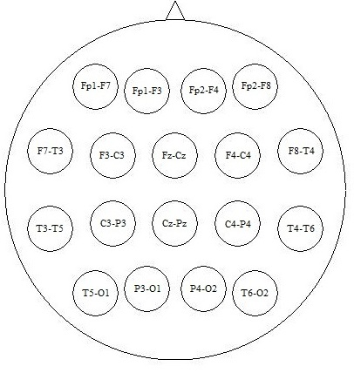


Data processing
Graph G=(V,E).
  Node v∈V: pairs of neighboring electrodes.
  Edge e∈E: subtraction of the corresponding measurements.
Weighted and fully-connected graphs.
Each graph corresponds to a 5 second length window.
Notes:
Bipolar montage: Each node represents the difference between two adjacent electrodes (time-series).
This representation was found to be more robust and allow us to analyze functional connectivity at the scalp level.

Slide 9
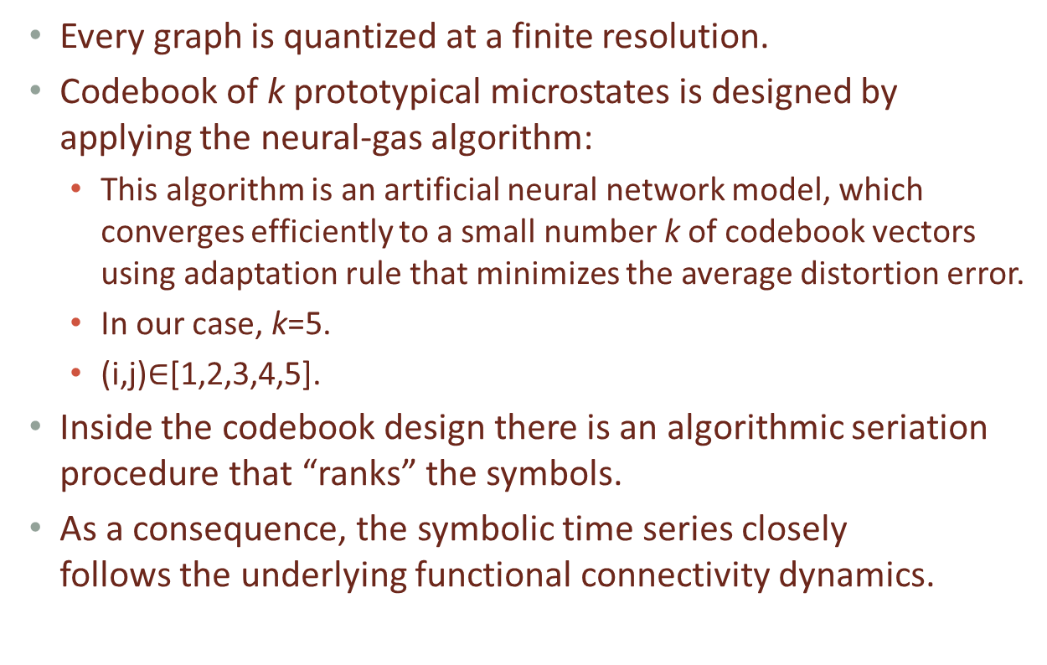
Symbolization
Every graph is quantized at a finite resolution.
Codebook of k prototypical microstates is designed by applying the neural-gas algorithm:
  This algorithm is an artificial neural network model, which converges efficiently to a small number k of codebook vectors using adaptation rule that minimizes the average distortion error.
  In our case, k=5.
  (i,j)$∈$[1,2,3,4,5].
Inside the codebook design there is an algorithmic seriation procedure that “ranks” the symbols.
As a consequence, the symbolic time series closely
follows the underlying functional connectivity dynamics.
Notes:
How to convert graphs into symbols and compose a string.
We assign a symbol to every graph.
K is the size of the alphabet.
Inverse procedure with a small reconstruction error.
Parameter k is chosen in a way that the reconstruction error is kept at minimum levels (In our case k=5).

Slide 10
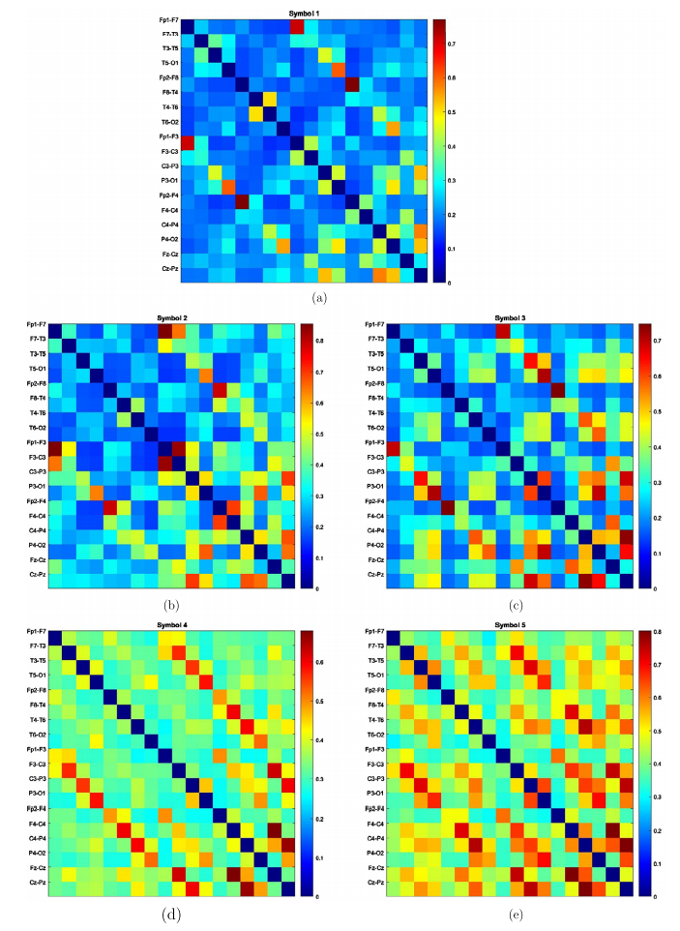
Microstates

Slide 11
Entropy of Markov Trajectories
A Markov chain modelling can be naturally derived from the symbolic time series and emphasizes the transition between connectivity microstates.
Motivated by the need to identify measurable changes in the connectivity dynamics flow during an epileptic seizure, we resort to a relevant technique that quantifies the entropy of Markov trajectories.
To recap, we use the finite state irreducible Markov chains modelling scheme and we focus on the observed trajectories T_{ij} (the dynamical system reached state j (final state) from state i (initial state)).
Notes:
Every symbol that follows another can be interpreted as a transition.

Slide 12
MoTif eXtraction (MoTeX)
Identifying repeated factors that occur in a string of symbols.
In our case, a motif is a string of letters (word), with predefined length l, on a specific alphabet .
The motif extraction problem takes as input a string s and the length l for the motifs. Then it determines all the possible motifs of length l, such that each motif occurs in the input string.
The detected motifs are ranked alphabetically.
Then, similarity scores, expressing the matching between each valid motif M_{i} and every segment S_{t} of the symbolic time series.
Derived and tabulated in a matrix with elements: SIM_{it} = Score(i,t) = e^{−||S}t^{−M}i ^{||/r}o (r_{o} is a scaling parameter that was
set equal to the mean distance from motif to segment).

Slide 13
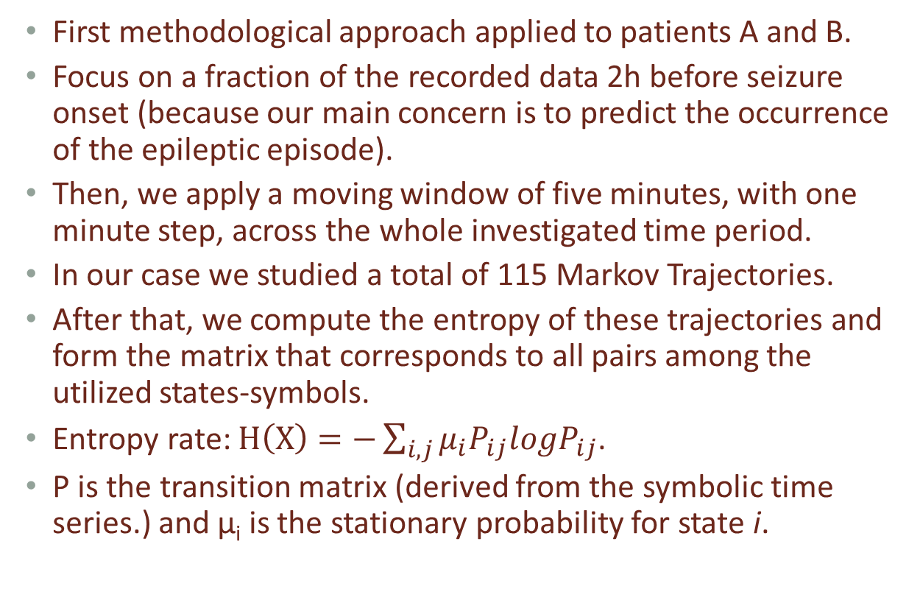
First Approach
First methodological approach applied to patients A and B.
Focus on a fraction of the recorded data 2h before seizure onset (because our main concern is to predict the occurrence of the epileptic episode).
Then, we apply a moving window of five minutes, with one minute step, across the whole investigated time period.
In our case we studied a total of 115 Markov Trajectories.
After that, we compute the entropy of these trajectories and form the matrix that corresponds to all pairs among the utilized states-symbols.
Entropy rate: $H\left(X\right)=−\sum_{i,j}{μ_{i}P_{ij}logP_{ij}}$.
P is the transition matrix (derived from the symbolic time series.) and μ_{i} is the stationary probability for state i.
Notes:
i and j are states.

Slide 14
Results (First Approach)
Entropy values for H(3,3), (B) Entropy values for H(1,5).

Slide 15
Second Approach
Second approach applied to the whole range of dataset of patient C (contains 2 seizures in total).
Data converted to symbolic time series, using Neural gas algorithm (k=5).
Application of the MoTeX tool to identify motifs.
Use of a 5min-window to compare the derived motif with the whole recording symbolic time series (overlapping).
Clear discrepancy, before each seizure onset.
Such a tendency is not appeared in the initial symbolic time series data.

Slide 16
Results (Second Approach)
Discrepancy between local and global distribution (Euclidean distance.)

Slide 17
Results (Second Approach)
Representation of the original symbolic time series.

Slide 18
Conclusions 1/2
Seizure prediction is a notoriously difficult task.
Introduce this prediction problem to the string algorithms community.
It is the first time that EEG epilepsy data are converted to symbolic time series and studied as strings, with quite interesting results.
Conversion of functional EEG data into symbolic time series.
First approach: we employed Markov chain modelling to characterize the transitions between connectivity microstates. We computed the entropy of Markov Trajectories.
Second approach: we applied MoTeX tool to identify motifs from the symbolic time series and compare their frequency of appearance over time.

Slide 19
Conclusions 2/2
The presented results indicate that string algorithms could contribute significantly to the solution of epilepsy prediction problem.
Both approaches contribute to the emerging field of “chronnectomics”.
The term “chronnectome” is a concept that incorporates dynamic view of functional brain connectomics.
Two or more brain regions (or sets of regions), all possibly evolving spatially in time, are coupled with connectivity strengths measured as explicit functions of time.
This is the first time that such a perspective is exploited for
the purposes of prediction in EEG epileptic data.

Slide 20
Plans for Future Study
Apply the suggested methodology to a sufficient number of patients in order to reaffirm and validate our results and
conclusions.
Study larger networks that will provide information from more electrodes.
Perform statistical validation tests to justify our results.
Do not attempt to describe and represent the connectivity dynamics for all patients collectively. Each person’s seizures are unique. Do not attempt to compare different patients with each other.
Introduce other prediction problems to the string algorithms community, for example prediction of suicidal behaviour, autism, depression to young children and/or adolescents.

Slide 21
Thank you!
Questions?
Contact:
Dr. Nantia Iakovidou
e-mail: nantia.iakovidou@kcl.ac.uk

