Slide 1

eXplainable Planning
(XAIP)
Daniele Magazzeni
IJCAI-17 Workshop on Explainable Artificial Intelligence (XAI)

Slide 2
Why should we care about AI Planning?
No deep
No learning
No big
Still many scenarios where
learning is not an option…
Because you don’t have data to learn from
Because you don’t have time to learn

Slide 3
AI Planning
A planner uses a (PDDL) model of an application domain
Models are described by actions (preconditions and effects) and continuous processes (for the environment)
Heuristics are used to guide the search in huge state spaces
Optimisation: minimize/maximise a cost function.
Temporal planning: actions have a duration. Concurrency, synchronisation (time windows), time dependent effects.
Planning with preferences: hard and soft goals.
Conditional planning: actions can perform observations, and the plan contains branches.
Planning is not just Blocks World !

Slide 4

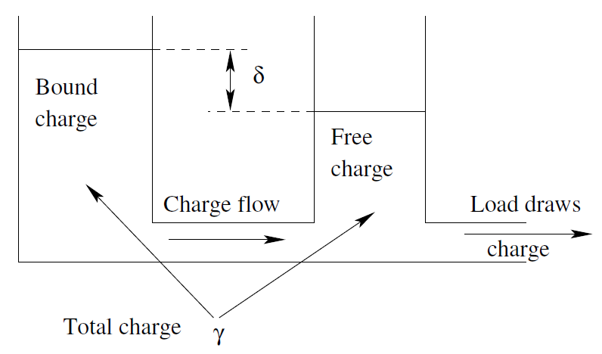
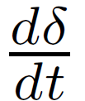



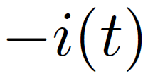

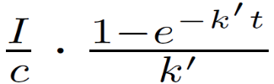




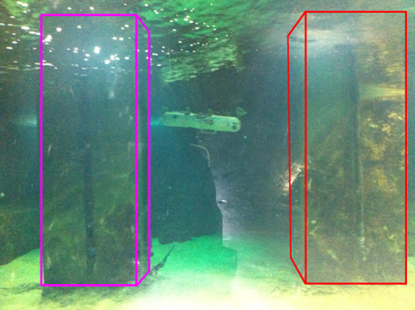
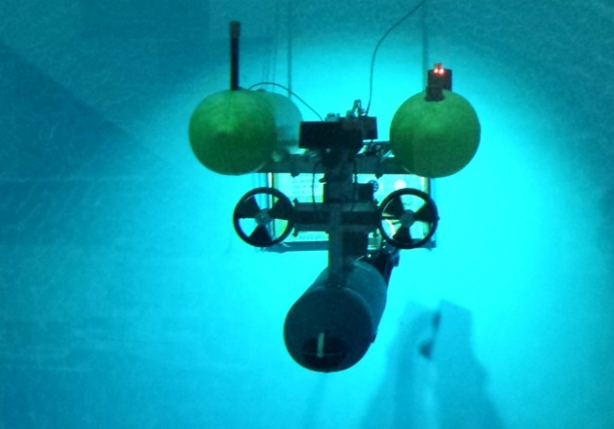
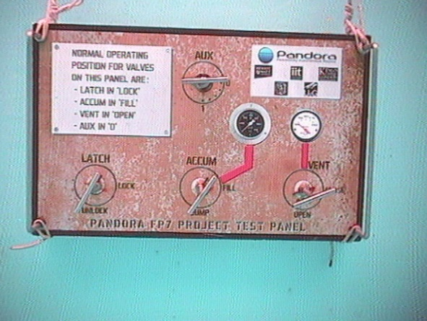
Complex Dynamics are Welcome!
Temporal Planning for Multiple-Battery Scheduling
(Fox, Long, Magazzeni, JAIR 2012)
Planning for Persistent Underwater Autonomy
Toward Persistent Autonomous Intervention in a Subsea Panel.
Autonomous Robots. (2016)
Opportunistic Planning in Autonomous Underwater Missions.
IEEE Transactions on Automation Science and Engineering. (2017)

Slide 5
Open Source Planners
Linear dynamics: POPF
-Forward heuristic search
-Use Linear Programming and Simple Temporal Networks to check temporal constraints
Polynomial Non-Linear dynamics: SMTPlan
-Encode the planning problem as SMT formula
-Use Computer Algebra System to compute indefinite integrals
http://kcl-planning.github.io/SMTPlan/
Non-Linear dynamics: UPMurphi
-Forward heuristic search
-Use discretisation to handle complex dynamics
http://kcl-planning.github.io/DiNo/

Slide 6
AI Planning in Real Applications
In the last few years, planners are becoming more
powerful, and planning is used in new (critical) domains.
-Mining
-Underwater Robotics
-Smart Energy
-Air Traffic Control
-Urban Traffic Control
-Search and Rescue Missions
-Human-Autonomy Teaming
Plans are more complex than before
(continuous nonlinear models, differential equations, fluid dynamics, etc…)
Explaining planning is more needed now than before

Slide 7
AI Planning in Real Applications
In the last few years, planners are becoming more
powerful, and planning is used in new (critical) domains.
-Mining
-Underwater Robotics
-Smart Energy
-Air Traffic Control
-Urban Traffic Control
-Search and Rescue Missions
-Human-Autonomy Teaming
In many cases, full autonomy is not requested !
Policies request human supervisors to accept/reject plans (i.e., to take responsibility!)
The bigger the risk, the more explanations are important!

Slide 8
AI Planning in Real Applications
In the last few years, planners are becoming more
powerful, and planning is used in new (critical) domains.
-Mining
IMPORTANT 1!
In these applications the planning model adheres to the specifics given by the user.
No model mismatch between planner and user!
-Underwater Robotics
-Smart Energy
-Air Traffic Control
-Urban Traffic Control
IMPORTANT 2!
The space of alternatives is huge and
difficult for the user to elaborate.
This is where the planner can be used
to provide explanation!
-Search and Rescue Missions
-Human-Autonomy Teaming
In many cases, full autonomy is not requested !
Policies request human supervisors to accept/reject plans (i.e., to take responsibility!)
The bigger the risk, the more explanations are important!

Slide 9
Why XAI in Practice?
Need for trust
Need for interaction
Need for transparency
Features of Planning
Based on models
Planning algorithms are transparent
Plan execution provides execution traces
Plans causality is explainable
Explanations in Planning
Explore the “space of plans” and compare alternatives

Slide 10
Many Works on Plan Explanation
  Translate PDDL in forms that humans can understand [Sohrabi et al.]
  Design interfaces that help this understanding [Bidot et al.]
  Describe causal/temporal relations for plan steps [Seegebarth et al.]
  Explaining observed behaviours [Sohrabi, Baier, McIlraith]
  Understanding the past [Molineaux et al.]
  Focus on human’s interpretation of plans [Seegebarth et al.]
And MANY more over the last 20 years….
However, making sense of a plan is different from explaining why a planner made a decision.

Slide 11
Some More Recent Works
Verbalization and transparency in autonomy [Manuela Veloso et al. IJCAI 2016]
Explainable Agency [Pat Langley et al. AAAI 2017]
Plan Explicability for Robot Planning
[Rao Kambhampati et al. ICRA 2017]
Plan Explanation as Model Reconciliation
[Rao Kambhampati et al. IJCAI 2017]
Planning as an Iterative Process
[David Smith, Invited Talk at AAAI 2012]

Slide 12
What eXplainable Planning is NOT !
XAIP is not explaining what is obvious !
Many planners select actions in their plan-construction process by minimising a heuristic distance to goal (relaxed plan)

Slide 13
What eXplainable Planning is NOT !
XAIP is not explaining what is obvious !
Many planners select actions in their plan-construction process by minimising a heuristic distance to goal (relaxed plan)
Q: Why did the planner do that ?
A: Because it got me closer to the goal !

Slide 14
What eXplainable Planning is NOT !
XAIP is not explaining what is obvious !
Many planners select actions in their plan-construction process by minimising a heuristic distance to goal (relaxed plan)
Q: Why did the planner do that ?
A: Because it got me closer to the goal !

Slide 15
What eXplainable Planning is NOT !
XAIP is not explaining what is obvious !
Many planners select actions in their plan-construction process by minimising a heuristic distance to goal (relaxed plan)
Q: Why did the planner do that ?
A: Because it got me closer to the goal !
A request for an explanation is an attempt to uncover a piece of
knowledge that the questioner believes must be available to the
system and that the questioner does not have.

Slide 16
Things to Be Explained
(some)
Q1: Why did you do that?
Q2: Why didn’t you do something else? (that I would have done)
Q3: Why is what you propose to do more efficient/safe/cheap than something else? (that I would have done)
Q4: Why can’t you do that ?
Q5: Why do I need to replan at this point?
Q6: Why do I not need to replan at this point?

Slide 17
Providing Explanations
Q1: Why did you do that?
Q2: Why didn’t you do something else? (that I would have done)
Quick (and useless) answer: because the heuristic evaluation was better for the decision the planner made.
We should demonstrate that the alternative action would prevent from finding a valid plan or would lead to a plan that is no better than the one found by the planner.
Algorithm:
-re-run the planner up to the decision point K,
-inject the human choice,
-plan from the state obtained after applying the action suggested by human

Slide 18
Providing Explanations
Q1: Why did you do that?
Q2: Why didn’t you do something else? (that I would have done)
Algorithm:
-re-run the planner up to the decision point K,
-inject the human choice,
-plan from the state obtained after applying the action suggested by human

Slide 19
Providing Explanations
Q1: Why did you do that?
Q2: Why didn’t you do something else? (that I would have done)
Algorithm:
-re-run the planner up to the decision point K,
-inject the human choice,
-plan from the state obtained after applying the action suggested by human

Slide 20
Providing Explanations
Q1: Why did you do that?
Q2: Why didn’t you do something else? (that I would have done)
Algorithm:
-re-run the planner up to the decision point K,
-inject the human choice,
-plan from the state obtained after applying the action suggested by human

Slide 21
Providing Explanations
Q1: Why did you do that?
Q2: Why didn’t you do something else? (that I would have done)
Algorithm:
-re-run the planner up to the decision point K,
-inject the human choice,
-plan from the state obtained after applying the action suggested by human

Slide 22
Illustrative Example
Rover domain (two rovers: r0 and r1)
Q1: why did you use Rover0 to take the rock sample at waypoint0 ?
NA: so that I can communicate_data from Rover0 later (at 18.001)

Slide 23
Illustrative Example
Rover domain (two rovers: r0 and r1)
Q1: why did you use Rover0 to take the rock sample at waypoint0 ?
why didn’t Rover1 take the rock sample at waypoint0 ?

Slide 24
Illustrative Example
Q1: why did you use Rover0 to take the rock sample at waypoint0 ?
why didn’t Rover1 take the rock sample at waypoint0 ?
We remove the ground action instance for Rover0 and re-plan
A: Because not using Rover0 for this action leads to a longer plan

Slide 25
Illustrative Example
Q1: why did you use Rover0 to take the rock sample at waypoint0 ?
why didn’t Rover1 take the rock sample at waypoint0 ?
We remove the ground action instance for Rover0 and re-plan
A: Because not using Rover0 for this action leads to a longer plan
Q2: But why does Rover1 do everything in this plan?

Slide 26
Illustrative Example
Q1: why did you use Rover0 to take the rock sample at waypoint0 ?
why didn’t Rover1 take the rock sample at waypoint0 ?
We remove the ground action instance for Rover0 and re-plan
A: Because not using Rover0 for this action leads to a longer plan
Q2: But why does Rover1 do everything in this plan?
We require the plan to contain at least one action that has Rover0 as argument (add dummy effect to all actions using Rover0 and put into the goal)
There is no useful way to use
Rover0 to improve this plan

Slide 27
Illustrative Example
Q1: why did you use Rover0 to take the rock sample at waypoint0 ?
why didn’t Rover1 take the rock sample at waypoint0 ?
We remove the ground action instance for Rover0 and re-plan
A: Because not using Rover0 for this action leads to a longer plan
Q2: But why does Rover1 do everything in this plan?
We require the plan to contain at least one action that has Rover0 as argument (add dummy effect to all actions using Rover0 and put into the goal)
There is no useful way to use
Rover0 to improve this plan
The planning model can be dynamically updated to answer user questions

Slide 28

Providing Explanations
Q3: Why what you want to do is more efficient/safe/cheap than something else? (that I would do)
Different metrics can be used to evaluate the plan.
For complex domains, most planners can only optimise makespan, but not other metrics.
Combine planners with the plan validator
VAL allows the evaluation of plans using different metrics

Slide 29
Providing Explanations
Q4: Why can’t you do that ? (that I would have done)
Two reasons why one action cannot be applied in the current state:
  1) Current state does not satisfy the action precondition (VAL)
  2) Using that action would prevent achieving the goal
Explaining 1) is trivial,
Explaining 2) is not.
Promising directions:
Proving plan non-existence [Backstrom et al., Hoffmann et al.]
Planning-as-model-checking [Traverso et al.][Bogomolov, Magazzeni et al.]
STN, STNU [Dechter, Vidal, Ghallab, et al.][Andrea Micheli, PhD Thesis 2016]
Notes:
ADD SCREENSHOT OF VAL

Slide 30
eXplainable Planning
at execution time
Q5: Why do I need to replan at this point?
In many real-world scenarios, it is not obvious that the plan being executed will fail. Often plain failures is discovered too late.
One possible approach is to use the “Filter Violation” (ROSPlan)
Once the plan is generated, ROSPlan creates a filter, by considering all the static preconditions of the actions in the plan.
Ex: navigate (?from ?to - waypoint) has precondition (connected ?from ?to)
If the plan contains navigate (wp3 wp5),
then (connected wp3 wp5 ) is added to the filter.

Slide 31
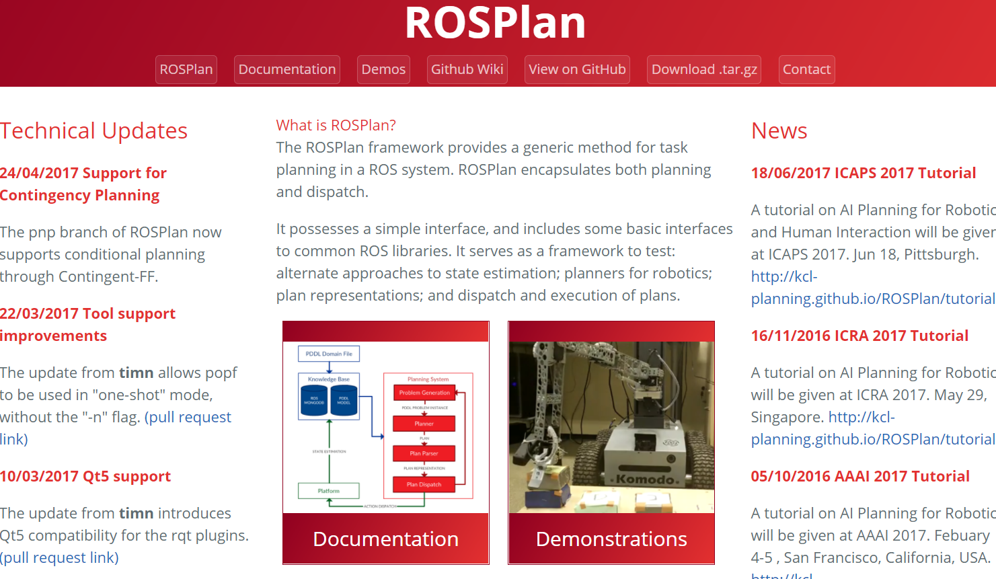
Planning actions are translated into ROS messages.
ROSPlan handles model updates, plan dispatch and replanning.
Open source: http://kcl-planning.github.io/ROSPlan/

Slide 32
Illustrative Example
AUV domain from (Cashmore, Fox, Long, Lakworthy, Magazzeni, ICRA 2014)

Slide 33
Illustrative Example

Slide 34
Illustrative Example
A lot of progress on
Plan Execution !

Slide 35
eXplainable Planning
at execution time
Q6: Why do I not need to replan at this point?
This explanation is of practical importance, related to situations where the environment being observed is different from what anticipated.
It is important to avoid the naïve approach of continuous replanning.
Example: unexpected current is slowing down the AUV, hence navigate action is taking longer than anticipated.
A promising research direction is the work on Dynamic Controllability of STN (Vidal, Fargier, Morris, Cimatti, Micheli, etc…)

Slide 36
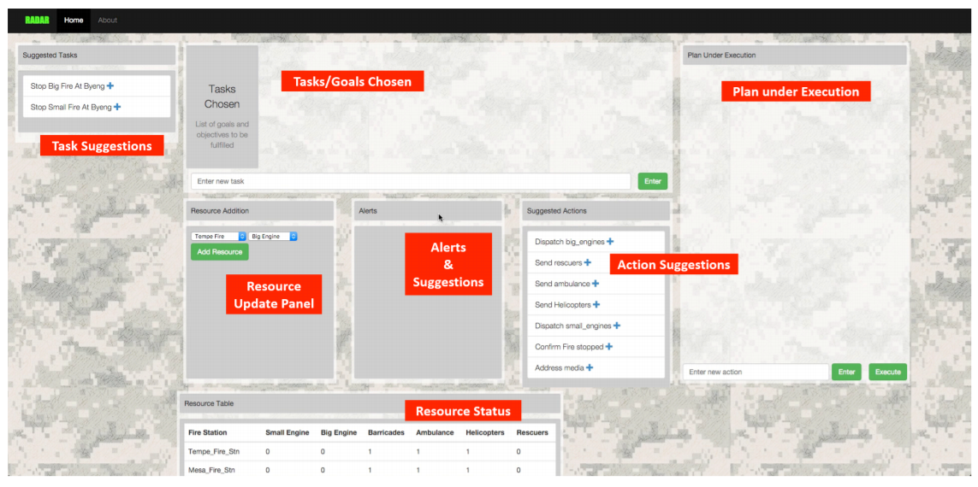
User Interfaces for XAIP
RADAR
Satya Gautam Vadlamudi, Tathagata Chakraborti, Yu Zhang, Subbarao Kambhampati

Slide 37
Current/Future Works in XAIP
Formal characterisation of “exploring the space of plans”.
Temporal explanations: why goal A is achieved before goal B?
Anytime planning: can I get a better solution if I give the planner 10 more minutes?
How to determine if an explanation is good?
Probabilistic/planning under uncertainty: observations/actions
eXplainable heuristics
Human/Planner interaction:
  provide set of plans and let the human choose one
  allow the user to accept only part of the plan
  allow the user to add new (high-priority) goals
  exploit human expertise during the search for a plan

Slide 38
Current/Future Works in XAIP
Formal characterisation of “exploring the space of plans”.
Temporal explanations: why goal A is achieved before goal B?
Anytime planning: can I get a better solution if I give the planner 10 more minutes?
How to determine if an explanation is good?
Probabilistic/planning under uncertainty: observations/actions
eXplainable heuristics
Human/Planner interaction:
  provide set of plans and let the human choose one
  allow the user to accept only part of the plan
  allow the user to add new (high-priority) goals
  exploit human expertise during the search for a plan
Reminder 1!
In these applications the planning model adheres to the specifics given by the user.
No model mismatch between planner and user!
Reminder 2!
The space of alternatives is huge and
difficult for the user to elaborate.
This is where the planner can be used
to provide explanation!

Slide 39
eXplainable Planning
(XAIP)
Daniele Magazzeni
(thanks to Maria Fox and Derek Long)
IJCAI-17 Workshop on Explainable Artificial Intelligence (XAI)

